Slide 1

Politics and Power

Slide 2
Karakia | MANAWA MAI
Manawa mai te mauri nuku
Manawa mai te mauri rangi
Ko te mauri kai au
He mauri tipua
Ka pakaru mai te po
Tau mai te mauri
Haumi e, hui e, taiki e
Embrace the life force of the earth, embrace the life force of the sky
The life force I have fathered is powerful, and shatters all darkness
Come great life force,
Join it, gather it, it is done

Slide 3

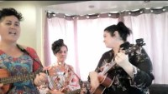
Waiata Purea nei
Purea nei, e te hau
Horoia, e te ua
Whitiwhitia, e te ra
Mahea ake nga, poraruraru
Makere ana, nga here
E rere, wairua, e rere
ki nga ao, o te rangi
Whitiwhitia, e te ra
Mahea ake nga, poraruraru
Makere ana nga here (x2)

Slide 4
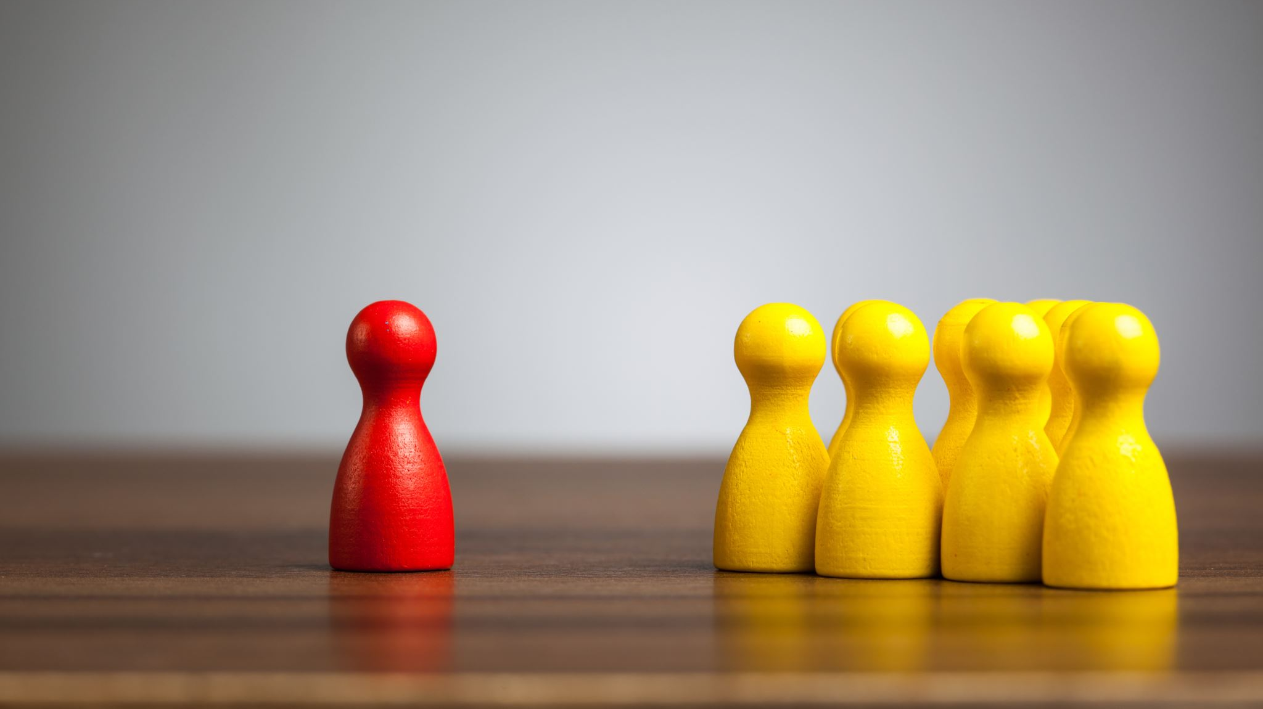
Politics and Power
Sociology for social practice 2023
C Tunnicliffe
With special acknowledgement to Peter Mathewson

Slide 5

Democracy
What is Democracy?
The word democracy comes from the Greek words "demos", meaning people, and "kratos" meaning power; so democracy can be thought of as "power of the people": a way of governing which depends on the will of the people.
There are so many different models of democratic government around the world that it is sometimes easier to understand the idea of democracy in terms of what it definitely is not.
Democracy, then, is not autocracy or dictatorship, where one person rules; and it is not oligarchy, where a small segment of society rules. Properly understood, democracy should not even be "rule of the majority", if that means that minorities' interests are ignored completely. A democracy, at least in theory, is government on behalf of all the people, according to their "will".

Slide 6
Why democracy?
The idea of democracy derives its moral strength – and popular appeal – from two (2) key principles:
1: Individual autonomy: The idea that no-one should be subject to rules which have been imposed by others. People should be able to control their own lives (within reason).
2: Equality: The idea that everyone should have the same opportunity to influence the decisions that affect people in society.
These principles are intuitively appealing, and they help to explain why democracy is so popular. Of course we feel it is fair that we should have as much chance as anyone else to decide on common rules!
The problems arise when we consider how the principles can be put into practice, because we need a mechanism for deciding how to address conflicting views. Because it offers a simple mechanism, democracy tends to be "rule of the majority"; but rule of the majority can mean that some people's interests are never represented.

Slide 7
Democracy in the modern world
While democracies share common features, there is no single model of democracy.
UN Resolution on promoting and consolidating democracy (A/RES/62/7)
Today there are as many different forms of democracy as there are democratic nations in the world. No two systems are exactly the same and no one system can be taken as a "model". There are presidential and parliamentary democracies, democracies that are federal or unitary, democracies that use a proportional voting system, and ones that use a majoritarian system, democracies which are also monarchies, and so on.
One thing that unites modern systems of democracy, and which also distinguishes them from the ancient model, is the use of representatives of the people. Instead of taking part directly in law making, modern democracies use elections to select representatives who are sent by the people to govern on their behalf. Such a system is known as representative democracy.
It can lay some claim to being "democratic" because it is, at least to some degree, based on the two principles above: equality of all (one person – one vote), and the right of every individual to some degree of personal autonomy.

Slide 8
Representative democracy
Representative democracy, also known as indirect democracy, is a type of democracy where elected delegates represent a group of people, in contrast to direct democracy.
Nearly all modern Western-style democracies function as some type of representative democracy.
Questions: Who represents you?
Who represents those who may be excluded?

Slide 9
Problems with democracy
Democracy doesn't mean much if you are hungry or homeless, or have no health care or your children can't go to school; even if you have a vote, democracy is not effective.
Susan George, President of ATTAC
Voter apathy: For a number of years, there has been concern about the status of democracy, perhaps particularly in the more established democracies. Much of this is based on the decreasing levels of citizen participation at elections, which appear to indicate a lack of interest and involvement on the part of citizens. A low voter turnout calls into question the legitimacy of so-called democratically elected governments, which are, in some countries, actually elected by a minority of the total electorate.
Some stats: Women (87 percent) were more likely to vote than men (83 percent). People in the older age groups were also more likely to vote than those in the younger groups. Seventy percent of people aged 1824 voted, compared with 94 percent of those aged 65 and over
In New Zealand 2014 election - 4.516 million (2014) - 85 percent of the eligible voting population voted in the 2014 General Election.
1.139 million did not vote

Slide 10

To think about: your perfect world
Spend a few minutes reflecting individually, and then discuss in a small group:
What would your ideal society, community or world be like?
How would you balance the rights and freedoms of individuals, with some collective belonging and responsibility?
Should people care for each other in some way, if so how?
What is the role for the state, or Government?

Slide 11
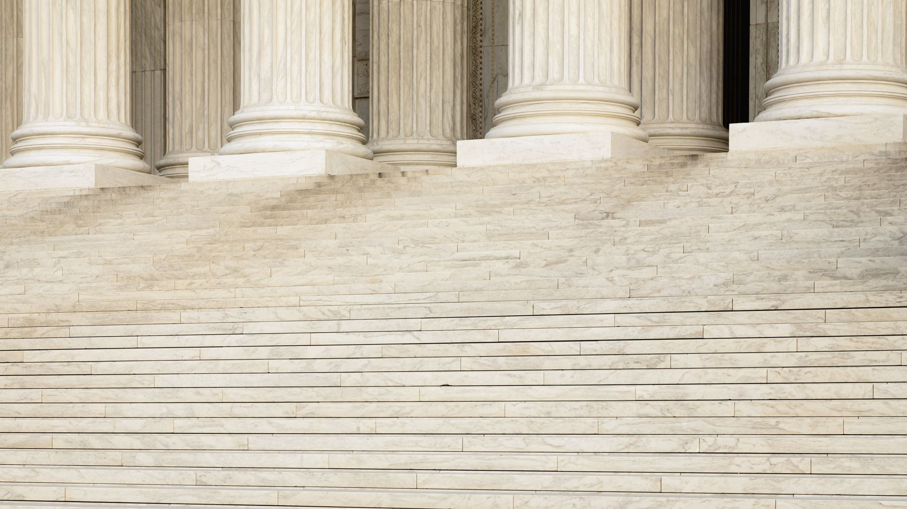
Politics

Slide 12


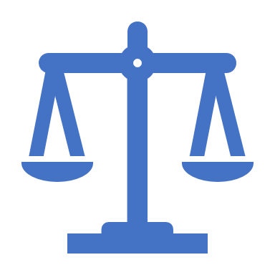
Politics
Action and activities that concern how power is exercised (Harris, 2017, p.11)
The activities associated with the governance of a country or area, especially the debate between parties having power
the practice and theory of influencing other people on a global, civic or individual level. More narrowly, it refers to achieving and exercising positions of governance — organized control over a human community, particularly a state . . . the study or practice of the distribution of power and resources within a given community . . . as well as the interrelationship(s) between communities.

Slide 13
Ideology, what do we mean?
A system of ideas and ideals, especially one which forms the basis of economic or political theory and policy
a world view, a system of values, attitudes and beliefs which an individual, group or society holds to be true or important ; these are shared by a culture or society about how that society should function
a set of conscious and/or unconscious ideas . . . a comprehensive normative vision, a way of looking at things . . . a set of ideas proposed by the dominant class of a society to all members of this society

Slide 14
Political Ideology
A certain ethical set of ideals, principles, doctrines, myths, or symbols of a social movement, institution, class, or large group that explains how society should work, and offers some political and cultural blueprint for a certain social order. A political ideology largely concerns itself with how to allocate power and to what ends it should be used.
May include two dimensions:
Goals: how society should work
Methods: the most appropriate ways to achieve the ideal arrangement

Slide 15
Principles for Wellbeing
Justice
Need
Risk
Equality
Freedom
Citizenship
Sustainable Development
Resilience
(Cheyne, O’Brien, & Belgrave, 2008)

Slide 16
to achieve well being, three broad questions:
Are we responsible for one another, as citizens, as taxpayers, as employees/employers, as family/whānau, or as members of an iwi or community?
If we are responsible, what form should this take: financial support, protection, or care?
Who should provide support or protection: the state, the market, the family, or charities? (Victoria University)
Different ideologies answer these questions differently

Slide 17
Competing Ideological labels: Left and Right Wing
The terms left and right wing, and centre, centre-right, and centre-left are often used to describe political ideologies, positions, parties, and individual politicians
You may have heard the terms ‘left wing’ and ‘right wing’ before - a politician might be accused of being ‘too left wing’, or a newspaper might be known as a ‘right-wing publication’. Both of these terms refer to the political spectrum.
In a nutshell: Think of the political spectrum as a scale with two opposite ends - the left and the right.
Each end represents a group of principles, and those on the left tend to oppose those on the right.
Most of these principles are about the best way to organise society in order for people to thrive.

Slide 18
Fun facts
The terms left and right originated in the French Revolution, from 1789
Supporters of the revolution sat on the left - supporters of the monarchy (king) sat on the right.
Over the nineteenth century the terms gradually moved from seating positions to refer to political positions, and were adopted by parties, more so on the “left”
Came to be applied to British politics from the 1906 general election, which saw the emergence of the Labour Party

Slide 19
Sociologist Robert MacIver, 1947
“The right is always the party sector associated with the interests of the upper or dominant classes, the left the sector expressive of the lower economic or social classes, and the centre that of the middle classes . . . The conservative right has defended entrenched prerogatives, privileges and powers; the left has attacked them. The right has been more favorable to the aristocratic position, to the hierarchy of birth or of wealth; the left has fought for the equalization of advantage or of opportunity, for the claims of the less advantaged”.

Slide 20
The Left could include . . .
Progressives
Communists
Social democrats
Civil libertarians
Social-Liberals
Greens
Anarchists
Socialists

Slide 21
The Right could include . . .
Social authoritarians
Neoliberals
Conservatives
Theocrats
Monarchists
Nationalists
Neo-Nazis
Capitalists
Economic libertarians
Fascists

Slide 22
Right wing is associated with
Individual responsibility
Private property
Free market economics
Economic growth and development, freedom for business to grow and prosper, employers’ rights
Competition, ruthless efficiency
Limited government, deregulation
Minimal taxation, flatter tax rates
Global free trade

Slide 23
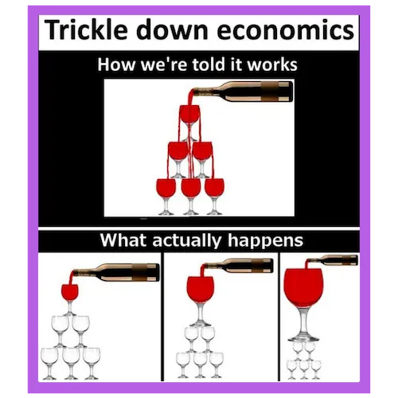
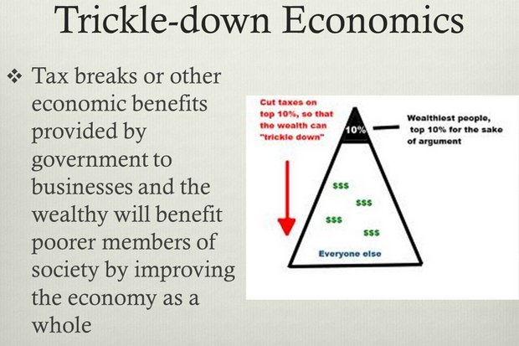
Right continued . . .
Trickle down
Welfare a minimal safety net only
Family values
One law for all
Punitive emphasis in criminal justice (although may favour privatised prisons)
Strong military defence

Slide 24
Left wing is associated with
Social justice, egalitarianism
Collective responsibility for a just and caring society
Social policies that advantage the working class and other disadvantaged groups, may include “positive discrimination”
Government intervention in the economy where needed for good of community and people’s wellbeing
Environmental protection
Regulation where needed

Slide 25
Left continued . . . .
Industrial relations policies supporting workers’ rights
Government provision of health, education and social services
Progressive taxation to fund government services and redistribution
Welfare as a citizen’s right to support according to need
Rehabilitation emphasis in criminal justice
Peace and disarmament

Slide 26

But it’s complicated . . .
Categories not clearly mutually exclusive, some overlap, eg Third Way
Some authors have suggested a continuum, however no agreed precise measure or scale of left or right-ness
Positions / parties that don’t easily fit:
      Indigenous parties, eg Te Pāti Māori
      Populist parties, eg New Zealand First
      Parties / governments in non-Western countries, eg Egypt’s Muslim Brotherhood
Problem of adoption of a package of positions on a range of issues that is not necessarily logical or consistent

Slide 27
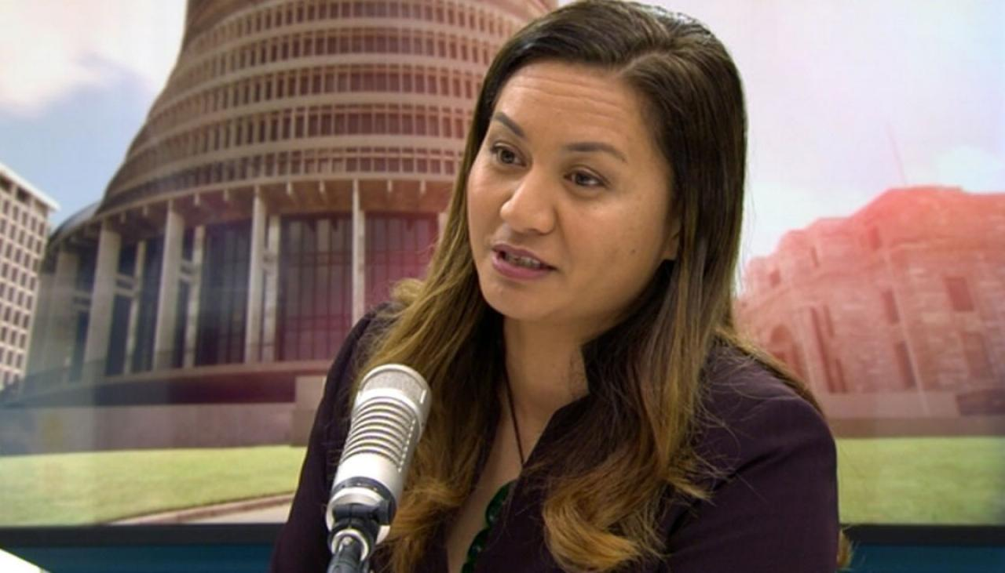
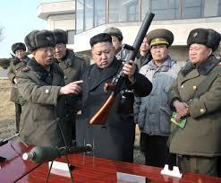
Labels can simplistically conflate quite different positions . . .
Left wing?

Slide 28
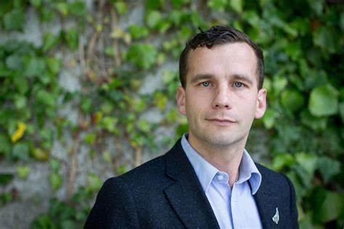
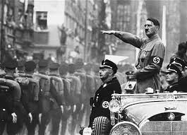
Right wing?

Slide 29
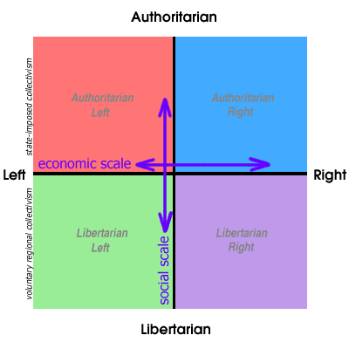
One Alternative: the Political Compass

Slide 30

About the Political Compass
The starting point of the (original) Political Compass was in 2001, when we recognised the inadequacies of the standard political measure: single left-right axis
It’s certainly fine for discussing economics but to this day is still widely — and wrongly — used to describe social attitudes. France’s National Front, for example, is popularly described as “far right”, yet its economic policies have sometimes been to the left of even the French Socialist Party. The party’s real extremism is in its social attitudes. That’s why we added a social scale.
Our essential point is that Left and Right, although far from obsolete, are essentially a measure of economics. As political establishments adopt either enthusiastically or reluctantly the prevailing economic orthodoxy — the neo-liberal strain of capitalism — the Left-Right division between mainstream parties becomes increasingly blurred. Instead, party differences tend to be more about identity issues. In the narrowing debate, our social scale is more crucial than ever.

Slide 31
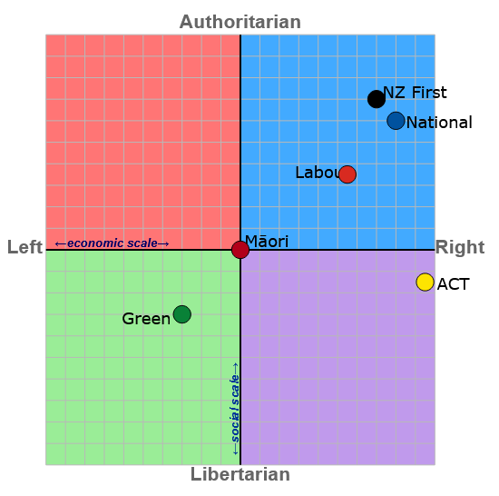
New Zealand Election 2020 (Political Compass)

Slide 32
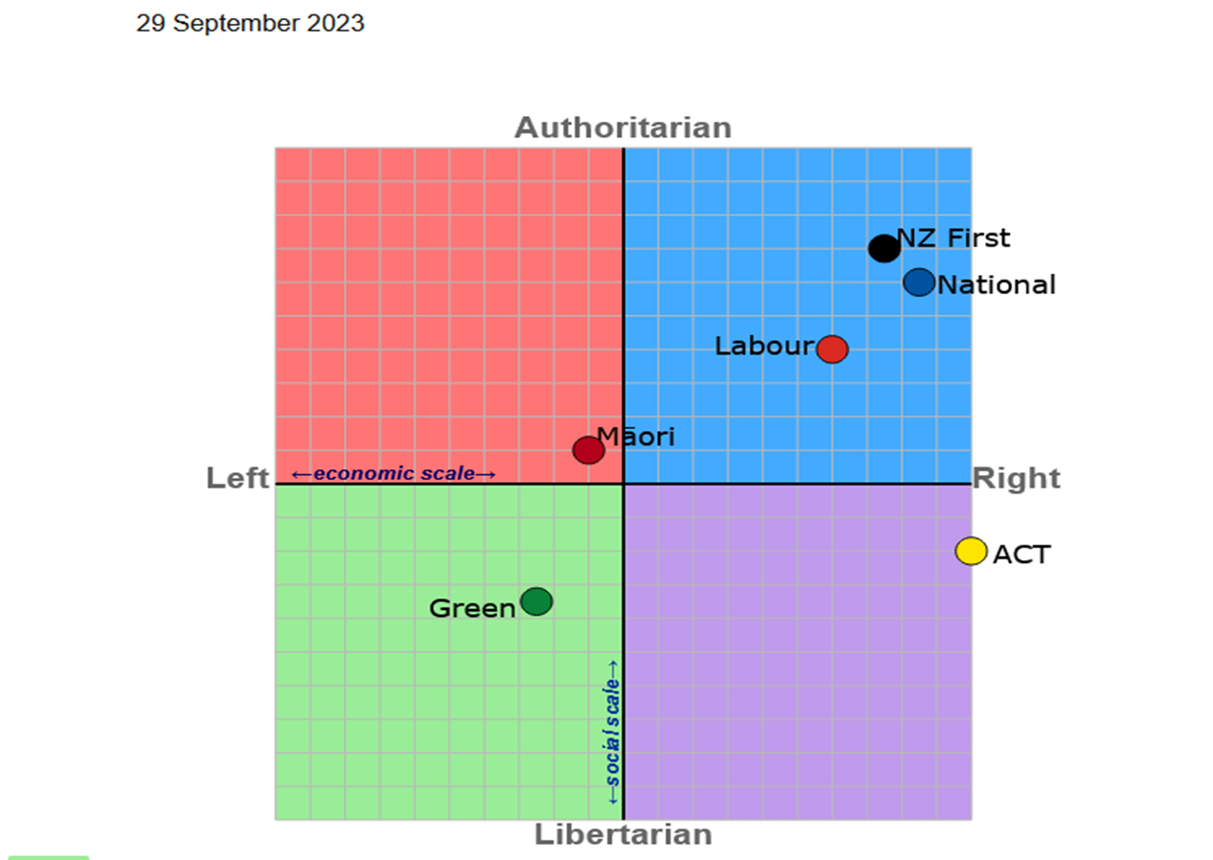
New Zealand Election 2023 (Political Compass)

Slide 33
Take the test
https://www.politicalcompass.org/test

Slide 34
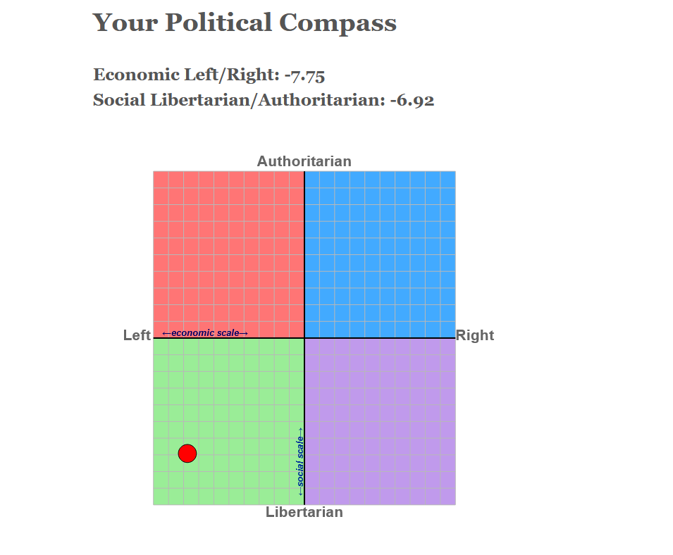
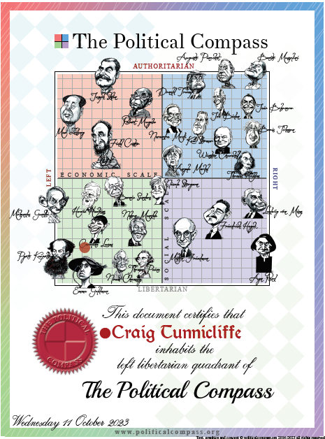
My results

Slide 35
Why does it matter?
Why does it matter?
It’s useful to understand the political spectrum for three reasons:
It can help you to spot bias. If a newspaper, news channel, or news site is known as having a left-wing or right-wing bias, it’s useful to keep that in mind when reading or watching their reports, as it might affect how they present certain people and events.
It can help you to reflect on your own bias. As you read through this guide, think about whether you lean more towards the left or right, and how this might impact your own views and interpretation of events.
It can help you to understand why a new policy or law is made. Very often, political parties will suggest policies that align with their place on the spectrum. These policies can then become law.
Here’s a brief video introduction: https://www.youtube.com/watch?v=5u3UCz0TM5Q

Slide 36
1 news vote compass: How do your views compare with the political parties?
Where do you sit? Find out here at 1News.co.nz/VoteCompass
Nearly half a million people used the academic-designed tool during the last election.
By using Vote Compass, New Zealanders can find out which political parties they are with on the key issues facing the country
You can choose to agree or disagree with 30 statements about issues like health, education, the environment, and tax. Vote Compass will then analyse your answers with the policies of different parties and show you how similar they are to your own views.

