Slide 1

Manufacturing of consent.
Technology, Media and Imagined community.

Slide 2
Karakia | MANAWA MAI
Manawa mai te mauri nuku
Manawa mai te mauri rangi
Ko te mauri kai au
He mauri tipua
Ka pakaru mai te po
Tau mai te mauri
Haumi e, hui e, taiki e
Embrace the life force of the earth, embrace the life force of the sky
The life force I have fathered is powerful, and shatters all darkness
Come great life force,
Join it, gather it, it is done

Slide 3


Waiata Purea nei
Purea nei, e te hau
Horoia, e te ua
Whitiwhitia, e te ra
Mahea ake nga, poraruraru
Makere ana, nga here
E rere, wairua, e rere
ki nga ao, o te rangi
Whitiwhitia, e te ra
Mahea ake nga, poraruraru
Makere ana nga here (x2)

Slide 4
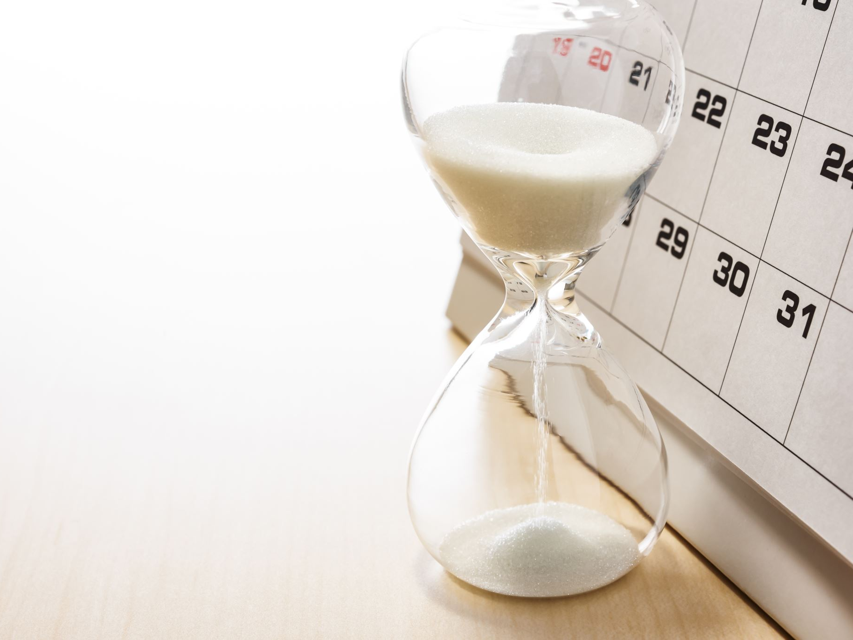
Recap from last week

Slide 5
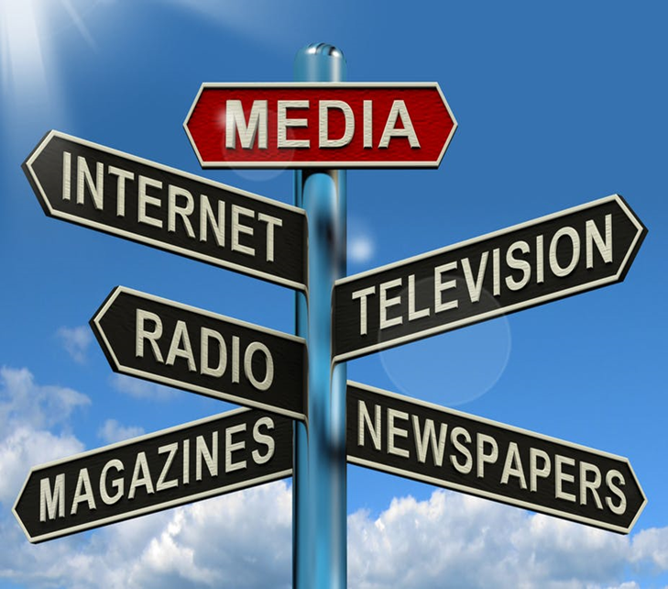
Poll: media and the news

Slide 6

What is technology
Technologies are means to ends.
They perform various functions
Technology can be objects, activities, and knowledges
A tool is useless unless you know how to use it.
Technologies reflect ideology
Technologies have unanticipated consequences
Technologies interact with the social
The social interacts with the technological
Technologies are not neutral
Technologies contain bias

Slide 7
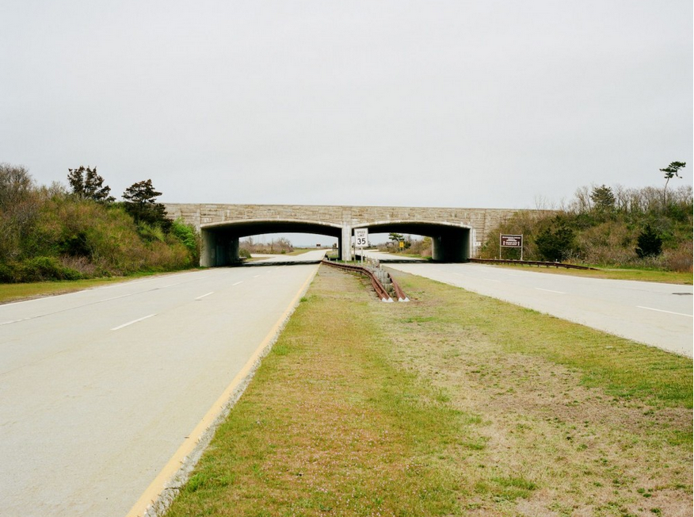
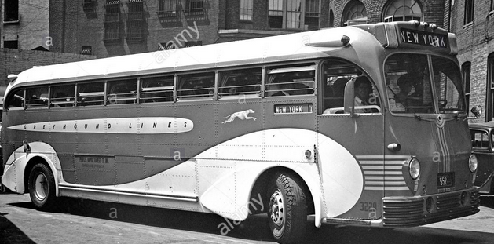
Racist bridges
Can a physical structure be racist?
Robert Moses was the designer of Jones Beach State Park in New York .
Moses harnessed the power of design to keep Jones Beach segregated. a “whites only” public beach.
Using his position as the Chairman of the Long Island State Park Commission, he demanded that bridges along the parkways (accesses points) that led to Jones Beach be built unusually low.
These low bridges were not an oversight, but rather a concrete example of Moses’s racist agenda.
The bridges barred public buses from accessing the beachfronts, making Jones Beach only reachable by car — an ownership demographic that unsurprisingly skewed largely toward white middle- and upper-class people.
A municipal bus is typically nine feet, eleven inches (3.02 meters
Moses built his bridges nine feet high (2.74meters)
Discrimination by design
Contemporary technologies are also open to having bias built in.
Watch (Are We Automating Racism? 5mins).
2.74meters
3.02 meters

Slide 8

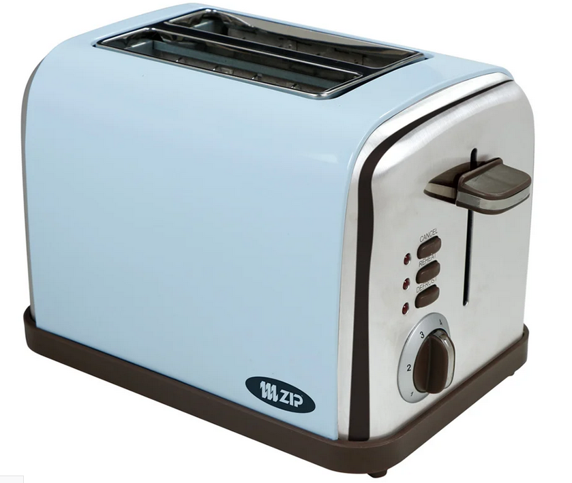
Technology and social change
Changes in technology are linked to changes in society.
Does technology determine society (e.g. industrial society)
Or does society determine the technology
When it comes to technologies sociologists ask us to look at the big picture.
The social shaping of technology and the role of technology in shaping us.
Even single objects attach to wider systems. (Toasters).

Slide 9




Media and social change
The term media refers to: the processes, forms and content of communication between a sender and a receiver.
Media contains messages that are transmitted through various mediums.
Mediums have changed over time
Watch: 2mins The Medium is the Message
Communication technologies

Slide 10





media and social change
Verbal (e.g. simple words to complex songs)
Writing, drawing, carving, weaving
Paper and written communication, transportation
Changing relationships of distance
Mass printing, transportation
Changing relationship of audience
Telegraph
Changing relationship of speed and distance

Slide 11
media and social change
Phone
  Change in conception of distance
Radio
Cinema
Television
  Changing location of audience
Satellites
  Global communication
Computers
(new mediums)
Computer mediated communication
Internet
  Changing relationship of content creation
  Changing relationship of time, space, distance, audience: Speed!
Personal devices
  Changing relationships with self?

Slide 12
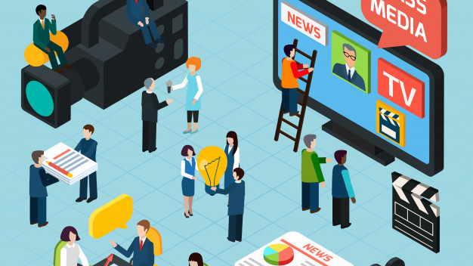
Mass media
Mass media is the communication that convey information, education, news, and entertainment to mass audiences
Print
  Newspapers,
  Magazines,
  Books
  Billboards,
  Direct mail,
Audio visual
  Radio
  Television
  Cinema
New media
  Internet
  www
  New media delivery technologies, cross media company convergence
  New interpersonal and interactive media.

Slide 13
the “mass media industry,”
the “mass media industry,” as a concept help us to pay attention to the ecology of media (the ways in which media are connect with other media, other institutions, corporations, governments etc.)
Mass media are organizations explicitly structured and organized to create, or gather, generate, and disseminate, news and entertainment through such different media as print, radio, television, the Internet, and more recently, through new technologies such as smart devices.
Mass media are like any industry, with well-defined organizational structure, logic, rules, and processes. Like any other for-profit corporate entity, media are subject to the economic logic of generating a product efficiently and making profits.

Slide 14
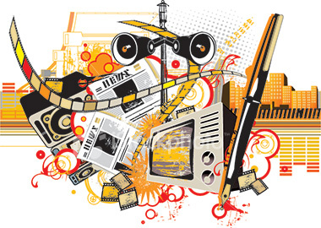
The functions of the media:
informational function
instrumental function
social control function
communal function

Slide 15
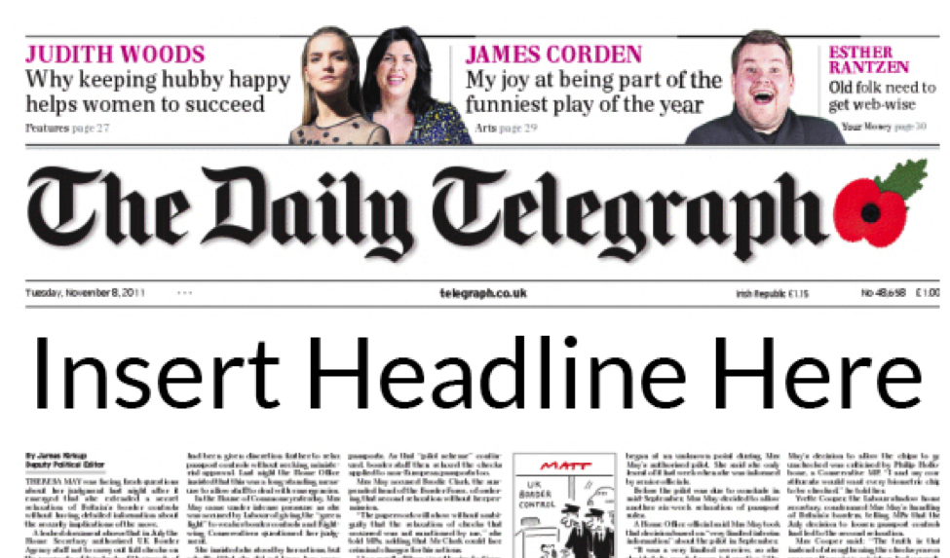
informational function
Media and other channels serve the informational function by providing information.
Current happenings, local and international.

Slide 16
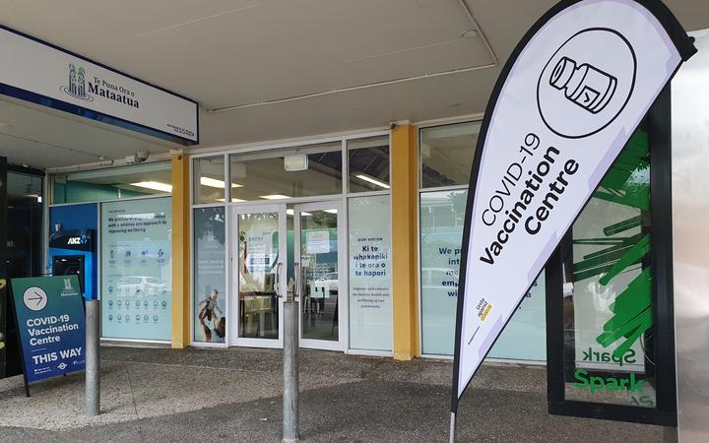
the instrumental function
Both in times of crises as well as in ordinary times, media provide information that allows for action, characterized as the instrumental function. This has also been called “mobilizing information” by some (Lemert, 1981).
For example: In a health context it may include announcement of dates, times, and places for screening, vaccination, or free clinics.
The instrumental function of media offers information that is practical and directly leads to action on the part of the audience.

Slide 17
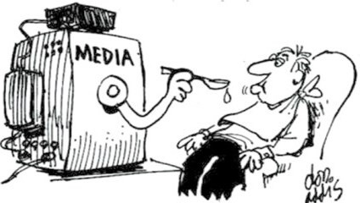
The social control function
The social control function of media has been well-documented
Media define the parameters of debate, social norms and acceptable behaviours.
The social control function includes elements of coercion, though media typically soften the coercion through ideological acceptance.

Slide 18

Remember hegemony
Force can be used as a system of control
When ideological acceptance of dominant norms, beliefs, and behaviours exist, force is not needed.
To create ideological acceptance a “cultural hegemony” is created through the institutions (e.g. education, media).
We accept the dominant beliefs as common sense. Common “life styles”
Our consent (to the status quo) is therefore manufactured and maintained.
The propaganda model of media analysis (watch: 5mins Noam Chomsky - The 5 Filters of the Mass Media Machine)

Slide 19
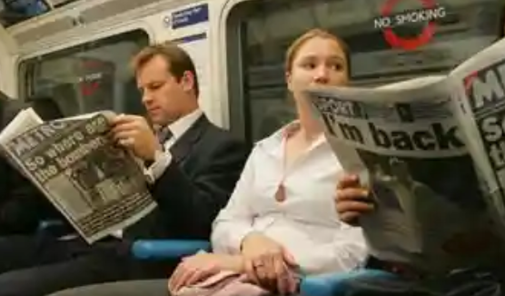
The communal function
Last, the communal function of media includes building a sense of community, social connectedness, norms of reciprocity, and access to social capital
Media use, particularly of local media, engenders a spirit of connectedness and identification with the local community, allowing for social action in pursuit of the interests of the community.

Slide 20
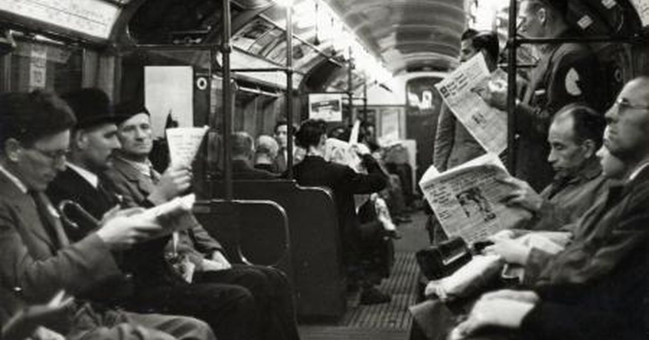
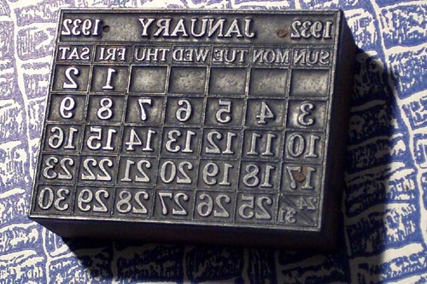
Imagined communities
FUN FACT:
The term stereotype, which we use as “fixed ideas” was originally used in early printing methods
Traditional involved a typographer painstakingly placing each type piece—each letter, each item of punctuation, etc.—onto a plate. Ink would then be applied to the type, and paper laid over it, before an upper plate would be lowered onto it and pressed against it, thereby transferring the ink to the paper.
This worked, but by the time the late 18th century had rolled around, an ever-increasing demand for printed material was happily met with innovation: the stereotype was a kind of printing plate that could be one of many. The process for creating a stereotype began with the original kind of plate, which was then used as a form to create a mold. The mold was strong enough to be used for casting multiple stereotypes from hot metal.
The durable stereotypes could then be used over and over to print multiple pages.
In his study on nationalism and national identity Benedict Anderson identified the construction of “imagined communities”.
The advent of the printing press allowed for the mass mechanical reproduction of printed works. A common language was used, and more people could access printed material.
This increased access, Anderson argues, united people that would otherwise have found it difficult to imagine themselves as part of the same community, mainly because of extreme linguistic differences and physical distance.
Print technology and newspapers in particular “making possible for enormous numbers of people to know of one another indirectly, for the printing press became the middleman to the imagination of the community."
the "very existence and regularity of newspapers caused readers, and thus citizens-in-the-making, to imagine themselves residing in a common time and place, united by a print language with a league of anonymous equals

Slide 21
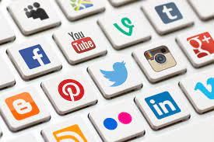
New media
Social media
  Addiction?
  Identity formation
  Body image (see here)
  Fake news? “click bait”, “rage bait”.
  Hate content
  Digital activism
Post truth?
  post-truth defined as ‘relating to or denoting circumstances in which objective facts are less influential in shaping public opinion than appeals to emotion and personal belief.
Conspiracy
  Algorithms
Surveillance
  As you watch technology, technology is watching you.
  Shoshana Zuboff on surveillance capitalism (watch from 2.43-8.25 5mins)
  Targeted information (advertising or political or propaganda)

Slide 22





Concept(s) of the week

Slide 23

Five Key Concepts
1. All media messages are ‘constructed.’
2. Media messages are constructed using its own language, style, techniques, codes, conventions, and aesthetics.
3. Each person interprets media messages differently.
4. The media contain ideological and value messages.
5. The media have commercial interests, social interests and political interests

Slide 24
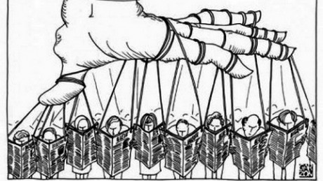
To study mass media remember
Who (says) What (to) Whom (in) what Channel (with) what effect?
How do we know it is true?

