Slide 1

Diversity and difference part 2: a focus on…
Gender & Sexuality
CSTU5170 - Sociology for Social Practice: Inequality and Social Change

Slide 2
Karakia | MANAWA MAI
Manawa mai te mauri nuku
Manawa mai te mauri rangi
Ko te mauri kai au
He mauri tipua
Ka pakaru mai te po
Tau mai te mauri
Haumi e, hui e, taiki e
Embrace the life force of the earth, embrace the life force of the sky
The life force I have fathered is powerful, and shatters all darkness
Come great life force,
Join it, gather it, it is done

Slide 3


waiata | Purea nei e te hau
Purea nei e te hau
Horoia e te ua
Whitiwhitia e te ra
Ma hea ake nga
Po raruraru
Makere ana nga here
E rere, wairua e rere
Ki nga ao o te rangi
Whitiwhitia e te ra
Mahea ake nga
Po raruraru
Makere ana nga here
https://youtu.be/PlHxXz4yJvM?si=P4cf_fUdpc6JxziX
Notes:
Scattered by the wind
Cleansed by the rain
Uplifted by the sun
All doubts are
Lifted away
All restraints are cast off
Fly free, o spirit
Fly to the realms of the heavens
Uplifted by the sun
All doubts are
Lifted away
All restraints are cast off

Slide 4

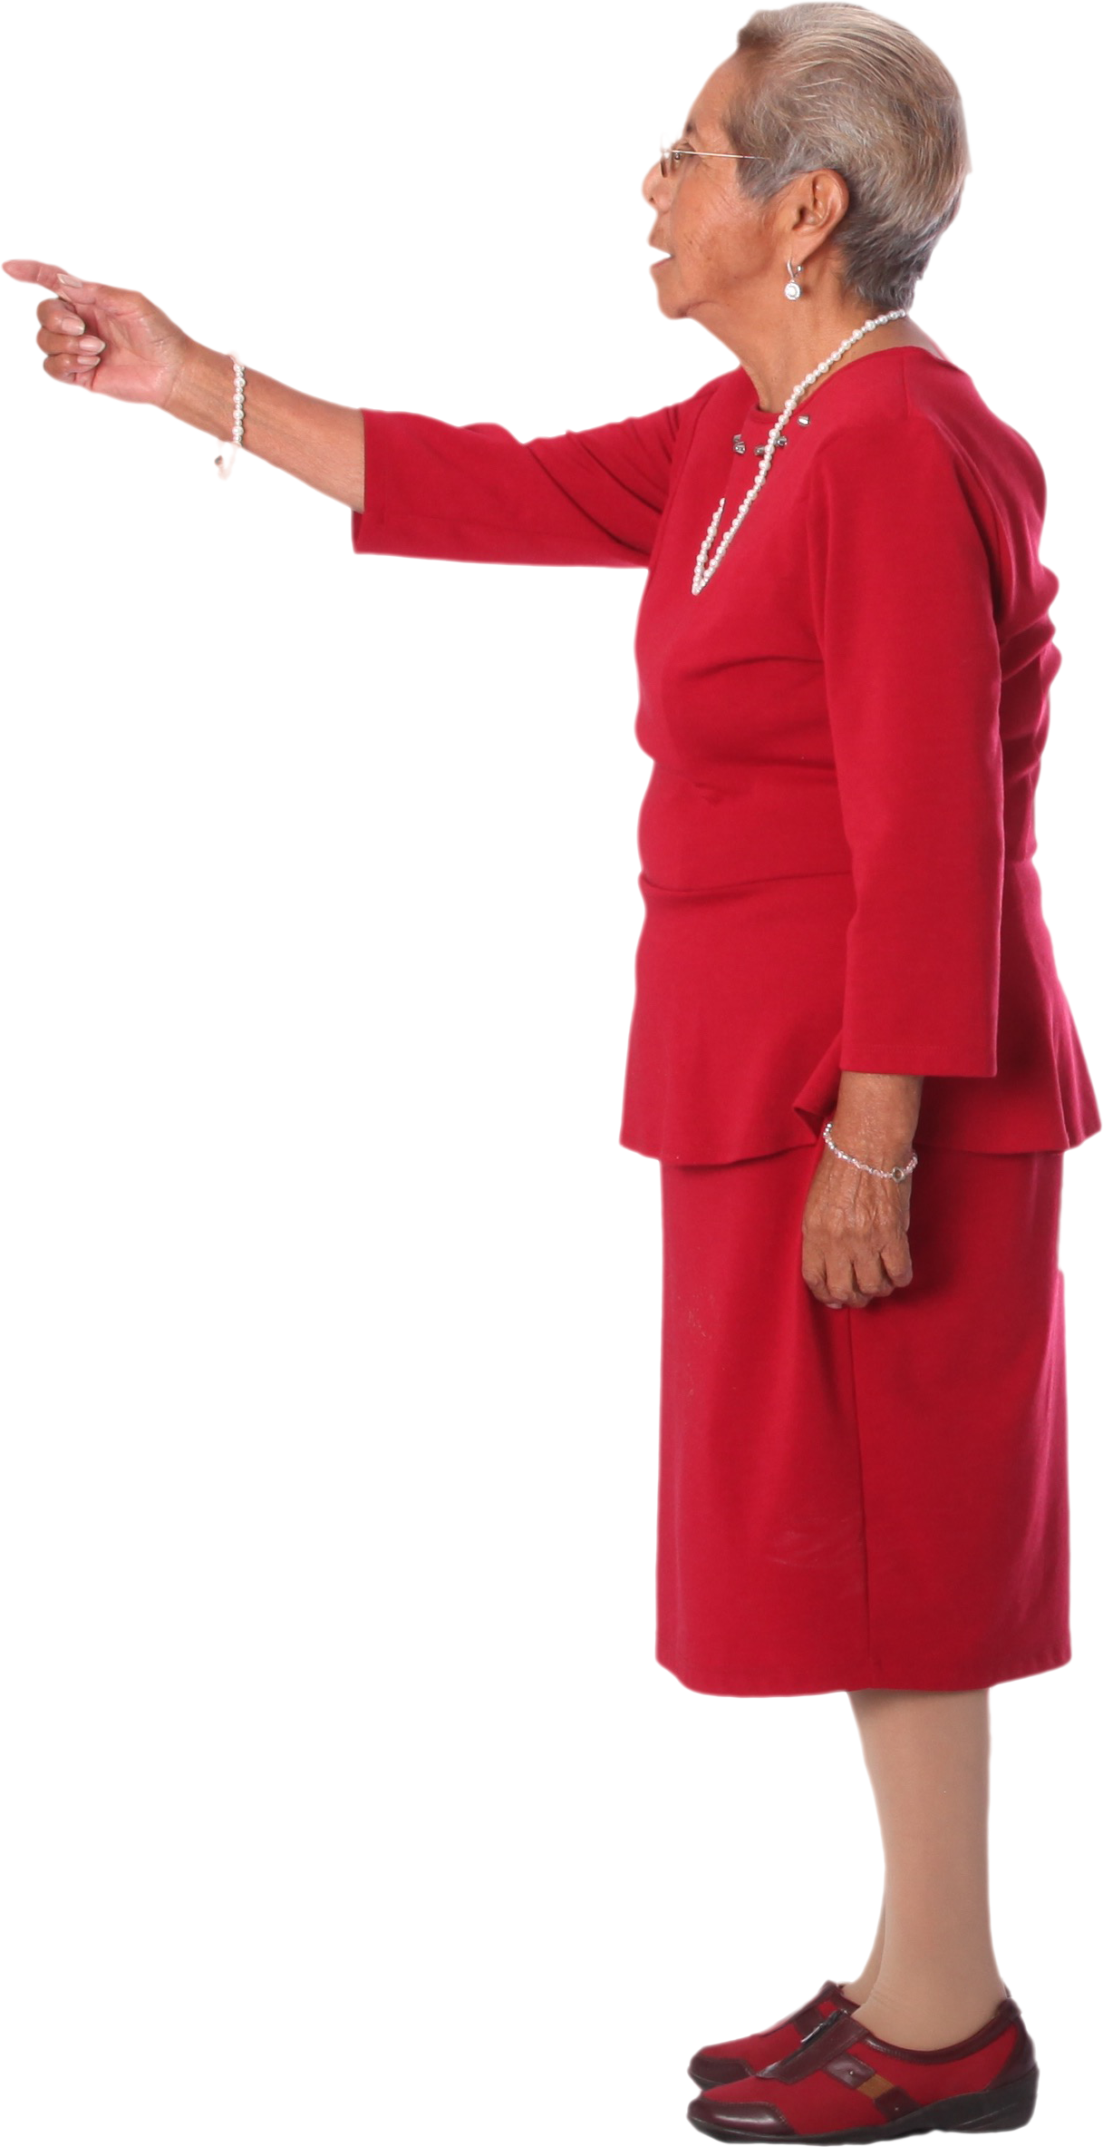

agenda
Recap last week
Recap key sociological concepts
Concepts of the Week
Gender
Lunch
Sexuality

Slide 5

Recap last week

Slide 6
Recap of some Key Sociological concepts
Norms
Normativity
Socialisation
Ideologies
Social structures
Stratification
The unspoken rules that shape our lived experiences
The expectations/assumptions that may come with certain norms.
The process in which we learn norms
Ideologies: A system, or combination of ideas that shape some aspect of our shared understanding of the world
social structures: are the patterned social arrangements in society that are both emerge from and shape of the actions of individuals. This includes social arrangements such as family, religion, law, economy, class, gender, ethnicity.
Stratification: Stratification means arranging something, or something that has been arranged, into categories. This tends to form a hierarchy with those stratified higher receiving more or greater access to social, political or economic power.

Slide 7




Concept(s) of the week

Slide 8
Gender Stratification, Patriarchy, Intersectionality
Gender stratification occurs when gender differences give men greater privilege and power over women, transgender and gender-non-conforming people.
Feminism focuses on the theory of patriarchy as a stratified system of power that organizes society into a complex of relationships based on the assertion of male supremacy.
Feminist theory uses the conflict approach to examine the reinforcement of gender roles and inequalities, highlighting the role of patriarchy in maintaining the oppression or marginalisation of women.
Intersectionality suggests that various forms of oppression– such as racism, classism, and sexism– are interrelated to form a system of oppression in which various forms of discrimination intersect. The theory was first highlighted by Kimberlé Krenshaw.

Slide 9
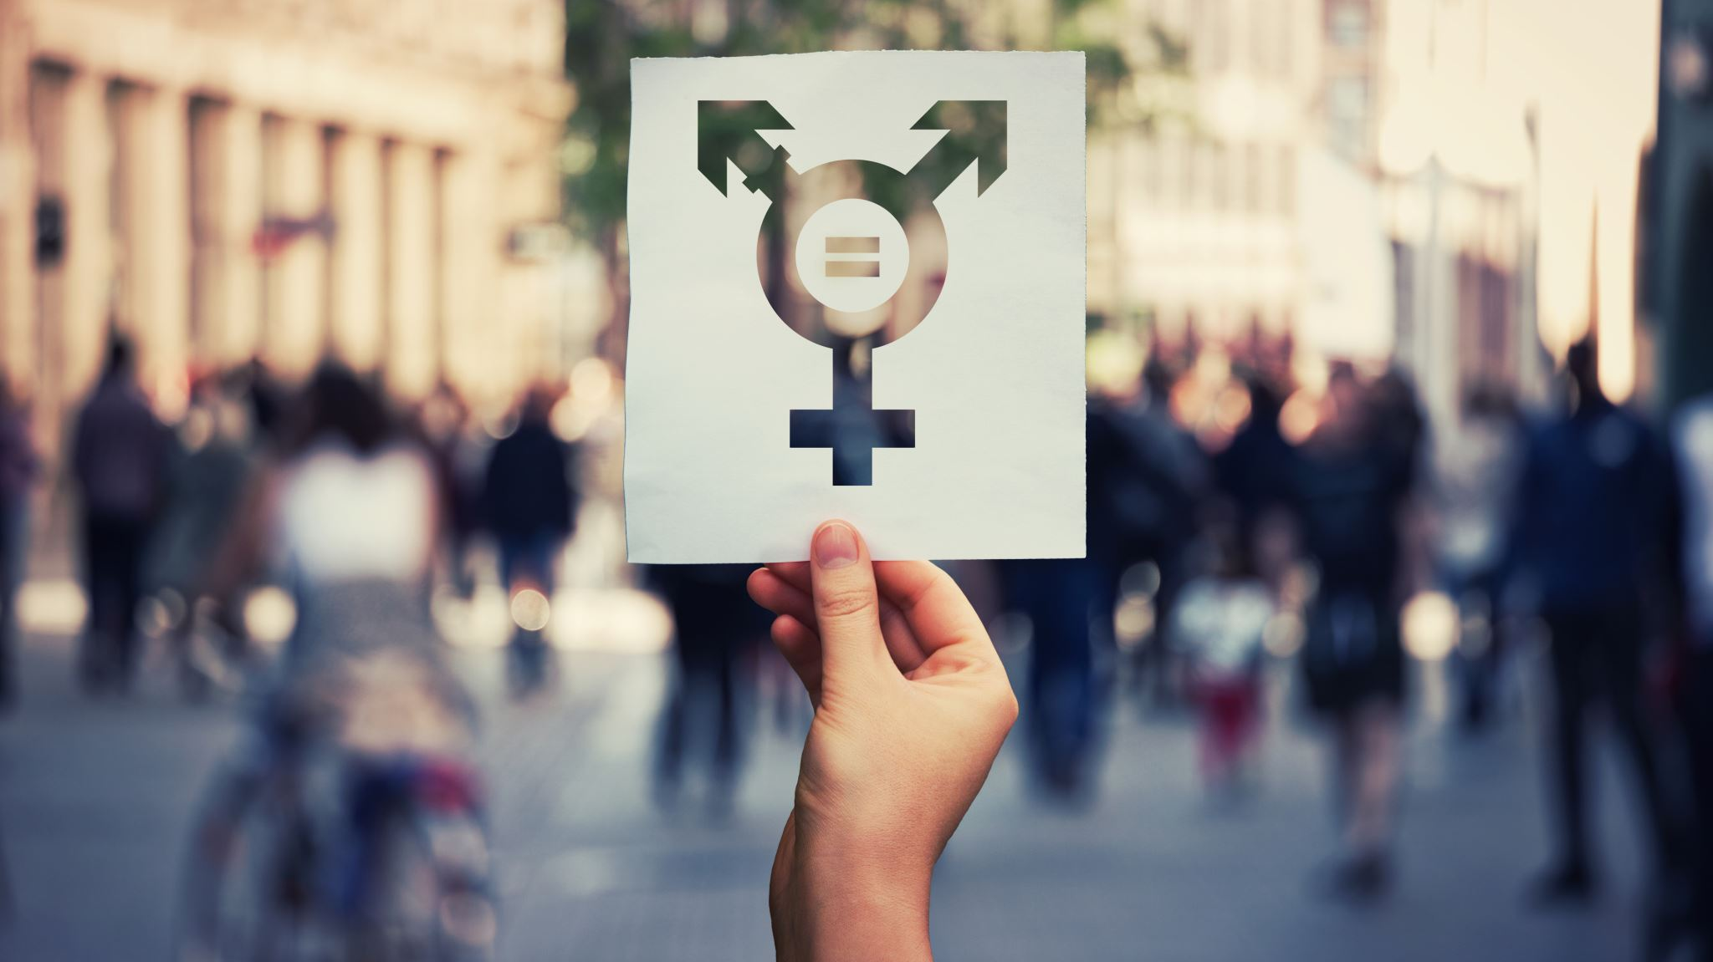

Gender and the study of Gender

Slide 10
Why Does Gender matter
It matters because it shapes the identities and behavioural expectations of individuals
Gender enters into how people see themselves, the ways they behave, how they view others, and how others view them.
It matters in the ways that it shapes social interaction.
  Identities are products of and sustained through interactions with others
Gender matters because it organises social institutions (think back to school, the rules, norms, etc).
Gender matters because ideas about gender are embedded in our social structure(s)
Gender appears in how we speak about gender (discourse)
Gender has impacts on life experiences
Gender impacts agency (our ability to act)
Gender is a site of inequality
“We cannot fully understand gender without attending to gender”

Slide 11
Gender, culture and Context
How gender is understood varies across cultures.
Much of the western analysis has focused issues of power and domination.
Other cultures have different ways of understanding gender and the relationships between genders.
Te ao Māori understandings of the interconnections of Wāhine Māori and Tāne Māori
Impacts of colonisation on traditional norms and social arrangements
Watch Pre-colonial attitudes to sex and gender fluidity

Slide 12
Questioning the binary
F
M
Discuss

Slide 13

Questioning the binary
Sex difference is a category used by human beings as a way of dividing up the world they perceive around them and making sense of it.
How it has been understood (the meanings associated with it) has varied over time and between cultures.
In recent (contemporary?) western society the normative environment creates/ has created the idea of a binary [either or] dichotomy of gender.
This is either woman or man
… a binary choice between two genders (men and women, linked to a biological deterministic position of male or female)
The idea that there are only two genders is sometimes called a “gender binary,” binary meaning either/or.

Slide 14

Questioning the binary
A binary is an either/or. Yes/No. True/False
Forms of binary categorization …have been very central to western thinking (Harriet, 2012, p.21)
In the social sciences, as well as in social work, acceptance of and reliance on binary opposites (dichotomies) creates boundaries between groups of people,
Examples: Us–them, Black–White, gay–straight, male–female, oppressed–oppressor, mentally ill–normal, and able-bodied–disabled.
Importantly within a binary one one group is often viewed or positioned as better/more superior to the other.
Binaries are in themselves oppressive, since they put limits on what we are expected, and thus able, to do (Harriet, 2012).
Seeing things as binary opposites (or as dichotomies) often hide more than they reveal (here we can talk of false dichotomies)

Slide 15
From sex to Gender
Sex is a biological categorization whereas gender is the personal/social/cultural elaboration of (or what is built onto…) biological sex.
Gender builds on biological sex, but it exaggerates biological difference, and it carries biological difference into areas of life in which it may be completely irrelevant.
This is a very important point
There is no biological reason, for example, why women should “sway” and men should “swagger” (do they?) , or why women should have red toenails and men should not.
Likewise there is no reason (other than social norms) to associate pink with girls and blue with boys.

Slide 16
From SEX (biological) to gender (Social/cultural)
Sex refers to “the base of biological sex differences”
for example, male, female, inter-sex
Gender: refers to the socio-cultural aspects of being a man or woman that is, how society sets the rules (or norms) for masculinity and femininity (Andermahr et al. 2000)
Gender therefore is not something fixed, but something that varies according to time, place and culture.
Sex is biological.
Gender is culturally defined and socially constructed

Slide 17
Gender
Gender (as conceptualised in the social sciences) is a different concept that biological sex.
Gender is the socially, culturally and personally defined aspects of what it means to have(or be) a particular gender. It is a social construction.
We are socialised into gender through our primary socialisation and the gender norms that exist in our cultural and social contexts
People seem to make a big deal about gender (fixed norms?). What is the first question we ask a new parent?
Watch Girl toys vs boy toys: The experiment
We are further socialised into particular gender roles, which carry gender expectations.
The institutions of society (e.g. religion, education, media etc.) continue this socialization process (and reinforce particular discourses of gender=hegemony).

Slide 18
Gender
In sociology gender is seen as representative concept that contains a number of component parts.
It includes how individuals see themselves.
Gender identity.
How others perceive them and expect them to behave.
Gender norms
The assumed tasks and functions that people should do based on gender
Gender roles
The interactions that they have with others.
Gender relations
And how they may present (or express) themselves
Gender expression
Gender is not a binary.
Rather gender is seen as comprising a spectrum of feminine and masculine.
Both men and women can exhibit a spectrum of gender traits that aren’t purely masculine or feminine.
For instance, someone might be a cisgender woman but have a more masculine gender expression.

Slide 19
Trans-Gender, Cis-gender, A-gender
Transgender (trans) and gender diverse are umbrella terms for people whose gender is different from their assigned sex at birth.
Cisgender (cis) is a term for people whose gender is the same as their assigned sex at birth.
Often one’s gender (identity and expression) aligns with one’s biological sex
This is termed cis gender (e.g. cis female, assigned female and identify as female or as a woman; cis male, assigned male at birth and identify as male or a “man”)
Agender is a term used by people who do not identify with any gender.

Slide 20
Transgender, gender diverse and non-binary
Transgender, gender diverse and non-binary are used to describe people whose gender identity (their internal sense of self) is different from the gender they were assigned at birth
Gender identity is your internal knowledge of your gender.
For example, your knowledge that you’re a man, a woman, or another gender.
Gender expression is how a person presents their gender on the outside, often through behaviour, clothing, hairstyle, voice or body characteristics.
Some people don't neatly fit into the categories of "man" or "woman," or “male” or “female.” Some people's gender changes over time. Some people don't identify with any gender at all and prefer the term non-binary.

Slide 21
Trans-Gender and Non binary
Transgender identity is generally defined as a “cross-gender identification,” however transgender identities go beyond the male/female dichotomy and embrace a range of gender diverse identities
Including Non binary
Nonbinary genders do not fit the man/woman gender binary. Like the term transgender, nonbinary can be an umbrella term.
People under this umbrella may also describe themselves using one or more of a wide variety of terms (like genderqueer or genderfluid) or may simply use ‘nonbinary’ or ‘nb’.
Approximately one third of people who identity as transgender do not identify as either male or female. Lamm 2019).
The terms transgender/gender diverse and non-binary are not indicative of sexual orientation.

Slide 22
Diverse Gender identities
Non-binary people are nothing new. Non-binary people aren’t confused about their gender identity or following a new fad.
Non-binary identities have been recognized for millennia by cultures and societies around the world.
For Māori Takatāpui meaning ‘intimate companion of the same sex has been reclaimed to embrace all Māori who identify with diverse sexes, genders and sexualities including whakawāhine, tangata ira tāne, lesbian, gay, bisexual, trans, intersex, and queer (Kerekere, 2016).
Read: GROWING UP TAKATĀPUI: Whānau Journeys
In the Pacific context other diverse gender identities include fa'afafine, fakaleiti and fakafefine

Slide 23

break

Slide 24
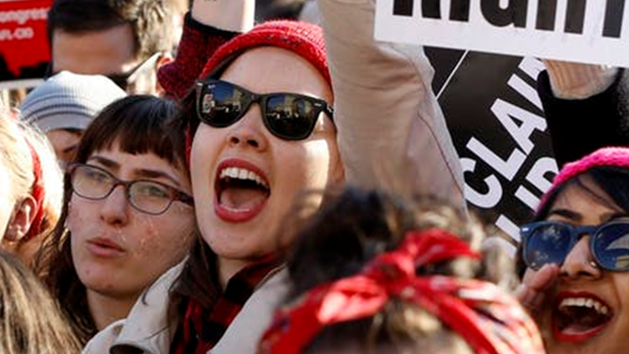
Feminist/gender theories of inequality

Slide 25
Gender theorising
Much gender theorizing has come from within ‘womens movements’ and in academic feminist writing.
Three main features of feminist theorising.
(1) a (not necessarily exclusive) focus on the inequities, strains, and contradictions inherent in gender arrangements
(2) an assumption that gender relations are not immutable, but rather changeable social creations.
(3) a normative commitment that societies should develop equitable gender arrangements (Chafetz, 1999)

Slide 26
Some Common Reactions when Looking at Gender Inequality
One common reaction is to see a discussion involving the hardships women experience as meaning that the speaker is claiming that ‘men have it easy’, or that gender inequality is ‘men’s fault’.
Gender inequality affects everyone.
Men don’t ‘have it easy’, but we are all accountable for the privileges we hold (including gender, “race”, class) and for working collectively to improve situations of inequality.
The issues we are examining here are larger than individual people’s intentions or actions.
They are ‘structural’ issues.
Many people, of all genders, buy into them and play them out

Slide 27
Types of Gender/ feminist theorizing
(also how to respond to people who suggest feminism is bad)
Liberal Feminism
Radical feminism
Black Feminism
Marxist and Socialist Feminism
Cultural Feminism
Ecofeminism

Slide 28
Types of Gender/ feminist theorizing
Post modern Feminism
Post structural Feminism
Queer Theory
Post Colonial Theories of gender
Anti oppressive Theory
Indigenous Theories
In Aotearoa. Mana Wāhine
Intersectional Feminism

Slide 29
Critique of feminism
Critiques of Feminism have included its tradition of both a Eurocentric and…
a middle-class lens on issues of gender.
Feminists of colour critiqued feminism for presenting ideas that did not map onto their reality
In the context of Aotearoa feminism can be critiqued for not attending to racism and colonization and for focusing on western understandings of gender oppression.

Slide 30
Key feminist ideas/areas of focus
Historical absence of women (gender blind history and theory) androcentrism. History has been His-story, not Her-story.
Women’s movements and the focus of gender analysis has shifted over time
Equality before the law (property and voting)
Equality in work “you have nothing to loose, but your kitchen sinks”
Arguing for change: "the personal is political“…
The personal is political ..argues that problems that seem to be individual (e.g. domestic violence) were in fact systemic, structural and therefore political power)
Body autonomy/reproductive autonomy
Domestic labour (2nd shift)
Sexism in society and in work (wage gap, glass-ceiling)
Gender Violence
Sexual Violence
Objectification (media)

Slide 31
Key feminist ideas/areas of focus
Gender as social construct
The need for Intersectional analysis
Watch: Intersectionality
Trans rights
Indigenous rights
Identity Politics and the Politics of Identity
Queer theory
#metoo
Consent culture
Constructions of Masculinity
  Hegemonic masculinity
  Toxic masculinity
  Alternative Masculinities
Body shaming
Social constructions of beauty
Sex positivity

Slide 32
Key concepts
Gender stereotypes: The statuses of male and female are often stereotyped according to the traits (aspects of “temperament” , personality etc.) they are assumed to possess by virtue of their biological makeup
(e.g. “natural” carers.)
Women have beeen (negatively) stereotyped as flighty and unreliable because they “possess uncontrollable raging hormones that fuel unpredictable emotional outbursts”.
(p.s. This is both wrong and sexist).
The assignment of negative stereotypes can result in sexism, the belief that the status of female is inferior to the status of male.
Actions based on this sexism leads to discrimination

Slide 33
Key concepts
Sexism is perpetuated by systems of patriarchy, male-dominated social structures leading to the oppression of women.
Patriarchy was described by Millett (1971) in her influential book Sexual Politics as a system of male domination over women that was embedded in all the institutions of modern society.
Through the structures of patriarchy, men held power over women and devalued their social activities and contributions.
Not only were social institutions such as families, schools, churches and work organizations seen as patriarchal, but, […] the very structures of language, ideas and thought were also shaped by men:
This is what became known as the ‘malestream’, which was to be challenged persistently by feminist academics.

Slide 34
Key concepts
Patriarchy, by definition, exhibits androcentrism (male-centred norms) operating throughout all social institutions that become the standard to which all persons adhere.
Sexism is reinforced when patriarchy and androcentrism combine to perpetuate beliefs that gender roles are biologically determined and therefore unalterable.
For example, throughout history beliefs about a woman’s biological unsuitability for anything other than domestic roles have restricted opportunities for education and employment
These restrictions have made men the guardians of what has been written, disseminated, and interpreted regarding gender and the placement of men and women in society.

Slide 35
Key concepts
Heterosexual normativity (hetero-normativity) was also seen as a major mainstay of male power, suppressing a range of other possibilities for attachment/ partnership
(homosexuality, bisexuality, passionate friend-ships, celibacy)
Men are not immune to the negative consequences of sexism and stereotyping.
Rigid construction of femineity and masculinity limit human agency and restrict different ways of expressing.
Masculinity as hegemonic (for men and women)
Watch: Decoding the Man Box - Kevin Powell, Tony Porter

Slide 36
Key concepts
Trans-feminism; both theory and praxis
Understanding the diversity of transgender identities and experiences
Addressing inequalities
Discrimination
Access to employment and housing
Transphobia
Challenging the biological determinism and binary thinking of movements for gender equality

Slide 37
Gender and sexuality

Slide 38
Why Does Sex Matter so Much?
Sex and sexuality are often referred to as the last taboo
It can be an area that people are uncomfortable discussing.
All societies regulate and approve certain patterns of sexuality and disapprove others (Stevens, 2011).
How human sexuality is expressed and patterned has been the subject of regulation in societies over centuries (Stevens, 2007).
As individuals we are encouraged to measure our sexual identity and sexual experiences against a politically and popularly supported ideal (Marsh, Keating, Punch & Harden, 2009).
This “ideal” can act as hegemonic, in the ways we accept and attempt to meet this ideal.

Slide 39




Gender and sexuality
Binary constructions of gender have been mapped onto binary understandings of sexuality
This constructs the normative environment = Heteronormative
Heterosexuality is assumed by default.

Slide 40
Sexuality
Defining terms:
The sexual characteristics and sexual behaviours of human beings, involving social, biological, physical and emotional (spiritual?) aspects.
It is about our desires, our connections, who we love, who we are drawn to.
It is about how we identify
And how we experience the world.

Slide 41
sexual orientation
Sexual orientation can be seen to have three components
Sexual attraction: sexual interest in another person. Sexual attraction is having sexual feelings towards someone. A person may be attracted to one specific sex or gender, to more than one sex or gender, or to no-one.
Sexual behaviour: how a person behaves sexually. It is whether they have sexual partners of another sex or gender, the same sex or gender, or refrain from sexual behaviour.
Sexual identity: how a person thinks of their own sexuality and the terms they identify with.
Sexual identity terms include lesbian, gay, straight, asexual, takatāpui, bisexual, or pansexual, among others.

Slide 42
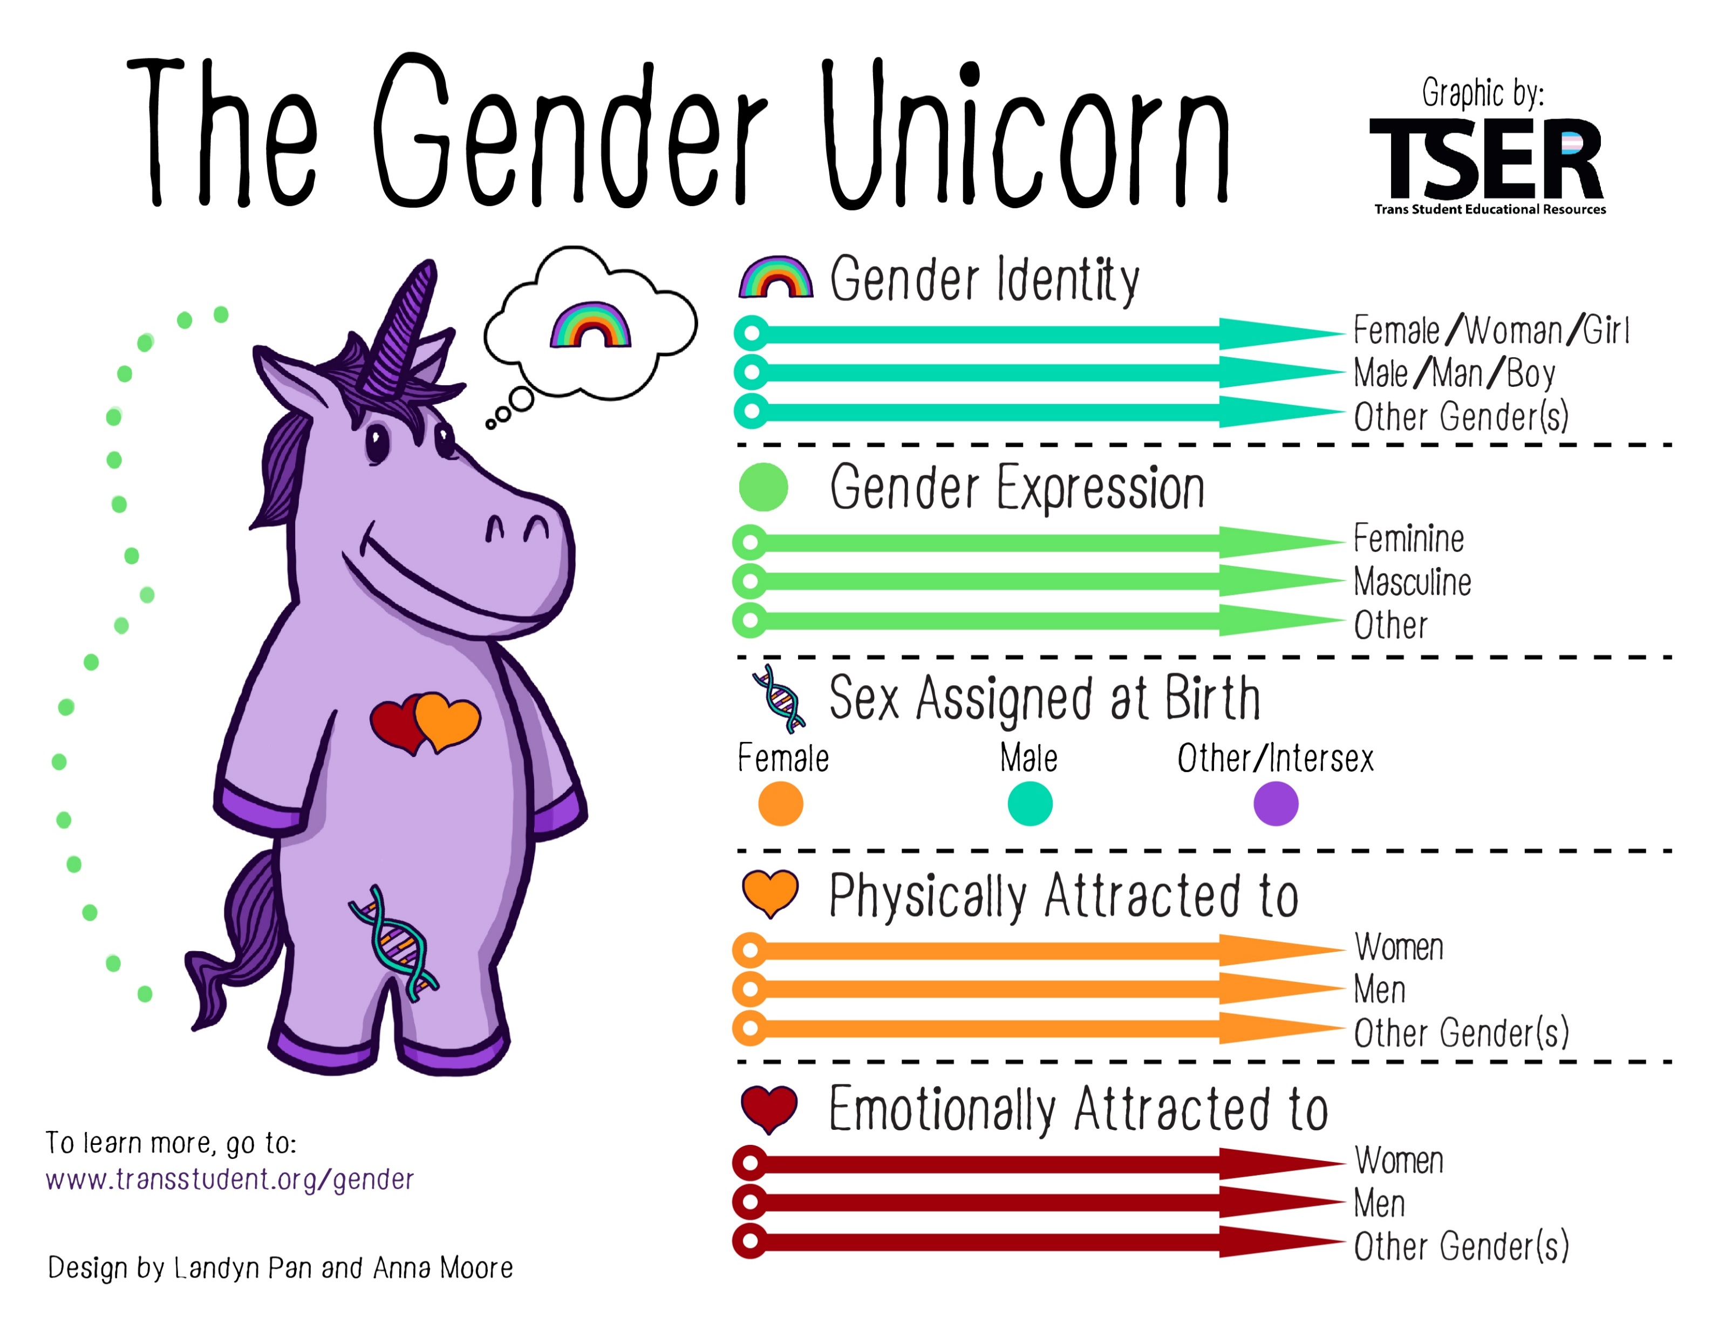

Slide 43
Sexuality and discrimination
Discrimination based on sexuality is prohibited by law yet it remains a prevalent feature of society. (including verbal harassment, access to housing etc.)
Much of this discrimination is based on stereotypes, misinformation, and homophobia (an extreme or irrational aversion to homosexuals)
Major policies to prevent discrimination based on sexual orientation have not come into effect until very recently
Sexual orientation is a significant source of social inequality
Homosexual Law Reform Act 1986
Civil Union Act 2004
Marriage (Definition of Marriage) Amendment Act 2013
How our Politian's voted

Slide 44
History of sexuality
All societies regulate and approve certain patterns of sexuality and disapprove others (Stevens, 2011).
How sexuality is understood varies across cultures
How sexuality is understood has changed over history
Religion and Medical discourse has structured much of western societies understandings of sexuality.
Sin
Deviancy

Slide 45
Religion and Sexuality
Christian attitudes to the body and to sex have shaped (and continues to shape) social norms
Positions the body as dangerous (especially the female body) as it is the site of temptation (for men). (Stevens, 2007, 2011)
Sex was for procreation by a married couple only– anything else was sinful(Stevens, 2011).
Social movements that opposed this view were crushed(Stevens, 2011).
In a 1993 letter to his bishops, John Paul said both sex before marriage and contraception were intrinsically evil (Stevens, 2011).

Slide 46
Sexuality and modernity
As Western societies modernised and secularised sexuality became the domain of doctors, illness, medicine and the law.
The trend of modernity to classify, compartmentalise, label, and describe was also applied to human sexuality.
Continued the religious trend to position heterosexuality as normal.
Referencing supposedly immutable (unchangeable) biological rules of males and females needing to mate anything outside this was viewed as abnormal.
The difference was that rather than sin, science was invoked
The rise of typologies and categories of people (not just behaviours but the establishment of “deviant” identities (e.g “the homosexual”)

Slide 47
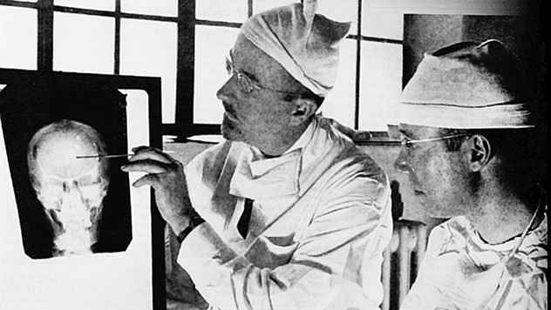

Slide 48
Sexuality and modernity
Theories of sexuality continued to be developed
E.g. Freud (repression of sexual desire appearing in neurosis)
Kinsey (sexuality as a continuum)
Alfred Kinsey, the creator of the Kinsey scale, has been called "the father of the sexual revolution”
The Kinsey scale was created in order to demonstrate that sexuality does not fit into two strict categories: homosexual and heterosexual. Instead, Kinsey believed that sexuality is fluid and subject to change over time.

Slide 49
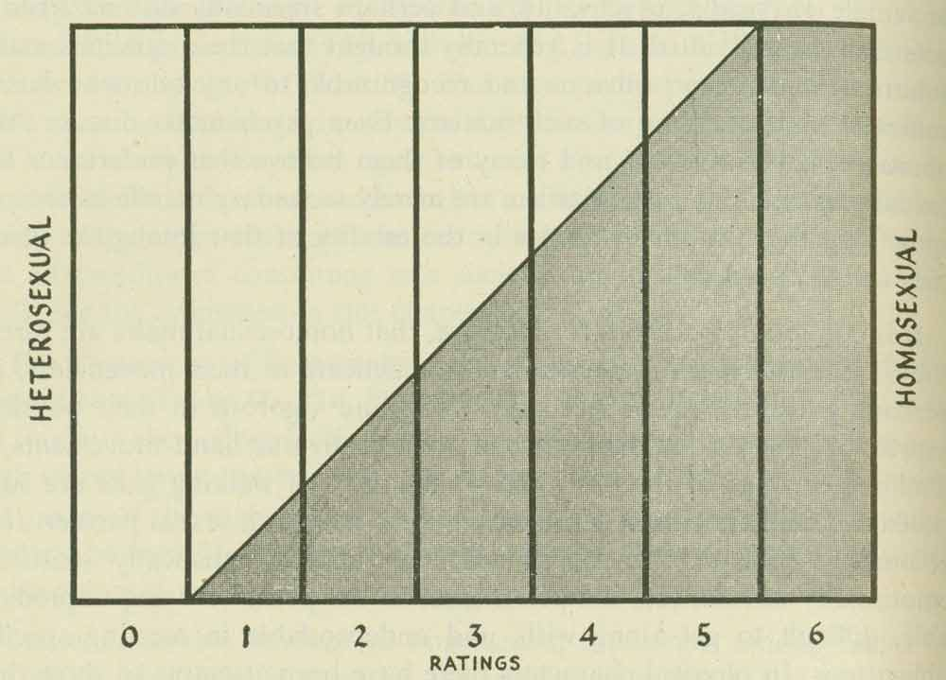
The Kinsey team interviewed thousands of people about their sexual histories. Research showed that sexual behavior, thoughts, and feelings towards the same or opposite sex were not always consistent across time.
Instead of assigning people to three categories—heterosexual, bisexual, and homosexual—the team used a seven-point scale. It ranges from 0 to 6 with an additional category of “X.”
Rating | Description
0 | Exclusively heterosexual
1 | Predominantly heterosexual, only incidentally homosexual
2 | Predominantly heterosexual, but more than incidentally homosexual
3 | Equally heterosexual and homosexual
4 | Predominantly homosexual, but more than incidentally heterosexual
5 | Predominantly homosexual, only incidentally heterosexual
6 | Exclusively homosexual
X | No socio-sexual contacts or reactions

Slide 50
Sexual Liberation - the 60s
An era of huge social change thanks to the generation born into post-war prosperity, building on earlier ideas (e.g. Freud, Kinsey)
Liberation movements on racial civil rights
gender rights and gender equality
Gay liberation
Growing political emphasis on identity, a product of post-war modernity

Slide 51
Reclaiming sexuality
As part of contemporary feminism, sex and sexuality have become central issues
Acknowledging diversity (within sexuality and gender identification)
Rainbow People with Disabilities
Rainbow Refugees and Asylum Seekers
Accepting/affirming diversity
Continuing the need for awareness of how diversity intersects with other inequalities
(Re)claiming autonomy of the body, mind, both singularly and within relationships (rejecting fixed ideas of gender norms)
Challenging ideas of relationship patterns and norms
Non-monogamy
Reclaiming sexuality and sexual agency
Opposing cultural conditions that objectify women (e.g. rape culture)
Consent

Slide 52
Contested Still
Sexuality is still a major arena of social controversy
Different groups claim they have the right to (de) regulate sexual identities and sexual behaviour
Particular points of conflict are body autonomy and non heterosexual
Prejudice
Stereotypes
Discrimination
Violence and death.

Slide 53
References
Else, A, (2018). 'Gender inequalities - Sexuality', Te Ara - the Encyclopedia of New Zealand, http://www.TeAra.govt.nz/en/gender-inequalities/page-2 (accessed 2 August 2018)
Bradley, H. (2013). Gender (2nd ed..). Polity.
Chafetz, J. S. (1999). The Varieties of Gender Theory in Sociology. In , Handbook of the Sociology of Gender (pp. 3-23). Springer Science & Business Media B.V. / Books
Cunningham, J. & Cunningham, S. (2008). Sociology and social work. Exeter: Learning Matters
Dominelli, L. (1997). Sociology for social work. London: Macmillian Press
Gannon, Susanne & Davies, Bronwyn. (2005). Feminism/ Poststructuralism. Pp.318-325.https://www.researchgate.net/publication/277139849_Feminism_Poststructuralism
Hicks, S., & Jeyasingham, D. (2016). Social Work, Queer Theory and After: A Genealogy of Sexuality Theory in Neo-Liberal Times. British Journal Of Social Work, 46(8), 2357-2373. doi:10.1093/bjsw/bcw103
Matthewman, S. (2013). Introduction: On being sociological. In S. Matthewman, C. L. West-Newman & B. Curtis (Eds.). Being sociological. (p.1-24).New York: Palgrave Macmillan.
Matthewman, S. & West-Newman, C. L. (2013). Controlling:power. In In S. Matthewman, C. L. West-Newman & B. Curtis (Eds.). Being sociological (2nd Ed), (p.63-78).New York: Palgrave Macmillan.
McLennan, G., McManus, R., Matthewman, S., Brickell, C., & Spoonley, P. (2019). Exploring society : Sociology for New Zealand students (Fourth ed.). Auckland: Auckland University Press.
Millett, K. (1971) Sexual Politics . London: Sphere.

