Slide 1
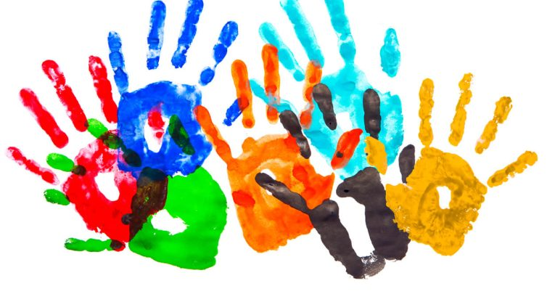
Diversity and Difference
Part1: Class, Ability, Nationality, Ethnicity, “Race” and Racism
C Tunnicliffe, 2023

Slide 2
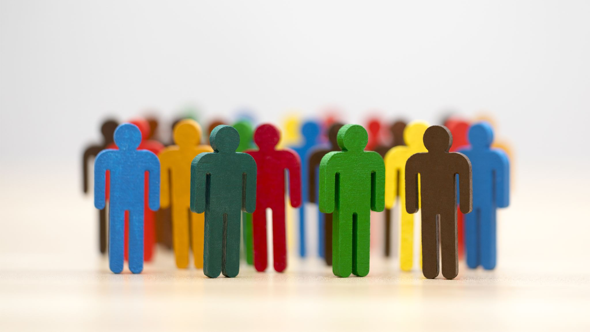
Agenda
Recap
Concepts of the week
(link to online textbook). https://philschatz.com/sociology-book/contents/m63483.html
Main Content for this week: Diversity and difference Part 1
Class, Ability, Nationality, Ethnicity, “Race” and Racism

Slide 3
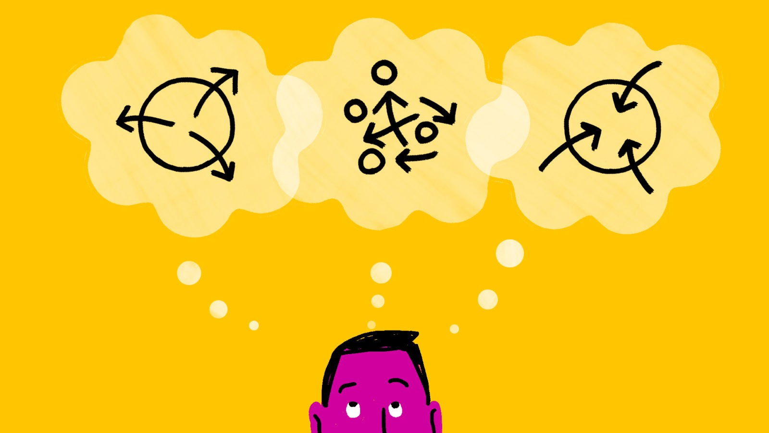
Last week recap
What did we cover?

Slide 4
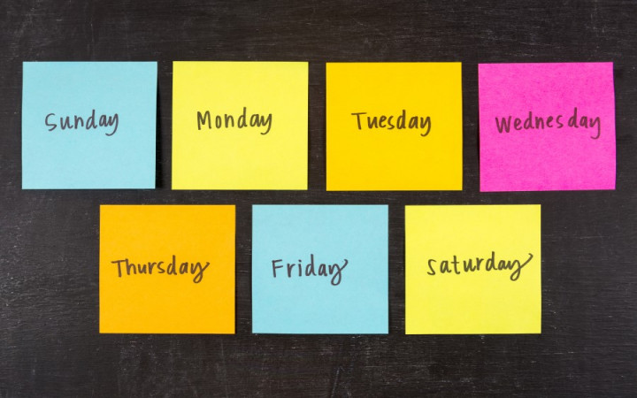
Concept(s) of the week

Slide 5


prejudice, stereotype, discrimination
The terms stereotype, prejudice and discrimination are often used interchangeably in everyday conversation.
In sociology they have more specific meanings

Slide 6
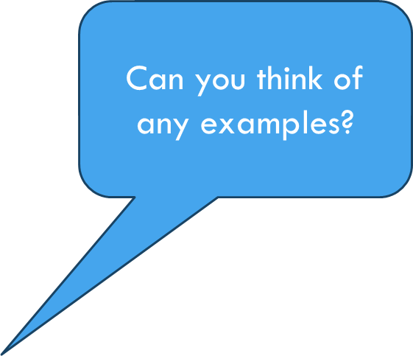
Prejudice
Prejudice refers to the beliefs, thoughts, feelings, and attitudes someone holds about a group.
A prejudice is not based on experience; instead, it is a pre-judgment, originating outside actual experience.

Slide 7
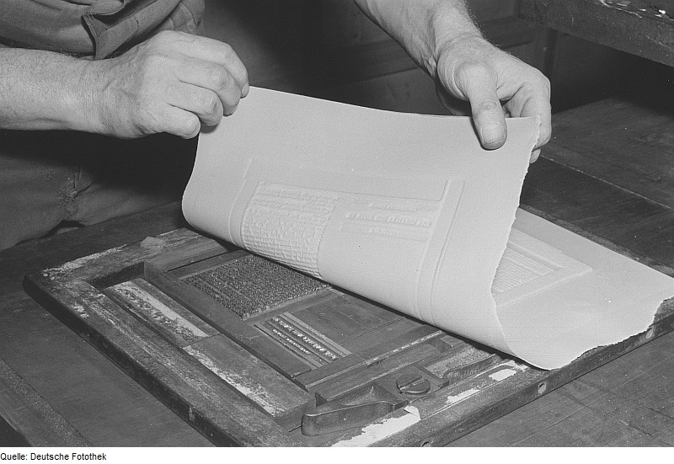
Stereotypes
derives from the Greek words στερεός (stereos), "firm, solid” τύπος (typos), impression, togther "solid impression. Stereotypes were used in printing, setting “type” so it could be replicated.
Can you think of any examples?
Stereotypes are oversimplified generalizations about groups of people. Stereotypes can be based on race, ethnicity, age, gender, sexual orientation—almost any characteristic.
They may be positive (usually about one’s own group)
but are often negative (usually toward other groups)
In either case, the stereotype is a generalization that doesn’t take individual differences into account.

Slide 8
Discrimination
While prejudice refers to biased thinking, discrimination consists of actions against a group of people.
Discrimination can be based on age, religion, health, and other indicators
Discrimination based on race or ethnicity can take many forms, from unfair housing practices to biased hiring systems.

Slide 9
discrimination
Overt discrimination has long been part of world history. In the USA, In the late nineteenth century, it was not uncommon for business owners to hang signs that read, "Help Wanted: No Irish Need Apply." And southern Jim Crow laws, with their "Whites Only" signs, exemplified overt discrimination that is not tolerated today.
However, we cannot erase discrimination from our culture just by enacting laws to abolish it. Even if a magic pill managed to eradicate racism from each individual's psyche, society itself would maintain it.
Sociologist Émile Durkheim (Structural functionalism) calls racism a social fact, meaning that it does not require the action of individuals to continue. The reasons for this are complex and relate to the educational, criminal, economic, and political systems that exist in our society.

Slide 10

Let’s take a break

Slide 11
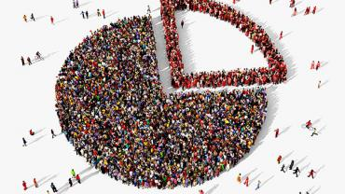
Diversity and difference

Slide 12
Difference and Diversity
Diversity is an undeniable part of the human condition. We are not all the same. We all have differences (e.g. in taste of music, food etc)
Some aspects of our diversity however are treated differently
“recognising and building on people’s differences is important and necessary, but not sufficient for a practice that has social justice as a primary goal. For social justice work both difference and domination dimensions must be recognised and addressed” (Reed, in Finn, 2016, p.24).

Slide 13
What are the Differences that make a Difference?
We need to pay attention to the difference that makes a difference
(what aspects of difference, e.g. gender, class, “race” lead to differences in how some people are treated?)
We have to look at not only differences but to also pay attention to the historical, political, and cultural processes through which difference and our ideas of difference are produced…
…and their relationship to the production, maintenance, and justification of inequality
This means we need to question how differences are given meaning, and give attention to relationships of power, privilege and marginalisation.

Slide 14
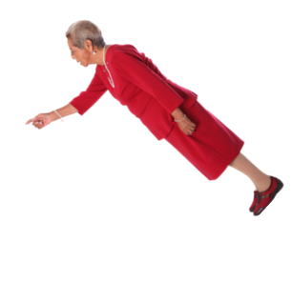
Which type of inequality should we focus on?
Income and Wealth
(Class, Status, Power)
Age
(issues such as Discrimination, Care and protection/elder abuse)
Ability/ Disability (Stigma)
Hidden (Dis)Abilities
Neuro diversity
Mental Health Addiction
Sexuality (LGBTI+)
(legal rights, non discriminating practice)
Gender (Gender norms, Gender stereotypes, Gender roles, Gender identity)
Ethnicity/ “Racial” inequality (Racism (individual, systemic, and structural)

Slide 15
C.A.G.E.S
CAGES is a helpful mnemonic (a way to help you remember things)
Class
Age and Ability
Gender
Ethnicity
Sexuality

Slide 16
Class
As we have seen class position is a key difference within society
Resourses, access, education, status, power.
Class priviledge
Classism
Stratification and the continuation of privilege and marginalisation

Slide 17
Let’s take a break

Slide 18
Ethnicity, Nationality, Race and Racism

Slide 19
Ethnicity, Nationality, Race and Racism
In popular discourse race, ethnicity and nationality are often used interchangeably (and incorrectly)
These are interconnected terms, but are not synonymous (not the same)
Each of these ideas can be the basis for social action
…And discrimination and oppression
…And privileges
Race, ethnicity and nationality are social (and cultural) constructs which we all use to wrap meaning around ourselves.
They have a history which shapes our current understandings
(e.g. nations have changed over time, indeed the concept of a nation or a nation state is a recent phenomenon

Slide 20
Ethnicity, Nationality, Race and Racism
We use (or are used by) these constructs or “irresistible ideas” to work out how to relate to ourselves and each other.
The ideas determine which groups we belong to, which groups we don’t and how to relate to other groups.
These concepts enter into us (society on the inside) and may play a large or small part in our own personal individual identities.
How do you describe yourself when in a different setting (overseas for example)?

Slide 21
Sociological ideas about: Race, Ethnicity and Nationality
Sociologists always interested in the relationship between groups and what creates a group.
Race, ethnicity and nationality make up a set of contested and often overlapping concepts.
There are different ways of thinking about race and ethnicity and nationality
Race, as a scientific category, has been fully discredited by contemporary science (i.e. DNA evidence)
Race to racialising – from category to process.
Sociologists more commonly now refer to ethnic groups not ‘races’

Slide 22
Some important considerations
The “project of modernity” sought to classify (name, and order) the natural world.
It created typologies (categories of types, e.g. birds-from other animals-to types of birds and their interrationships)
Western “science” applied these ideas to humans. Focusing on visible difference (including colour, and other physical differences
Imperialism and Colonialism contain ideologies of difference that constructed difference in terms of “superiority” and “inferiority”
Constructing “different races” provided the justification for different treatment. (e.g. individual rights for one race, but not for another).
Social Practitioners need to challenge these ideologies.

Slide 23

Defining terms, Nationality, Nationalism, Race and Racism

Slide 24
Nation-states
The combination of a large community (nation) and a territorial , political form (state), creating a cultural-political entity.
Nations are constructed, through politics, and through war.
The nation state is a relatively recent label used to describe a distinct country, with boarders, and sovereignty over its own territories.
Nation states control political power and the legitimate means of force within a defined territory. (this can be described as a monopoly on violence force).
Watch: animation of changing boundaries
https://youtu.be/-6Wu0Q7x5D0?t=881

Slide 25
Nationality
Nationality refers to the country of citizenship. This can be the country you were born in or the country to move to and then apply for citizenship.
https://oag.parliament.nz/2013/citizenship/part3.htm
Nationality is a legal identification of a person in international law, establishing the person as a subject, a national, of a sovereign state.
Nationality is also used (perhaps incorrectly) as a term for national identity.
National identity is a constructed fiction.
A set of ideas about “shared” history, people of influence, and stability over time.
…often conflates (mixes together and confuses) ethnicity (or a particular ethnicity) with national identity.
National identity is an ideological construction that can be used for political purposes.

Slide 26
Nationalism
Nationalism is both an inclusive and an excluding concept.
It is about loyalty and strong support for one’s own nation
It is often about describing national characteristic and values in a positive way, through contrasting with other nations
Ideas of who should (and who should not) be included in this nation is often a feature of Nationalism.
Nationalism can be toxic and divisive. Especially when combined with ideologies of “race” or ethnicity (which excludes others not of this “race” or ethnicity)
Nationalistic movements generally aim for some form of political independence (some have valid claims, others are deeply questionable)
https://youtu.be/sazitj4x6YI?t=68
Ps. The term globalist (rather than globalisation) has problematic connections to both conspiracy theories and extreme right wing discourse.

Slide 27
Ethnicity
Ethnicity is a product of how a particular group sees its history, its identity; how it defines membership; how it continues to uphold its practices and beliefs, and how it interacts with others.
It captures the idea of belonging to a particular cultural group and the significance of this identity for an individual.
Ethnicity is a measure of cultural affiliation. It is not a measure of race, nationality, or citizenship.
An ethnic group can be defined as: a group whose members identify with each other, on the basis of common ancestry or decent.
Ethic groups are usually united by common cultural, behavioral, linguistic or religious practices.
Ethnicity is about traditions and culture.

Slide 28
Ethnicity
An ethnic group is made up of people who have some or all of the following characteristics:
one or more elements of common culture, for example religion, customs, or language
unique community of interests, feelings, and actions
a shared sense of common origins or ancestry, and
a common geographic origin.
People can belong to more than one ethnic group.

Slide 29
Ethnicity
Ethnic groups within a society may be treated differently from other ethnic groups.
Some ethnic groups may have more rights and privileges than other ethnic groups.
Often the “dominant” ethnicity will have more access to power.
Ethnicity is both a place of comfort and consensus and a potential site of difference and division

Slide 30
Race
Race is an Idea
Racialisation = the social processes by which a population group is categorized as a race...
… and the associated meanings, beliefs and attitudes that are ascribed (given to) people of that “race”
Race is not a scientific category (although historically it has been used as one)
Biological assumptions of racial categories have long been discredited in scientific thought.
However, “Race” remains a powerful idea that influences behaviour and our perceptions of the world we live in.

Slide 31
Race
Races have been classified/constructed on observable differences.
These have included, phenotypical (relating to the observable characteristics of an individual) difference such as skin colour, facial characteristics etc)
These differences have then been racialised where differences are then linked to negatively valuated social, psychological or physical traits
For example claims that “races” have difference in IQ, or a propensity (“natural” tendency) to certain behaviours, i.e. criminal, violent etc.
Science (Scientific racism) has been used to try and validate these claims.
legislation has been used to legitimise actions based on racial assumptions (e.g. segregation)

Slide 32
Race
Racial identities are negotiated, contested and defined in a process of oppositional interaction with “the other”.
The “other” is stereotyped, and marked as different and often as “less than”
Race can, and has been, used as a political act of resistance. To take the concept and use it to build solidaity.
For example the use of “Black” in the USA to highlight injustice against people of colour, and based on shared experiences of discrimination and oppression

Slide 33
Let’s take a break

Slide 34
Racism
Racism is difficult to define, and it operates on many levels
Racism operates on macro level (e.g. ideologies of racism),
the meso (within our systems and institutions)
and the micro (or individual).
Analysis needs to recognize these different levels of racism.

Slide 35
Prejudice and Discrimination and stereotypes
Stereotyping, Prejudice and Discrimination are all concepts associated with “race” and racism.
Stereotypes: are over simplified or untrue generalisations about social groups.
Racial Prejudice: learned beliefs and values that lead an individual or group of individuals to be biased for or against members of particular groups.
Racial discrimination is about actions; the unfavourable treatment of all persons socially assigned to a particular racial category.
When stereotypes imply negative evaluations of social groups they become a prejudice. When prejudice is acted on (through the use of power) it becomse discrimination.

Slide 36
Racism: levels of racism
Ideological
Cultural
Structural/Institutional/Systematic
Individual

Slide 37
Ideological racism
Ideological racism is the set of ideas that support the construction of race as a category.
Race is an ideological construction
So it’s just an idea?
Yes.
But it’s an idea that’s real like a rock – it can get thrown at you and when it hits – you bleed (Anon)
The problem of ideology, therefore, concerns the ways in which ideas of different kinds grip the minds of the masses, and thereby become a 'material force' (Hall, 1996, P. 27)
Ideological racism constructs “race” as naturally stratified with one race being “superior”

Slide 38
Racism ideology and colinisation
The construction and application of ideas about ‘race’ were essentially a product of European expansionism and the establishment of colonial empires.
As a way of classifying and understanding others, ‘race’ was used by European nations as a means of justifying their dominance and exploitation of non-white peoples:
these peoples were variously seen as pagan, uncivilised, backward, primitive, intellectually inferior and incapable of contributing to modernity.
The expansion of the colonial empires, especially those that were capitalist in nature, involved complex arguments about the superiority and inferiority of certain ‘races’.
This is epitomised in the social and legal circumstances of the slave states of the southern USA, where an absolute division between black and white was constructed and was later justified by the so-called science of ‘race’.
Scientists supposedly ‘proved’ that ‘races’ existed and that there were significant cultural, intellectual and physical differences between them.

Slide 39
Cultural Racism
Cultural in this context is about the broad cultural messages that dominate a particular culture.
Cultural racism refers to representations, messages and stories that reinforce racist attitudes, beliefs and practices.
And create the dominant cultural narrative.
Cultural racism shows up in advertising, movies, history books etc. it includes whose story is told, and by whom. How people are represented and who is represented
It helps justify actions… such as racial profiling (an action by an authority based on the assumption (stereotype) that every person in a particular racial group is sufficiently likely to be a criminal that they can be stopped, searched and/or questioned)
Cultural dominance creates “normative whiteness”
“white” is seen as the norm

Slide 40
Structural/Institutional/Systematic
Racism can be embedded in the institutions and structures of social life
Two main types of institutional racism. The first, which is called ‘‘direct,’’ occurs when policies are consciously designed to have discriminatory effects
The second type, ‘‘indirect’’ institutional racism, includes practices that have disparate racial impacts even without any intent to discriminate (such as network hiring in workplaces).
Institutional or systemic racism, asks us to look at the ways that the system and our institutes have been constructed.
e.g. Systems of law (law, courts, prisons, police). Education system.
While there may be formal or legal equality, inequalities can be seen in application and in outcomes

Slide 41
Individual Racism
Individual racism refers to the beliefs, attitudes, and actions of individuals that support or perpetuate racism in conscious and unconscious ways.
Examples include telling a racist joke, or not hiring a person based on ideas of race
More than jokes however is often an underlying belief in the inherent superiority of one’s own group of people over other racial groups,
The dominant cultural narrative about racism typically focuses on individual racism and fails to recognize racism as ideological/structural or systemic.

Slide 42
Individual Racism: Unconscious bias
“refers to a bias that we are unaware of and which happens outside of our control”
“It is a bias that happens automatically and is triggered by our brain making quick judgements and assessments of people and situations…
… influenced by our background, cultural environment and personal experiences”. (Auckland University, 2018, p.1)
Listen: (13mins) Consciously stamping out unconscious bias

Slide 43
Individual Racism: Micro aggressions
“a comment or action that subtly and often unconsciously or unintentionally expresses a prejudiced attitude toward a member of a particular “racial” group
“Racial microaggressions are brief and commonplace daily verbal, behavioral, or environmental indignities,
whether intentional or unintentional they may communicate hostile, derogatory, or negative racial slights and insults toward people of colour.”
e.g. you speak so well for …..
But where are you really from…

Slide 44
Privilege
Racism of all types lead to inequality and marginalisation.
Those who are not effected by racism (i.e. constructed as a racialised other) can be said to have privilege.
Privilege in one aspect of societies structures does not always equate to privilege in other social grouping.
Watch: (20min) Deconstructing White Privilege with Dr. Robin DiAngelo
https://youtu.be/DwIx3KQer54

