Slide 1
Consensus and Conflict:
The context of change.
Inequality, Class, Stratification, capitalism
CSTU5170 - Sociology for Social Practice: Inequality and Social Change
C Tunnicliffe, 2023

Slide 2
Karakia | MANAWA MAI
Manawa mai te mauri nuku
Manawa mai te mauri rangi
Ko te mauri kai au
He mauri tipua
Ka pakaru mai te po
Tau mai te mauri
Haumi e, hui e, taiki e
Embrace the life force of the earth, embrace the life force of the sky
The life force I have fathered is powerful, and shatters all darkness
Come great life force,
Join it, gather it, it is done

Slide 3


waiata | Purea nei e te hau
Purea nei e te hau
Horoia e te ua
Whitiwhitia e te ra
Ma hea ake nga
Po raruraru
Makere ana nga here
E rere, wairua e rere
Ki nga ao o te rangi
Whitiwhitia e te ra
Mahea ake nga
Po raruraru
Makere ana nga here
https://youtu.be/wRWwrdRjkDA
Notes:
Scattered by the wind
Cleansed by the rain
Uplifted by the sun
All doubts are
Lifted away
All restraints are cast off
Fly free, o spirit
Fly to the realms of the heavens
Uplifted by the sun
All doubts are
Lifted away
All restraints are cast off

Slide 4
Agenda
Discuss essay due date
Recap last week
Explore sociological theories (different paradigms).
Explore inequality
Explore class and stratification

Slide 5
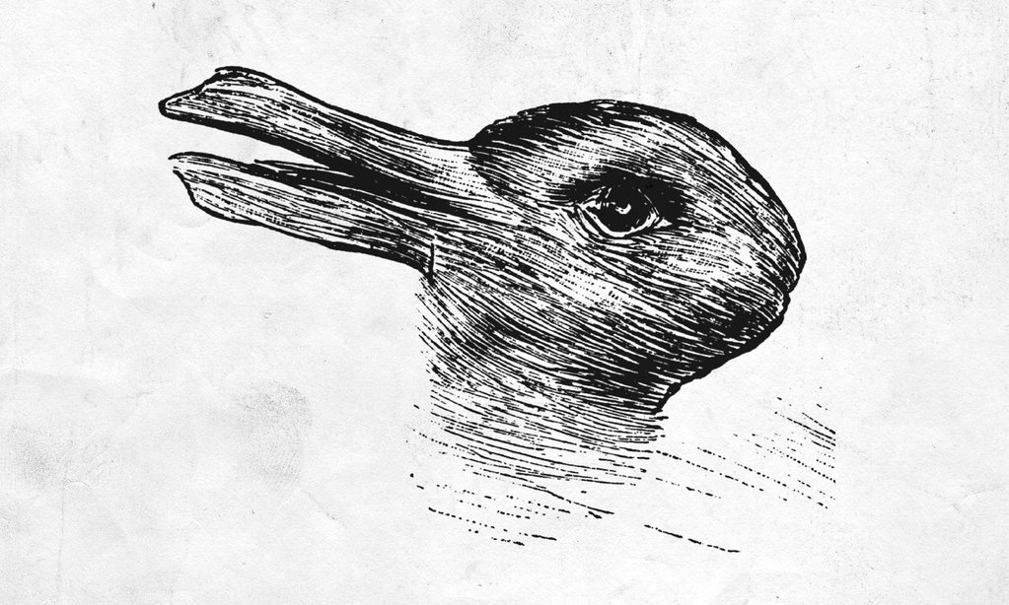
Thinking sociologically
Looking at things in different ways.
Looking at the history of the collective us.
How did it become this way?
Are we free to act or are we determined by our social context(s)?
Sociology provides concepts and Frameworks for helping our understanding of our (any others) lives.
Theories, frameworks, paradigms.

Slide 6

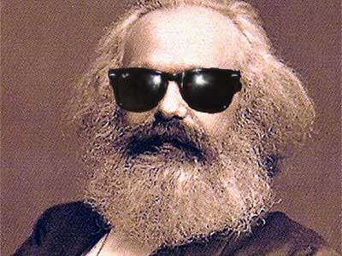
Theories theories and more Theories
Why?
We all use theories to guide us. We wonder about –why can’t I find a job, be rich? Why don’t my parents understand me? Or why can’t I understand my children? Why did that relationship not work?
We construct stories that seek to explain this wonderings.
Social theory is the same. It seeks to provide stories that explain our world. Why does it work this way, and not some other way.
It may even go further and seek to offer alternative visions of the future…
As Marx famously put it…
The philosophers have only described the world… the point is to change it.

Slide 7



Foundational Theoretical Perspectives in Sociology
(don’t worry, you don’t have to memorise these!)
Theoretical Perspectives | Level of analysis | Focus on
Functionalism: | Macro | Structures and institutions
Conflict (critical) theory: | Macro | Structures, Ideologies
Symbolic interactionalism | Micro | Human interaction and the construction of meaning
These are all considered modern theories (theories developed within modernity, specifically late modernity 1880-1960s)
They are influenced by the ideologies of the time (ideas about what is, and what ought to be).
Strongly influenced by a western world view (ethnocentrism). Often overlooked difference (e.g. gender and non-western contexts).
Creating “grand narratives” of society, people and social change.
Today we will explore Functionalistic and Conflict (or critical) approaches to theory

Slide 8
More recent developments in theory
Just as society is not static (fixed/unchanging) so to theories of society have changed and developed.
Some of these theories includes the Neo-Marxian theories, social exchange theory, Symbolic Interactionism, Feminism (including liberal feminism, radical feminism, black feminism, and other theories of gender, Structuration theory, Globalisation theory, Critical theories of Race and Racism, Postmodern theory(ies)
Decolonisation Theories
Indigenous theories (e.g. Kaupapa Māori Theory)

Slide 9
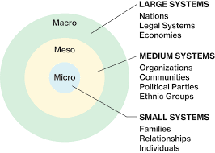
Sociological Levels of analysis

Slide 10
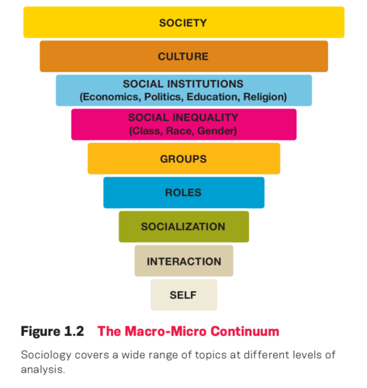
Sociological Levels of analysis

Slide 11
Key debates in sociology (and some more key ideas)
A big debate in sociology is the relationship(s) between structure and agency.
Structure (the social patterns through which a society is organized)
Agency (the ability to act or to effect change also the capacity of individuals to perceive their situation, reason about it, consciously monitor their action, form motives)
The structure agency debate is the question of how much the structures of society constrain or determine individual lives (or how much agency do we actually have).
Macro approaches tend to focus on the effects of structures on people. They understand the ways structure constrain options/choice
Micro approaches tend to focus on how the individual acts on their environments. They stress free will and choice.

Slide 12
Structuralism
Structure (the social patterns through which a society is organized)
Structuralism argues that modern societies are complex interconnected systems, or subsystems (e.g. economics, politics, culture), that together make up the whole of society.
And that….
Rather than individuals acting freely…
we are often influenced by objective forces that are both hidden and outside of our control.
“being human involves living in a world that has been determined”
“Men (sic) make their own history, but they do not make it as they please; they do not make it under self-selected circumstances, but under circumstances existing already, given and transmitted from the past” (Marx, 1851).

Slide 13
Functionalism
Developed from the “classic” sociology of Durkheim.
It is a structural perspective on society
Society can be seen to being held together by consensus (shared rules, morals, norms).
Our shared ideas create a collective conscience which binds society together.
Institutions (e.g. family, education, religion) are seen in terms of their function in maintaining society. Institutions were seen as part of a whole (like the organs in a body) requiring each to function properly and support the functioning of the others.
In modern societies the division of labour causes more interdependence (i.e. we need others to help us fulfil our needs) which in turn creates social solidarity.

Slide 14
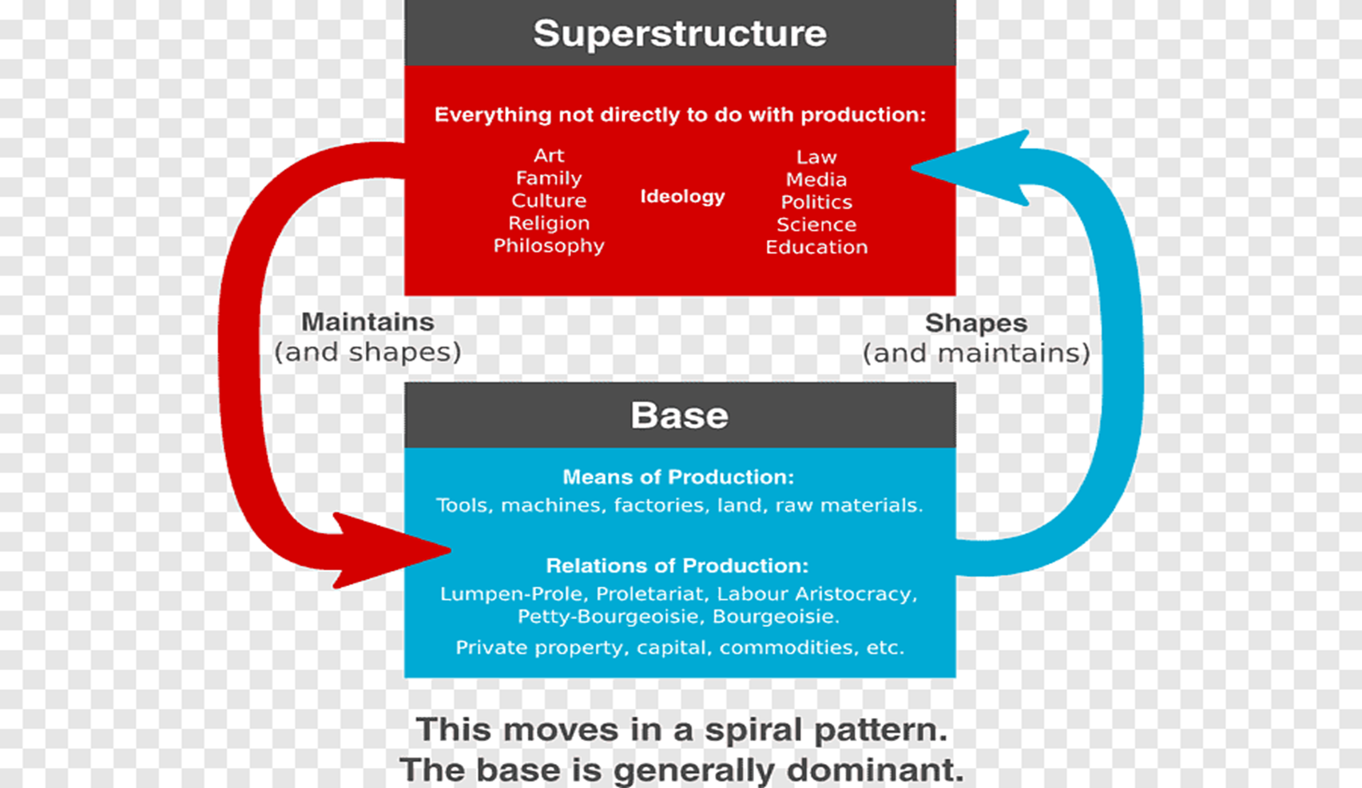
Conflict/Critical theory
Developed in the influential work of K Marx
He saw conflict, not consensus as being the key feature of society.
In particular, within capitalistic society, this is conflict between classes (i.e. the capitalist class expliting the working class)
Society was seen as having an economic base (substructure) – containing the forces of production and the relations of production And The superstructure – which contains the rest of society – including family, the education system, ideas and beliefs, the legal system, the political system.
The base is material while the superstructure is non-material (ideological)
The ideological elements of society create a false consciences about the true reality of exploitation
Watch https://youtu.be/UCSGGATWiQc (first 5 minutes)

Slide 15

Coffee (or non-caffeinated beverage of choice) break
“Coffee break” may impose a normative standard ☺
15
14
13
12
11
10
9
15mins
2
3
4
5
6
7
8
0
1

Slide 16
Group korero
What does inequality mean to you?
Are there different types of inequality?
Are some more important than others?
Discuss
Feedback

Slide 17
Inequality and Social Practice
Inequality is an issues for social work, as it forms a central part of the context of practice.
In our competencies as:
“Competence to promote the principles of human rights and social and economic justice” (Social Workers Registration Board [SWRB],2021).
It is also described internationally through the International Federation of
Social Work (IFSW) stating that “Social, Economic and Environmental Justice are fundamental pillars underpinning social work theory, policy and practice” (IFSW, 2020)

Slide 18

Defining terms: inequality
Inequality: is the condition in which members of society have different amounts of income, wealth, prestige or power.
It is the actual results of not having equality.
Early sociologists explored inequality of income and wealth sometimes known as economic inequality or resource inequality.
The economy is the way that resources get distributed. This means that we need to focus on the ways that resources are distributed by our current economic system.
The concepts of class and stratification help us understand how certain groups have advantages over other groups.
Ps. There are many kinds of inequality – of age, ability, gender, ethnicity, sexuality, etc

Slide 19
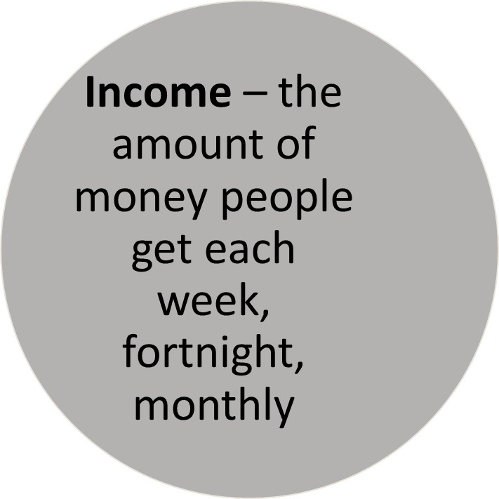
Defining terms: What’s the difference between income and wealth?
Wealth – assets (e.g. houses,) investments stocks, bitcoin, retirement funds or cash in the bank )

Slide 20
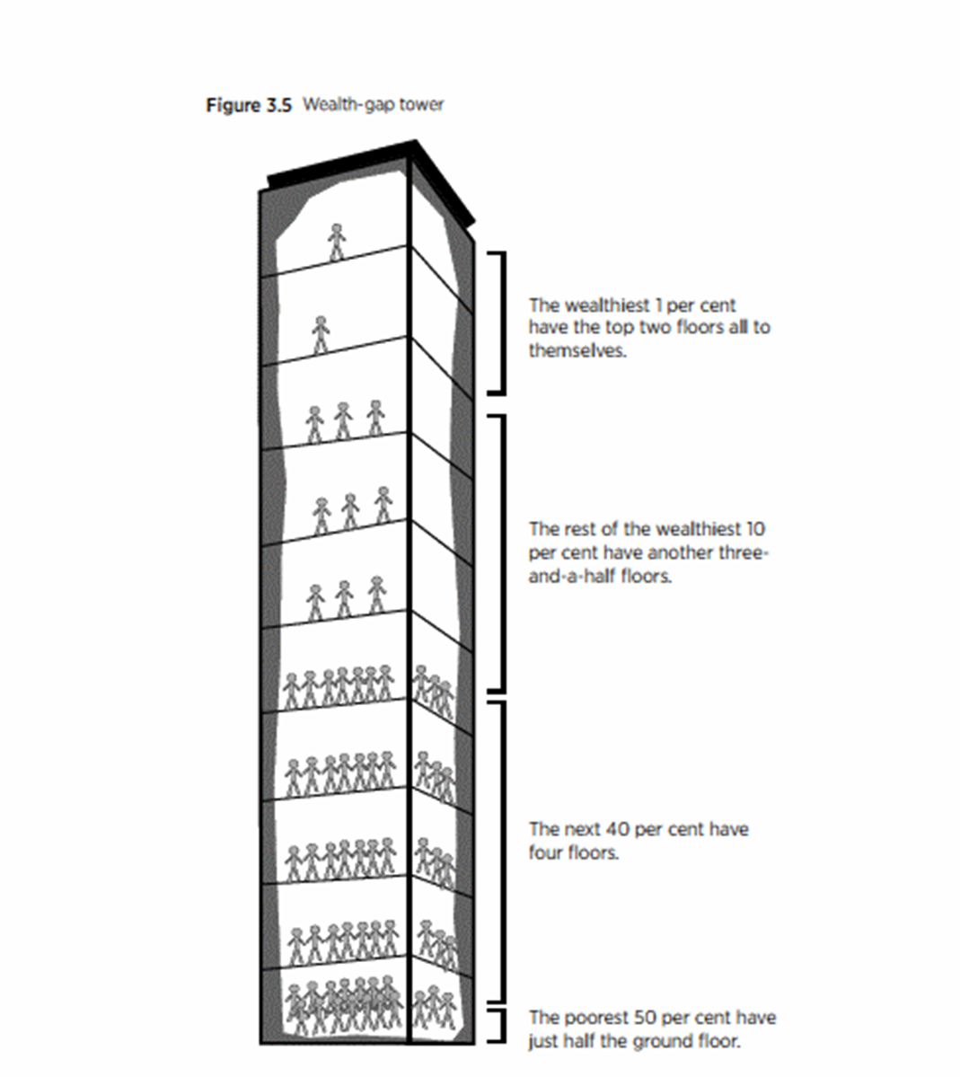
Wealth inequality
Wealth is typically much more unequally distributed than income: while the richest 10% of income earners have 27% of all after-tax income, the wealthiest 10% of asset holders have 59% of all wealth.
  Note that these are not necessarily the same people: those with high wealth may have low incomes, (e.g. an Auckland pensioner living in a $2 million house but relying on New Zealand Superannuation for income.
The intergenerational transfer of wealth, power, social position and status creates a legacy of historical (and contemporary) privilege long after the historic acts of acquisition have taken place.
This allows for certain advantages
  Inheritance
  Class advantages (e.g. health, education, housing)

Slide 21
Wealth inequality
The distribution of economic resources has been a perennial concern of developed societies because of its effect on individual life chances and the wider social fabric (Rashbrooke, Rashbrooke & Chin, 2021).
Having sufficient income and wealth is essential to an individual’s ability to lead a fulfilling life and pursue their goals (Rashbrooke, Rashbrooke & Chin, 2021).
Conversely, a lack of income and/or wealth may severely hamper an individual’s prospects (Rashbrooke, Rashbrooke & Chin, 2021).
Large inequalities of income and wealth may also lead to negative social outcomes and raise profound ethical questions (Rashbrooke, Rashbrooke & Chin, 2021).
Question: how can we understand inequality in a capitalist society?

Slide 22
Class
Answer: one way is to explore class.
Working definition: A division of social types
  Historical: Kings/Queens, Lords/Ladies, surfs or peasants
With Capitalism (especially industrial capitalism) things change.
Two different ways of explaining class.
Marx: The bourgeoisie (capitalists) and the proletariat (workers) classes
Weber: Class, Status and Power.

Slide 23
Defining terms: class
The concept of class is one of the most significant ideas in sociology.
Class: the division of a society based on social and economic status (e.g. the expression “people from different walks of life”, the haves and the have nots)
Class is the social divisions within a society based on access to income, wealth, status, and power.
The life experiences of each “class” will be different (often very different) .
What are some of the words that you have heard to describe this difference?
Class becomes stratified and social mobility limited.
Watch: Comedy sketch on class

Slide 24

Stratification
Stratification is metaphor drawn from geology
the study of rock layers (strata) and layering (stratification)

Slide 25
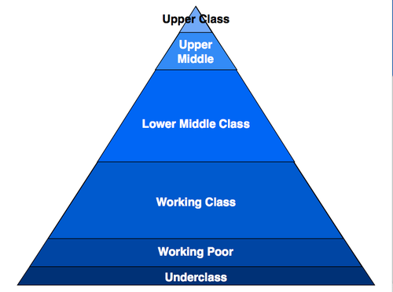
Defining terms: stratification
Put simply social stratification refers to the ways that groups of people are organised unequally within a broad social hierarchy
With this system a smaller number of people sit comfortably on the top while those below, increase in number (size of population) and experience more inequality the lower down the hierarchy.
The words used to describe these different strata and the amount of layers depends on different interpretations.
It is both a process (e.g. class reproduction) and a condition (relative inequalities)
Ps. There are many kinds of stratification – of age, ability, gender, ethnicity, sexuality, etc

Slide 26
Stratification is created!
“this hierarchal characterisation of society is a process in that it does not simply exist. Rather it is something that has been created and maintained…
it is a condition in that inequality is hardened or institutionalised and where there is a system of social relationships that determine who gets what and why” (Mayeda, 2013, p.80)

Slide 27
Sociology: Class, Inequality, Stratification, and Capitalism
Sociology has focused on Class, Stratification and Inequality within a context of Capitalism
Class and stratification identify what position people may occupy within a Capitalist system, but also, and importantly, how they come to occupy this position.
It is NOT seen as natural, but rather a product of social, economic, and political relations.
To understand class stratification and inequality we need to also understand Capitalism

Slide 28

Capitalism
Capitalism is an economic system based on the private ownership of the means of production and their operation for profit.
“A system of wage labour and commodity production for sale, exchange, and profit, rather than the immediate need of the producers” (Scott & Marshall, 2009, p.59).
Capitalism has been around for a long time, but modernity (particularly industrialisation) allowed it to be more productive (destructive?) than ever before.

Slide 29
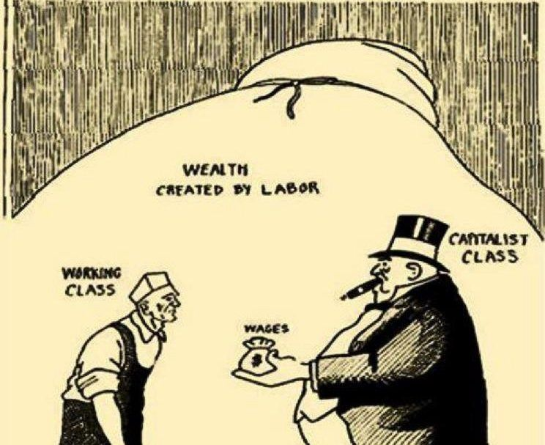
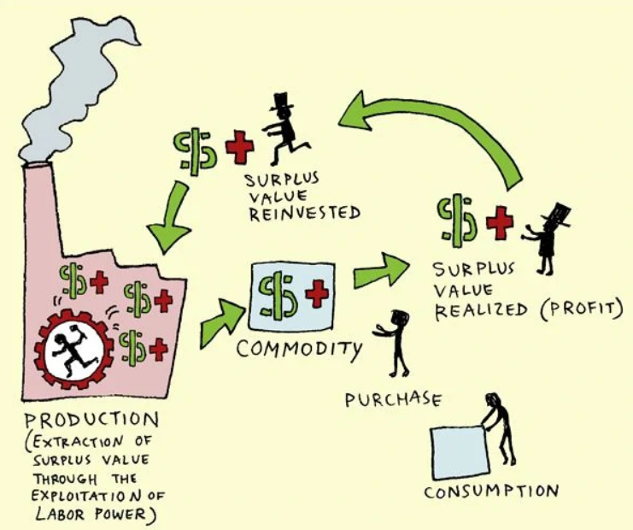
Capitalism
Capital creates Capital
Capital is created by purchasing commodities (raw material, machinery, labour) and combining them into a new commodity with an exchange value higher than the sum of the original purchase
This is made possible by labor power/workers (which themselves are turned into a commodity by capitalism, think about the term “human resources” department)
Workers earns a wage (exchange value) that is less than the value that is produced for the capitalist
The difference is termed “surplus value” and is retained by the capitalist (profit). This profit can be paid to business owners or reinvested to make more profit.

Slide 30
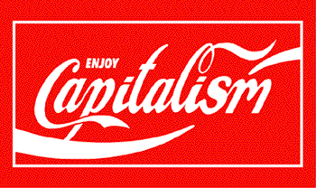
Capitalism
Is supported by a capitalistic ideology (private property, profit motive, also ideas like work-hard (work ethic), consume, “the rich are rich because they earned it”)
Capitalism requires social institutions, including: private property laws and enforcement, “free”/available labour, an extensive monetary system, market networks (for both raw materials and produced commodities), education, laws and legal systems and systems of policing.
These institutions present an ideology (a set of ideas about the world) that supports the status quo, and reflects the interests of the dominate (oppressor) class.
Subordinate classes take exploitative relations of production for granted, as something solid and unchangeable.
Hegemony describes the ways social institutions convince us that there is no alternative.

Slide 31

Ideology and Hegemony
With rising inequality, and a system that advantages the few over the many, how does capitalism continue to be supported?
Gramsci identified the ideological tool called hegemony.
Institutions, such as religion, schooling and the media, reflect and establish a particular view of the world; one which favours and reinforces the dominant ideology (and dominating ideologies) (Kellner, 2001; Mullay, 1997).
The dominant attitudes (and existing structures e.g. wealth inequality) become internalised and accepted as “common sense” resulting in a false consciousness in the subordinated classes (Ledwith, 2011).
Rather than needing to be coerced into an acceptance of the status quo, hegemony results in DOMINATION BY CONSENT

Slide 32
Marxist/ critical analysis of Capitalism
Capitalism contains inherent conflicts (contradictions).
Watch: David Harvey on The Contradictions of Capitalism
Class antagonisim, the interests of capital vs. the interests of the worker
Boom and Bust
Constant growth
Rising inequality
Capitalism needs unemployment
Reserve army of labour
  The unemployed or under employed
  a relative surplus-population is necessary for the demand and supply mechanism of the labour market.
  The availability of labour influences wage rates and the larger the unemployed workforce grows, the more this forces down wage rates; conversely, if there are plenty jobs available and unemployment is low, this tends to raise the average level of wages—in that case workers are able to change jobs rapidly to get better pay, or to argue for better pay in their current job.
Notes:
The separation of workers from the ownership of the means of production hid from view the actual process of exploitation. Marx called this “commodity fetishism” and ‘false consciousness’ in which workers saw themselves as being potentially equal with the capitalists (Marx, 1976, Capital Vol 1 pp.163-77). (ie Marx argues workers are conned and deluded into thinking they are getting a fair share of the market)
Highlight the importance of the ideas of “commodity fetishism” and ‘false consciousness’ in which workers saw themselves as being potentially equal with the capitalist. Idea of fair share and what makes it seem that way. Important to touch on surplus value.

Slide 33
Marxist analysis of Capitalism
Marx predicted the end of capitalism from (mostly) internal contradictions.
The competitive nature of capitalist property relations undermines capitalist development from within, leading to crises of production.
This is because the pressure for profits causes both a downward pressure on wages and the overproduction of goods. Effectively, the poverty of the workers undercuts the market for the goods, meaning that they cannot be sold, leading to economic slumps.
Marx argued that capitalist relations of production (private property) were holding back economic development and, eventually, this would lead to their overthrow.
Notes:
The separation of workers from the ownership of the means of production hid from view the actual process of exploitation. Marx called this “commodity fetishism” and ‘false consciousness’ in which workers saw themselves as being potentially equal with the capitalists (Marx, 1976, Capital Vol 1 pp.163-77). (ie Marx argues workers are conned and deluded into thinking they are getting a fair share of the market)
Highlight the importance of the ideas of “commodity fetishism” and ‘false consciousness’ in which workers saw themselves as being potentially equal with the capitalist. Idea of fair share and what makes it seem that way. Important to touch on surplus value.

Slide 34
Marxist analysis of class.
Conflict: Wage workers and capitalist employers are involved in constant struggle over the rate of exploitation. I.e. wages vs profit
The separation of workers from each other (the division of labour) and from any control over what and how things get produced (the ownership of the means of production) hide from view the actual process of exploitation (i.e. the appropriation of surplus value (profit) by the bourgeoisie/capitalists and paying workers the lowest amount possible).
This creates alienation (from the work itself and from other workers) and a false consciousness for workers (they may imagine they are lucky to have a job and do not see the relationship as one of exploitation)
Class relations are caused by the way society is Structured
Notes:
The separation of workers from the ownership of the means of production hid from view the actual process of exploitation. Marx called this “commodity fetishism” and ‘false consciousness’ in which workers saw themselves as being potentially equal with the capitalists (Marx, 1976, Capital Vol 1 pp.163-77). (ie Marx argues workers are conned and deluded into thinking they are getting a fair share of the market)
Highlight the importance of the ideas of “commodity fetishism” and ‘false consciousness’ in which workers saw themselves as being potentially equal with the capitalist. Idea of fair share and what makes it seem that way. Important to touch on surplus value.

Slide 35
Weberian analysis
Elements of Structual
agreed that capitalist society was best defined as a class society.
Classes as economic categories offering/giving similar life chances
Class was not as ridged as Marx described, but rather 2-way Mobility was possible
  Class is fluid – people move up and down – up mostly as a result of being sensible and increasing their SHARE of the market. Down through poor decisions ☹
  (does anyone remember YUPPIEs)
  Increasing market share by acting rationally (logically and in their own best interests).

Slide 36
Weberian analysis
Class (says Weber) is more than just an economic relationship. There are other forces involved
“Status” and “Party” also need to be considered.
Class
  Class groups have similar economic interests , material wealth, and opportunities for income
  These similarities provide members comparable life chances
  A class group is characterised by labour market conditions.
  Classes within class
Notes:
Highlight the idea of rationality – suggests choice – idea of people being able to barter what they happen to be born into (assets – knowledge – contacts – alliances with others / political groupings) into better positions in society – ie up the ladder. Could be very simplistically reduced to the notion that Weber says society CAN be fair and class is only one of many ways to describe differences in society and Marx says society CANT be fair and that production relations / expropriation of surplus means that society is inherently designed to suit the rich. Maybe important to contrast the two ideas (Marx / Weber) again and check how the ideas fit with peoples lived experience. – AND ask who benefits from each idea?

Slide 37
Weber and Status
  Status Is based on evaluations of honour or prestige within society
  We value things other than economic resources
    These value judgements can relate to things such as:
      Linenage, Education, Ethnicity, Religion, Gender, Ability…
      We may value some work more than other forms of work
  There may be some opportunity to gain prestige/status
  There may be some social restrictions on inter status relationships.
  Status may be displayed or hidden. (can you think of examples?)

Slide 38
Weber and Party
Membership of groups that seek power or influence
Parities mobilize members and resources to achieve common goals and membership gives individuals access to contacts, resources and a collective organization, increasing their ability to achieve their ends.
Networks
Clubs
Associations
Unions
Political parties

Slide 39
Group exercise.
Discuss class in groups.

Slide 40
References
Borell, B., Moewaka Barnes, H., & McCreanor, T. (2018). Conceptualising historical privilege: the flip side of historical trauma, a brief examination. AlterNative: An International Journal of Indigenous Peoples, 14(1), 25–34. https://doi.org/10.1177/1177180117742202
Bottero, W. (2005). Stratification social division and inequality. London ; New York: Routledge.
Giddens, & Sutton, P. W. (2017). Essential concepts in sociology (Second edition..). Polity.
Rashbrooke,M., Rashbrooke, G. and Chin, A. (2021). Wealth inequality in New Zealand
An analysis of the 2014-15 and 2017-18 net worth modules in
the Household Economic Survey. Retrieved https://www.wgtn.ac.nz/__data/assets/pdf_file/0007/1935430/WP-21-10-wealth-inequality-in-New-Zealand.pdf
Marx, K. (1851). The Eighteenth Brumaire of Louis Bonaparte. Retrieved https://www.marxists.org/archive/marx/works/1852/18th-brumaire/ch01.htm
Mayeda, D. (2013). Stratifying:Inequalities. In S. Mattehwman, C. West-newman and B. Curtis (eds). Being Sociological. NY, New York, Palgrave.
Scott, J., & Marshall, G. (2009). A dictionary of sociology (3rd ed. rev.. ed., Oxford paperback reference). Oxford: Oxford University Press.

