Slide 1

Looking back to move forward: Drivers of change.
Ideology, Imperialism, Colonisation, Colonialism, Capitalism, Industrialisation, Modernization, Urbanisation

Slide 2
Karakia | MANAWA MAI
Manawa mai te mauri nuku
Manawa mai te mauri rangi
Ko te mauri kai au
He mauri tipua
Ka pakaru mai te po
Tau mai te mauri
Haumi e, hui e, taiki e
Embrace the life force of the earth, embrace the life force of the sky
The life force I have fathered is powerful, and shatters all darkness
Come great life force,
Join it, gather it, it is done

Slide 3
Waiata | Purea nei
Purea nei, e te hau
Horoia, e te ua
Whitiwhitia, e te ra
Mahea ake nga, poraruraru
Makere ana, nga here
E rere, wairua, e rere
ki nga ao, o te rangi
Whitiwhitia, e te ra
Mahea ake nga, poraruraru
Makere ana nga here (x2)
https://youtu.be/wRWwrdRjkDA

Slide 4


Slide 5

Agenda
Quick review of last week.
Highlight some key concepts
Discuss “what make us ‘Modern’.
Explore social change (if we are modern, how did we become ‘modern’
Explore the links between capitalism (a central driver of modern societies) and colonisation
Continue to not freak you out!

Slide 6
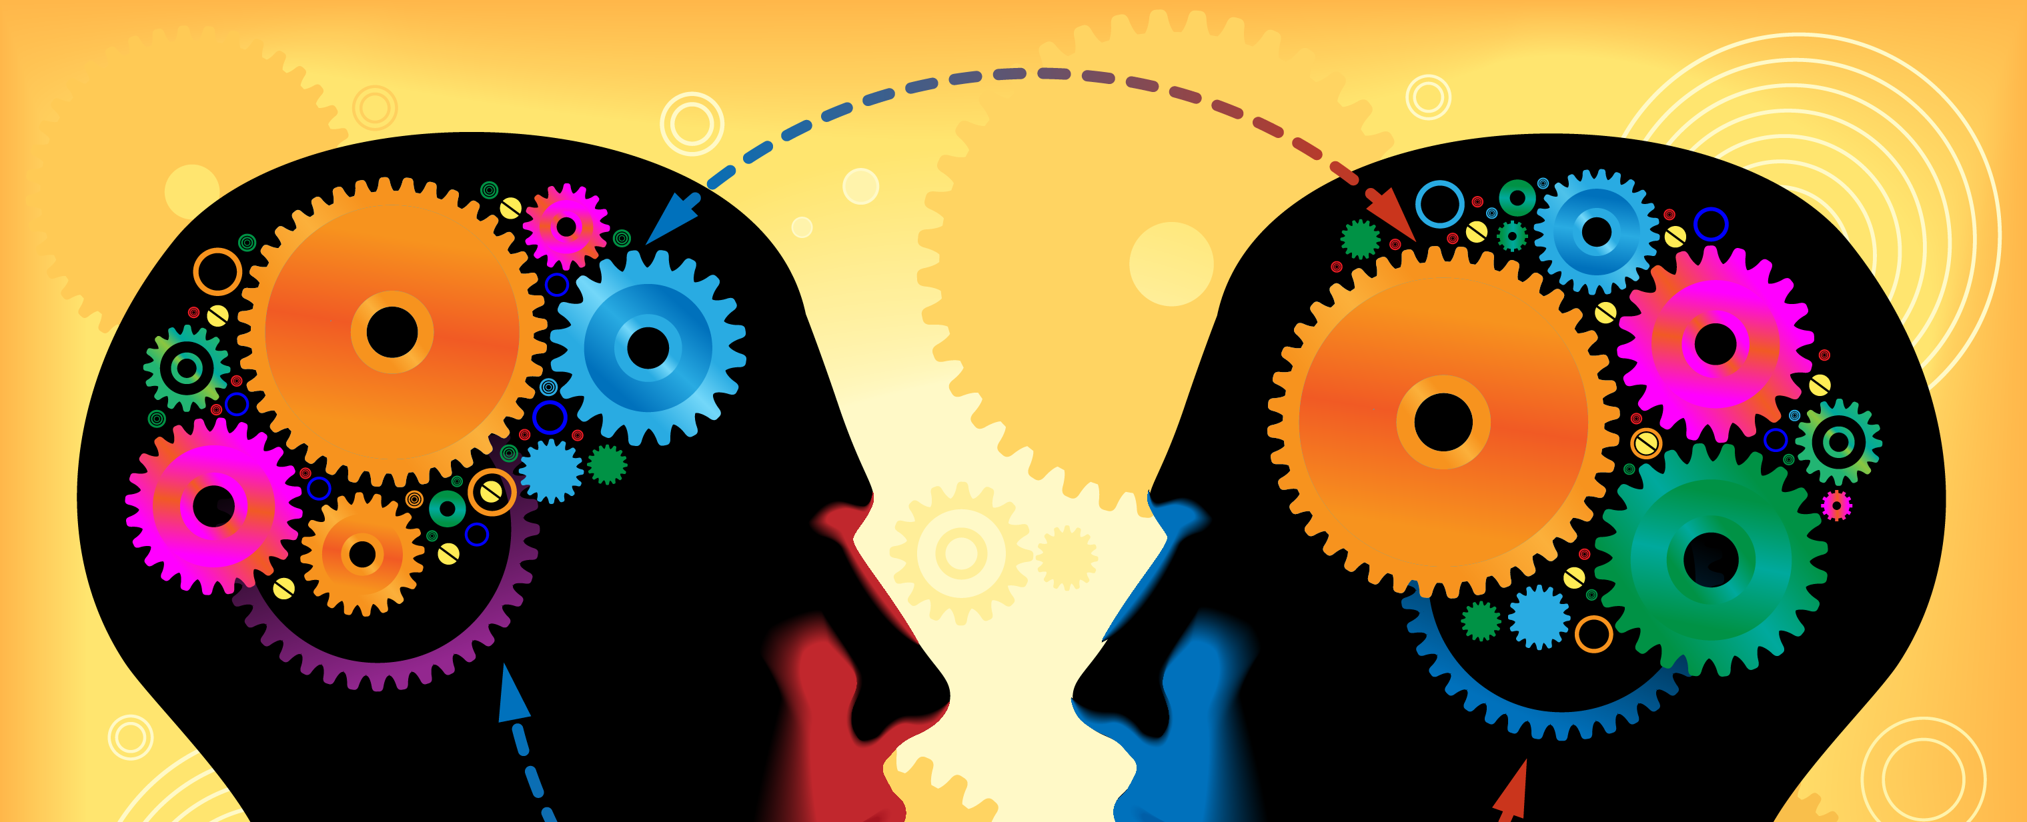
Remember last week?
What did we cover?

Slide 7
Remember “theory” from last week
What is theory?
Sociologists make social theory “in order to understand the world better” (Becker cited in Mathewman and West-Newman, 2013, p. 13)
Theories draw attention to features of society that would otherwise remain hidden (Mathewman & West-Newman, 2013).
Theory involves the development of specific concepts that have explanatory value.

Slide 8
Ideology
A “set of ideas” or a belief structure.
Often used to talk about political (or power) ideas
In critical theory: ideology (or ideologies) reflect the thinking and interests of the dominant groups of society.
Ideology can therefore be seen as hiding the true motives of those in power.
Marxists may talk of Capilatisitc Ideology (the ideology that supports Capitalism)
Feminists may talk of Patriarchal Ideology (the ideology that support men’s power over society)
Ideologies may refer/draw from other ideologies (e.g. Capitalism draws from ideologies about individualism).

Slide 9
Hegemony
Gramsci identified the ideological tool called hegemony to explain the ways that oppressing groups continued their domination of oppressed groups.
Hegemony operates through an attempt at the monopolisation (sole control) of meaning by socially dominant groups.
Institutions, such as religion, schooling and the media, reflect and establish a particular view of the world (the meaning of things); and it is one which favours and reinforces the dominant ideology (Kellner, 2001; Mullay, 1997).
Through control of these institution the socially dominant groups can shape the ways issues are both understood and presented.
The dominant attitudes become internalised and accepted as “common sense” resulting in a false consciousness in the subordinated classes (Ledwith, 2011).
Rather than needing to be coerced into an acceptance of the status quo, hegemony results in DOMINATION BY CONSENT

Slide 10
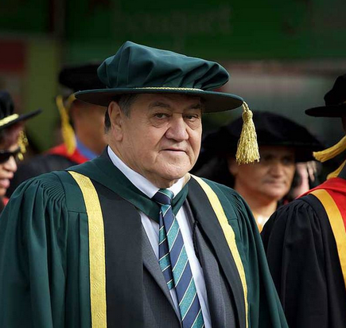
Professor Graham Hingangaroa Smith: Hegemony
“Hegemony is a way of thinking – it occurs when oppressed groups take on dominant group thinking and ideas uncritically and as `common-sense’, even though those ideas may in fact be contributing to forming their own oppression. …
It is the ultimate way to colonize a people; you have the colonized colonizing themselves!” (Smith, G, 2003).

Slide 11
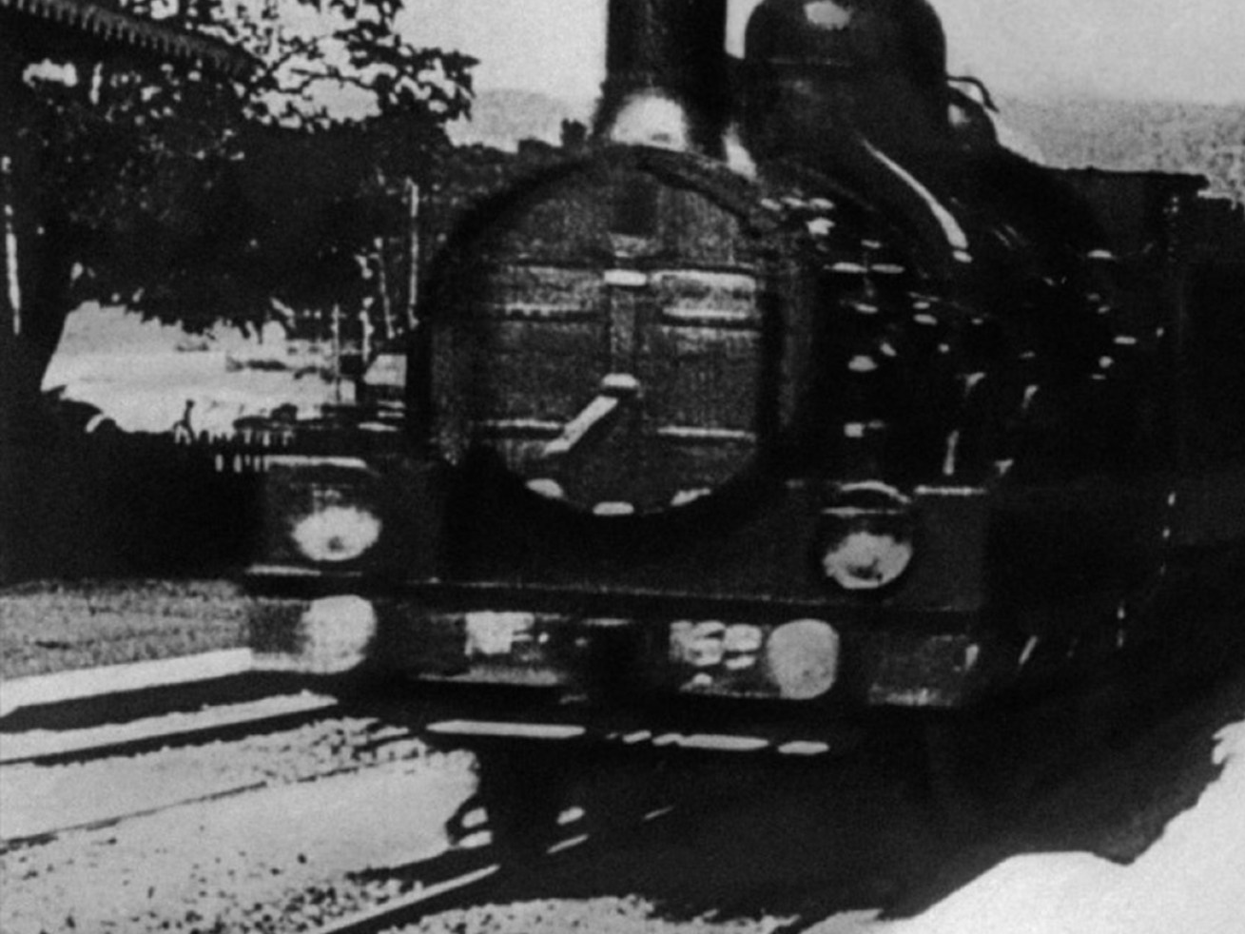
Introduction to the modernity thesis

Slide 12

The modern: modernity
  In popular use modern is thought of anything new.
  Is sociology however it has a particular meaning
  Modernity is a time period (from 19th century to the late 20th century, 1800-1960-ish)
    It is seen as a period of huge social change that fundamentally changed the ways that societies organise themselves
  Some would argue that we have actually left this time period.
    That we now live in a new type of world (e.g. post industrial, post modern, hyperreality)

Slide 13
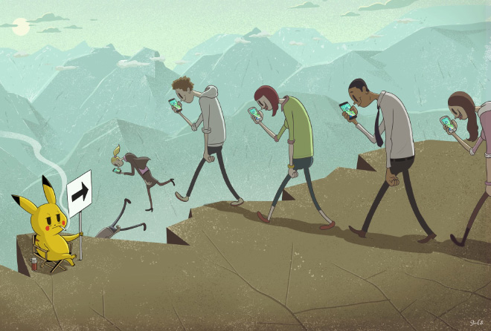
Modernity has been about change
What are some changes that you have seen in your life time?
Discuss.
Think about other changes in social life between you and the two generations before you. When they were young, could those people be openly gay or trans? Was same-sex marriage an option for them? Was divorce? Could women work after marriage? If so, in what jobs? Could they afford a house? Did people have the option to undertake tertiary study? What did mental health provision look like? Could children speak Māori at school? Did teachers (and parents) practise corporal punishment? And how did people have a social life before the internet was invented?

Slide 14
A “blip” in time
The modern nation-state is only a couple of centuries old.
With the majority of the world’s states (what we call countries) only becoming independent after World War 2)
Industry (or industrialisation/the process of industrialising) has been experienced for less than 300 years.
In this 300 years, and particularly over the last 100 or so years, most of the planet has been impacted either directly or indirectly by industrialization.

Slide 15

What were the central changes/ influences that led to modernity?
Sociologists love the term revolution
They identify 3 revolutions
The Enlightenment 1730s- 1840
  An ideological revolution
The French revolution 1789-180
  A political revolution
The industrial revolution 1780- 1840
  A socio-economic revolution

Slide 16
Timeline (not to scale!)
The enlightenment 1730-1800
1500
1850
French rev 1789-1804
Industrial rev1780-1840

Slide 17
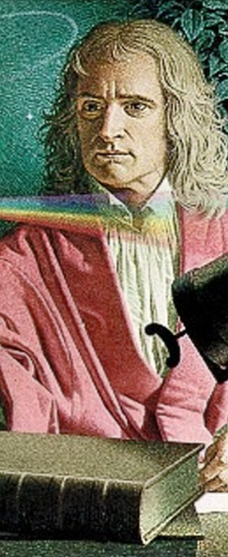
The Enlightenment:
an ideological change
C17th & C18th liberal intellectual movement
The enlightenment was centrally an “idealist” phenomenon
It was believed that the right sort of ideas would produce a more “rational” and free society
Ideas included
Rationalism and Reason
  Prejudices can be corrected under the application of pure reason (we can be objective)
Science
  Empiricism (observation, measurement, facts)
And progress

Slide 18

The Enlightenment: an ideological change
Other ideas included human’s domination of nature
Individualism as a dominant ideology
Commitment to science, critique/rejection of superstition, and religious dogma
Universalism
Reason science and progress were applicable to all of humanity
The west and the rest
  The west (from a western perspective) was seen as being more “advanced” that other cultures.
Colonisation brought these ideas to, so called “primitive” societies.
  Eurocentrism, Racism, ideologies of supremacy, ideologies of “civialisation”.

Slide 19

The Enlightenment: an ideological change
According Habermas (1987) “the enlightenment sets the project of modernity’ in motion”
A culture of rationalism and individualism with a belief in ever better (never ending?) progress
Enlightenment was seen as a journey to individual and human freedom

Slide 20
The French Revolution:
A Political change
1789
Described as the “invention of modern political life”
Opposed the Absolutism of the monarchy
Democratic government
Active individual citizenship
Liberal democratic ideologies
  Liberty (Freedom), Equality.
The first modern nation-state
Significant effects on the thinking of other parts of Europe
It was violent and bloody.

Slide 21

The French Revolution:
A Political change
Freedom dreams
Revolutions
Rights (for some)
Citizenship
Democracy

Slide 22
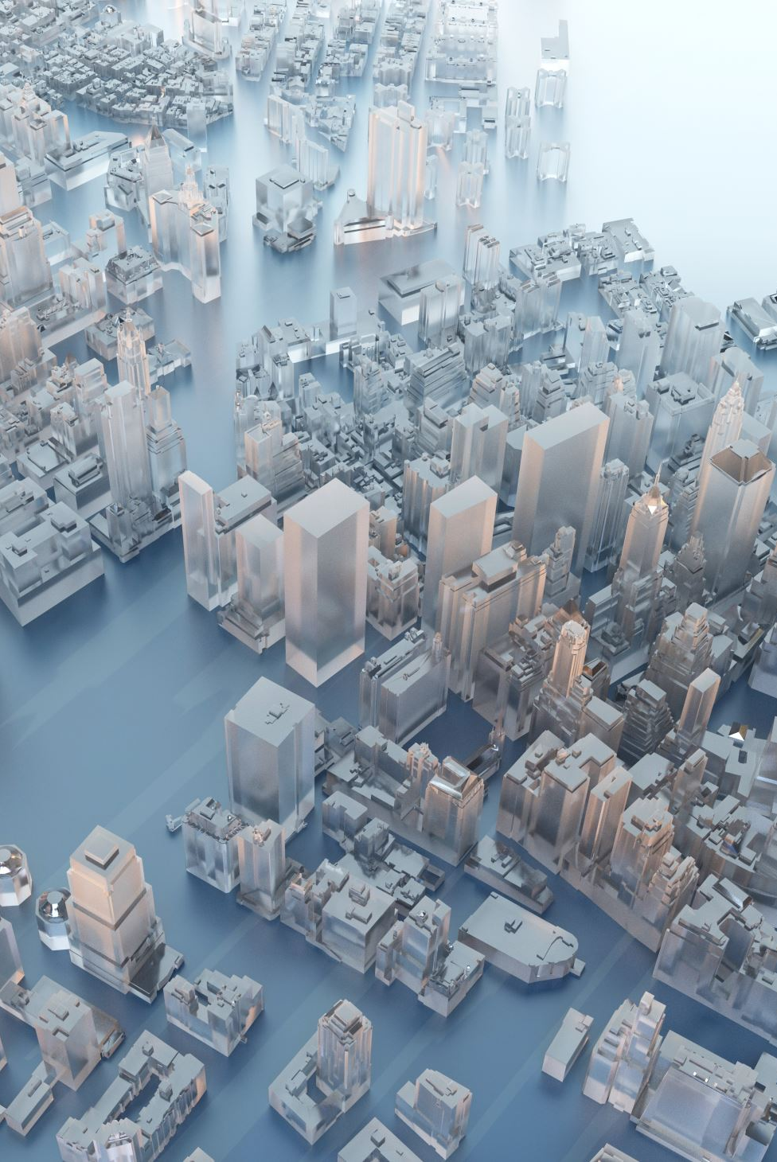
The Industrial Revolution a technological and a Socio- economic change
Late C18th, early C19th – beginning in Britain
Invention of modern economic life
  Industrial Capitalism
Rise of the factory system
  Watch: https://youtu.be/3Efq-aNBkvc

Slide 23
The Industrial Revolution a technological and a Socio- economic change
Division of labour (specialisation)
Massive increase in economic output
Massive increase in wealth & living standards (though unevenly distributed)
Changes in ways of living
  Cities/urbanisation
  Transport
  Communication mediums
  Mass communication mediums

Slide 24
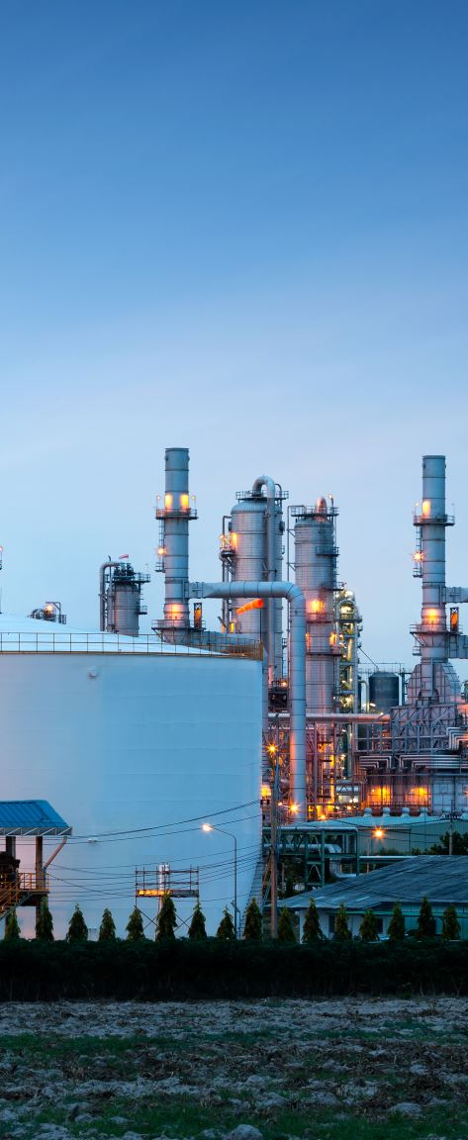
The Industrial Revolution a technological and a Socio- economic shift
The industrial revolution was not a single event, but many interrelated developments
Large numbers of people left the land to work in new factories
  The factories, in turn, were transformed by other technological developments
Rise of large economic bureaucracies to provide services to industry and the emerging capitalist economic system
A belief in the need of a free market
The beginning of labour movements

Slide 25
Break

Slide 26
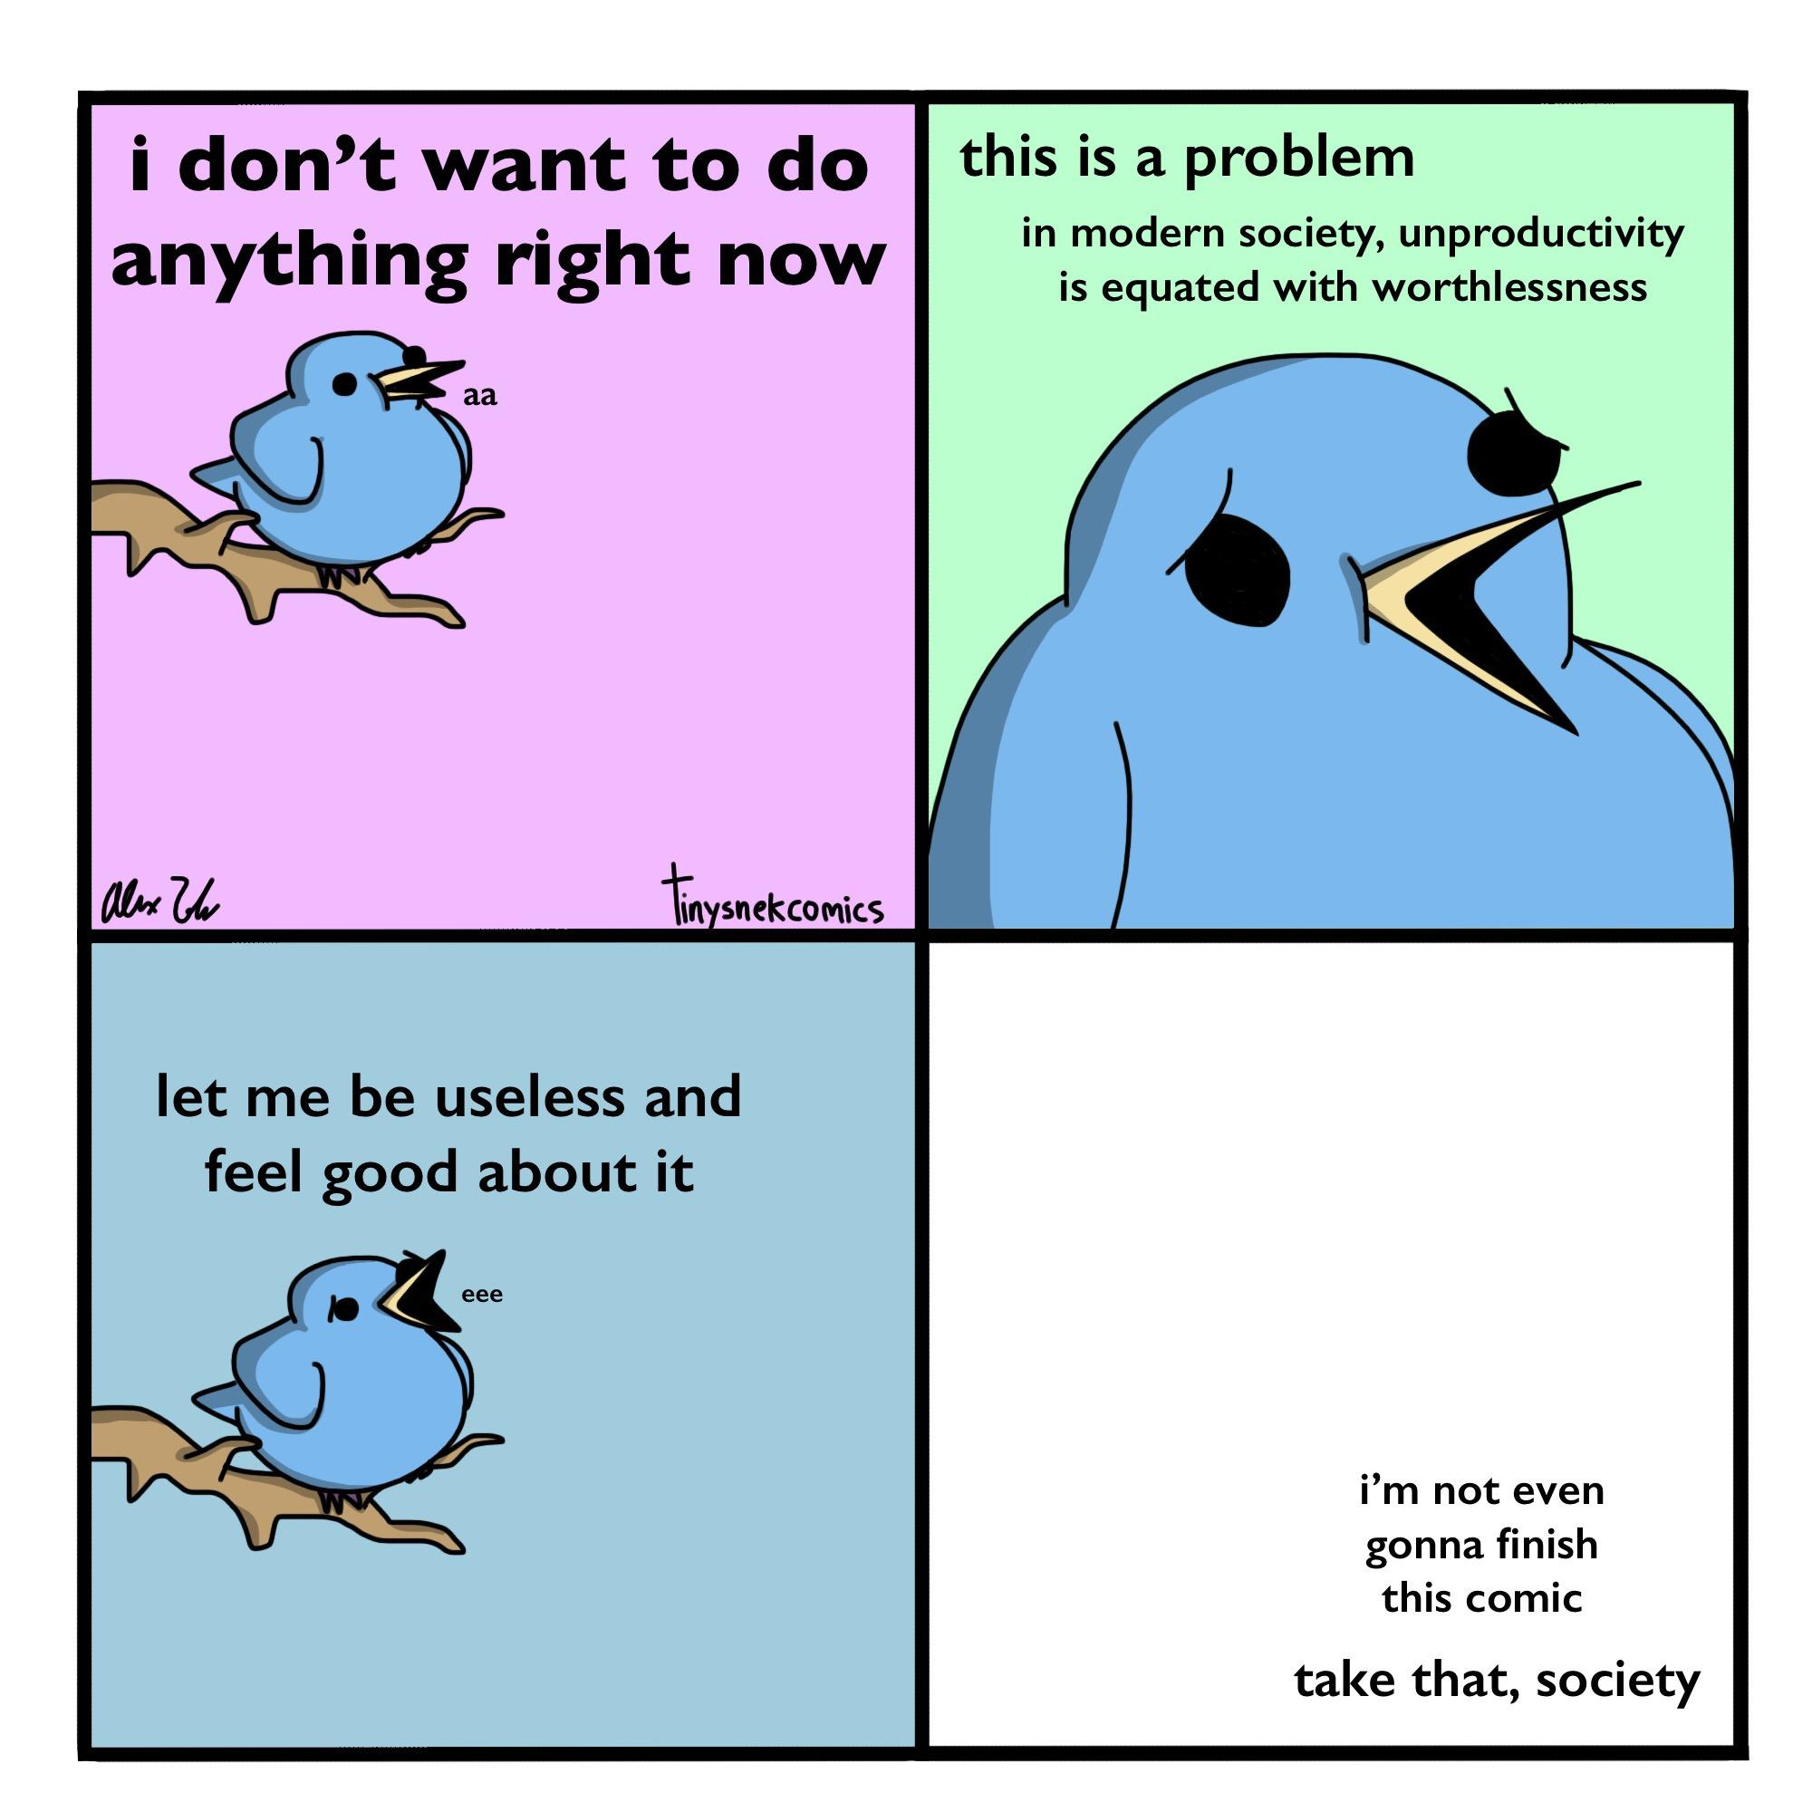

Slide 27

Toward a theory of modernity
Sociology began as an attempt to understand the word (as it was) and how it was changing.
It was a response to the rapid social, political and cultural change(s) that were effecting Europe
Some cautions!
Sociology has created a story (a discourse) of modernity (in doing so it may silence other stories).
  Power is obviously an issue here
It has come from a particular intellectual tradition: Eurocentric (from a “western” view) and androcentric (from a masculine point of view).
  Contemporary sociology has sought to address these limitations and biases

Slide 28
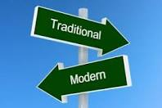
From traditional to modern
Modernity is often contrasted with pre-modern, or pre-industrial or “traditional” society.
There is no one kind of traditional society!

Slide 29
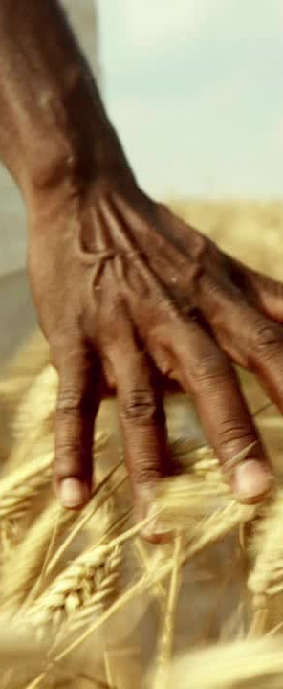
Traditional societies
Sociology has often contrasted modernity with traditional or pre-modern society.
Crone (2015, cited in McLennan, McManus, Matthewman, Brickell & Spoonley, 2019, p.29-30) summarises traditional societies as being defined by the following features. They:
  Are rural and agricultural
  Have subsistence economies defined by scarcity
  Are on a small scale (typically based on households and regions)
  simple divisions of labour
  Are based on ascribed status/lineage: you are who you are born to
  Assert the importance of the group (social roles) over individuals (self-actualisation)
  Have politics as an elite only activity
  Change slowly: traditional societies are stable and coherent

Slide 30
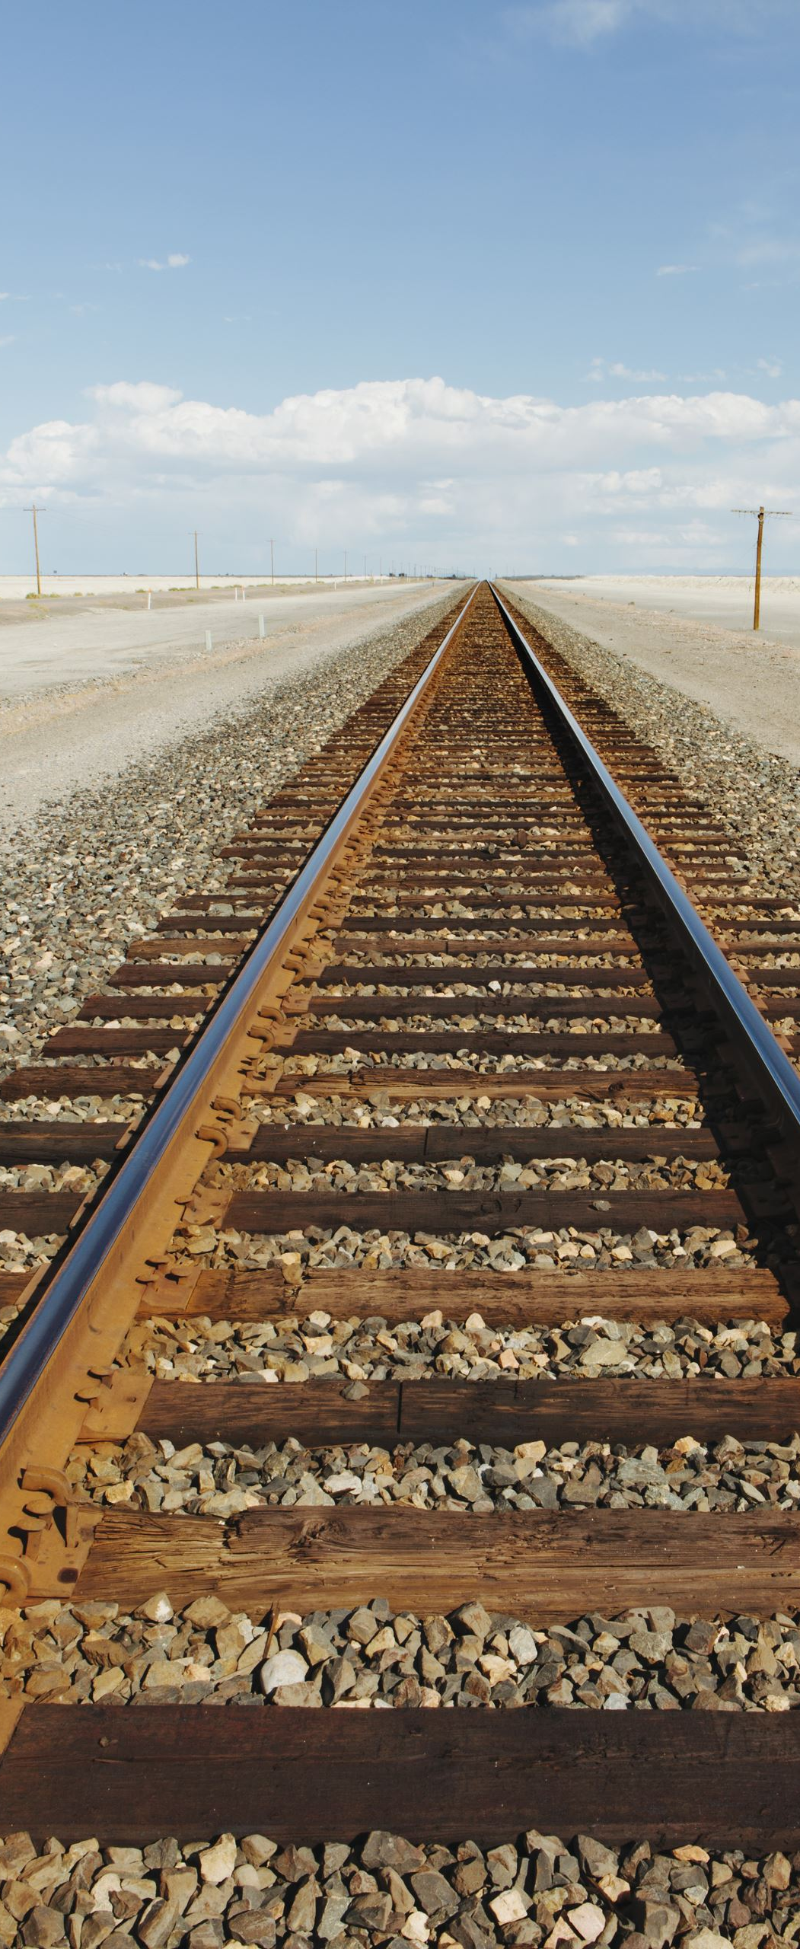
Modern societies
Secular rather than religious
Capitalist, rather than feudal/ slave based or socialist in economic structure
Industrial rather than pre- or post industrial
Dynamically mobile
  Transport, Railway and Trains, roads and automobiles, sea-travel airtravel
  communications
Individualism as a powerful ideology
Urban rather than rural
Democratic in political ideology
A mass society, in terms of access to basic goods and rights
  (McLennan, Ryan,& Spoonley, 2000).

Slide 31

Capitalism
Capitalism is an economic system based on the private ownership of the means of production (the stuff and the things that make the things) and their operation for profit.
“A system of wage labour and commodity production for sale, exchange, and profit, rather than the immediate need of the producers” (Scott & Marshall, 2009, p.59).
Capitalism has been around for a long time, but modernity (particularly industrialisation) allowed it to be more productive (destructive?) than ever before.

Slide 32
Colonisation and Imperialism
Colonisation is a process whose primary purpose is the forced transfer of power, resources and status from one group to another (Billig, 1995; Smith, 1999 cited in Borell, Moewaka Barnes & McCreanor, 2018).
At its heart it involves historical acts of dispossession for indigenous people: dispossession of their lives through acts of war and violent destruction of people and property, and the dispossession of lands and other material resources often resulting in starvation and material poverty (Borell, Moewaka Barnes & McCreanor, 2018).

Slide 33
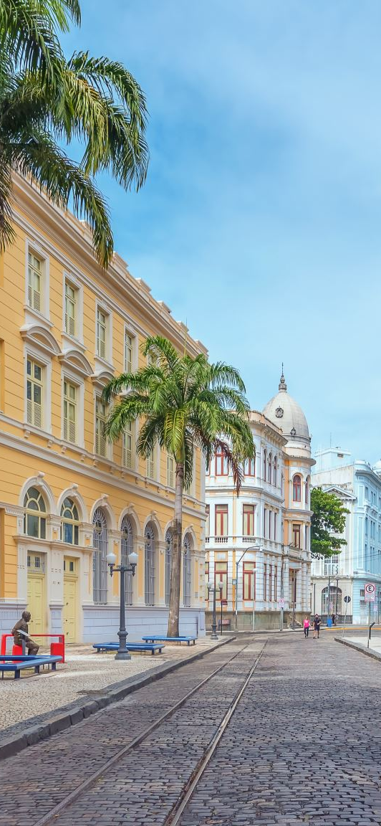
Colonisation,
Imperialism, Colonialism
Colonialism refers to the attitudes and ideology that accompanies colonisation (Said, 1993).
It represents a belief on the part of the colonisers in the superiority of their own culture, values and political or economic systems over that of others, and this justifies imposing their own “naturally superior system on others for their own good.
Indigenous people were also often expressly prohibited from practising their own cultural traditions (Voyce, 1989, cited in Borell, Moewaka Barnes & McCreanor, 2018) resulting in the dispossession of long-held models of collective healing and the social and cultural structures that maintained social order.

Slide 34

Colonisation and Capitalism
There is a strong link between capitalism and colonisation
Capitalism expands as it seeks new markets and new raw materials.
Colonisation is a process whose primary purpose is the forced transfer of power, resources and status from one group to another (Billig, 1995; Smith, 1999 cited in Borell, Moewaka Barnes & McCreanor, 2018).
At its heart it involves historical acts of dispossession for indigenous people: dispossession of their lives through acts of war and violent destruction of people and property, and the dispossession of lands and other material resources (Borell, Moewaka Barnes & McCreanor, 2018).
Colonisation imposes its economic, political, social and cultural arrangements within the territory it is colonising.
Indigenous peoples are forced to integrate into this new arrangement in order to survive.
As they may no longer have access to material resourses they are forced to engage with capitalism (usually as labour).

Slide 35
Colonisation and Capitalism
Indigenous people were also often expressly prohibited from practising their own cultural traditions (Voyce, 1989, cited in Borell, Moewaka Barnes & McCreanor, 2018) resulting in the dispossession of long-held knowledges, including models of collective healing and the social and cultural structures that maintained social order.
Colonisation introduces a new dominant ideology that seeks to impose itself.
It does so through the establishment of new social institutions (laws, education, media, etc…)
Remember hegemony?
Cognitive imperialism: “the imposition of one way of knowing as a norm through a relationship of domination”.

Slide 36

Aotearoa and colonisation
In Aotearoa the establishment of colonisation brought into contact a people (Europeans; with a distinct tradition of economic and social organisation and associated ideologies) with an indigenous population (Māori) who possessed a very different mode of providing for their own existence (e.g. traditional kinship structures, gardens, hunting, kai gathering, trade).
This brought into conflict agents of the capital class (with ideas of private property, industrial production) with Maori society and its system of rights, mutual obligations and it's own political authority.
Many hapu and iwi resisted (and continue to resist) this process, but the creation of capitalism in Aotearoa was the result of decades of coercive and violent measures.

Slide 37
Break

Slide 38
references
Cunningham, J. & Cunningham, S. (2008). Sociology and social work. Exeter: Learning Matters
Dominelli, L. (1997). Sociology for social work. London: Macmillian Press
Matthewman, S. (2013). Introduction: On being sociological. In S. Matthewman, C. L. West-Newman & B. Curtis (Eds.). Being sociological. (p.1-24).New York: Palgrave Macmillan.
Matthewman, S. & West-Newman, C. L. (2013). Controlling:power. In In S. Matthewman, C. L. West-Newman & B. Curtis (Eds.). Being sociological (2nd Ed), (p.63-78).New York: Palgrave Macmillan.
McLennan, G., Ryan, A., & Spoonley,, P. (2000). Exploring Society: Sociology for New Zealand students. Auckland: Pearson Education.
McLennan, G., McManus, R., Matthewman, S., Brickell, C., & Spoonley, P. (2019). Exploring society : Sociology for New Zealand students (Fourth ed.). Auckland: Auckland University Press.

Slide 39
Karakia whakamutunga:
Kia tau
Kia tau
kia tātou katoa
Te āio, te aroha me te marutau
Tihei Mauri Ora

