Slide 1
HAWKINS SESSION
Welcome to
ESTIMATION AND tendering 2023
Estimate including Tender Process
NOVEMBER 2023

Slide 2
Why are you studying this Course?
The aim of this course is to enable you to:
To develop an understanding of the key processes and techniques undertaken to secure work.

Slide 3
  Learning Outcomes
After successfully completing this module, participants will be able to:
Demonstrate knowledge of the Estimating Process for a Tender Submission by applying this to a case study.
Demonstrate knowledge of the key factors influencing decisions in the Tender Process and Analyse the reason for the decision made during the tender process.
Demonstrate knowledge of the appropriate Communication Skills needed for the tender process.

Slide 4
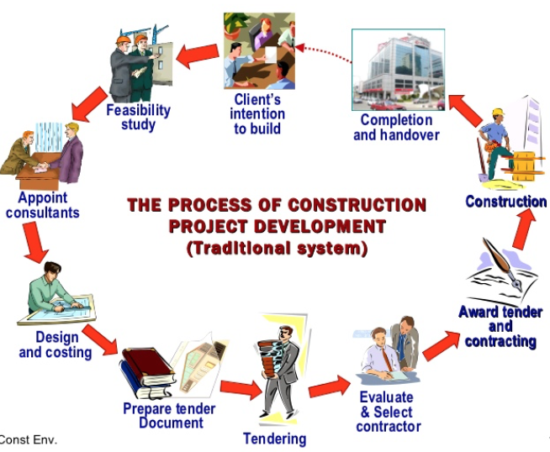
Exploring the Theme
(Sxsw Construction Environment, 2011)

Slide 5


Estimation Phase
The Early Stages of a Contract
Concept Design
Preliminary Design
Documents used for Tender Estimate
Developed Design
Basic elemental estimating
Detailed Design
Estimating using sub-elements and approximate quantities
Estimating using detailed Trade-based quantities and rates

Slide 6
Superficial or Functional Estimating ($/m2 or $/unit) techniques
CONCEPT DESIGN
Establish Budget / Feasibility
PRELIMINARY DESIGN
DEVELOPED DESIGN
Elemental Estimating
Control within the Budget
Estimation in Design Phase leading to Tendering Phase
DETAILED DESIGN
Schedule of Quantities
&
Unit Rate Estimating
Tendering Process
Stage 1 to Stage 6
Tender Quotation / Estimate
TENDERING

Slide 7
Functional Unit Method
Examples of cost per functional unit:
(Used at Stage A – Briefing – Inception)
Schools, universities, colleges - per student
Hotels, hospitals - per bed
Restaurants, cinemas - per seat
Car parks - per car

Slide 8
Functional Unit Method cont.
Example:
Hospital of 340 beds
Cost per bed = $140,000
Total estimated cost = 340 x $140,000
= $47,600,000
Separate allowance must be made for site works and external services

Slide 9
Superficial Method
Cost per square metre of floor area:
(Used at Briefing Stages A - Inception and Stage B – Feasibility)
Example:
Project of 852 m²
Cost per m² = $1,406
Total estimated cost = 852 x $1,406
= $1,197,912

Slide 10
Job Name: BioTech Office Building (Campbell)
Element No. | Element Name | Element % | Elemental Rate $/m2 | Element Total
1 | Site Preparation | 1.87 | 46.97 | 181,647
2 | Substructure | 5.83 | 146.89 | 568,038
3 | Frame | 7.17 | 180.64 | 698,544
4 | Structural Walls | 3.42 | 86.11 | 333,003
5 | Upper Floors | 6.60 | 166.17 | 642,587
6 | Roof | 4.19 | 105.55 | 408,145
7 | Exterior Walls & Exterior Finish | 5.48 | 137.95 | 533,462
8 | Windows & Exterior Doors | 8.98 | 226.02 | 874,018
9 | Stairs & Balustrades | 1.01 | 25.55 | 98,811
10 | Interior Walls | 1.96 | 49.27 | 190,522
11 | Interior Doors | 1.80 | 45.28 | 175,112
12 | Floor Finishes | 2.92 | 73.55 | 284,411
13 | Wall Finishes | 2.20 | 55.39 | 214,198
14 | Ceiling Finishes | 1.70 | 42.68 | 165,029
15 | Fittings & Fixtures | 1.12 | 28.19 | 109,028
16 | Sanitary Plumbing | 3.32 | 83.52 | 322,981
17 | Heating & Ventilation Services | 8.11 | 204.09 | 789,230
18 | Fire Services | 1.66 | 41.72 | 161,320
19 | Electrical Services | 6.52 | 164.25 | 635,156
20 | Vertical and Horizontal Transportation | 2.42 | 61.03 | 236,000
21 | Special Services | 0.54 | 13.58 | 52,510
22 | Drainage | 0.58 | 14.57 | 56,330
23 | External Works | 0.00 | 0.00 | EXCL
24 | Sundries | 0.39 | 9.81 | 37,928
25 | Preliminaries: 8% of Sub-Total El 1-24 | 6.38 | 160.70 | 621,441
26 | Margin: 5.5% of Sub-Total El 1-25 | 4.74 | 119.32 | 461,420
27 | Contingency: 10% of Sub-Total El 1-26 | 9.09 | 228.88 | 885,087
GFA: | 3,867 | 100.00 | 2,517.70 | 9,735,957
 |  | Final Total |  | $ 9,735,957
 | Exclusions

Slide 11
Question
Why do we need to know how much the Estimate Cost for the Tender is at this early stage?
Why do we need to know the Elemental breakdown of Estimate cost at this early stage?

Slide 12
Exercise - Estimation
Prepare a Preliminary Cost Plan Estimate for a Proposed New Biotech Office Building with a GFA of 7,734.00 m2

Slide 13
Tendering Process
The Tendering Process can be express on the following Line-flow diagrams according to stages of the tendering process:
The Clients’ perspective
Stage 1 – Initial actions & appraisals:
Stage 2 – Project appreciation & enquiries
Stage 3 – Resource & Preparation of the Estimates
Stage 4 – Adjudication meeting
Stage 5 – Tender submission
Stage 6 – Follow up action

Slide 14
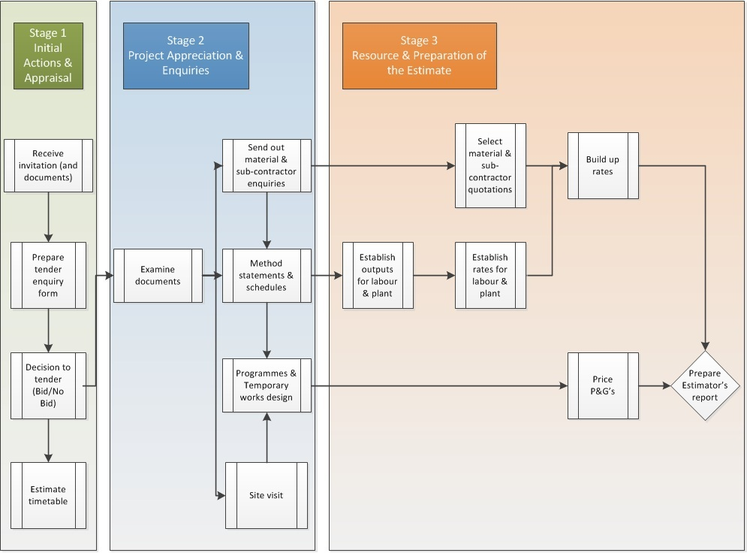

Slide 15
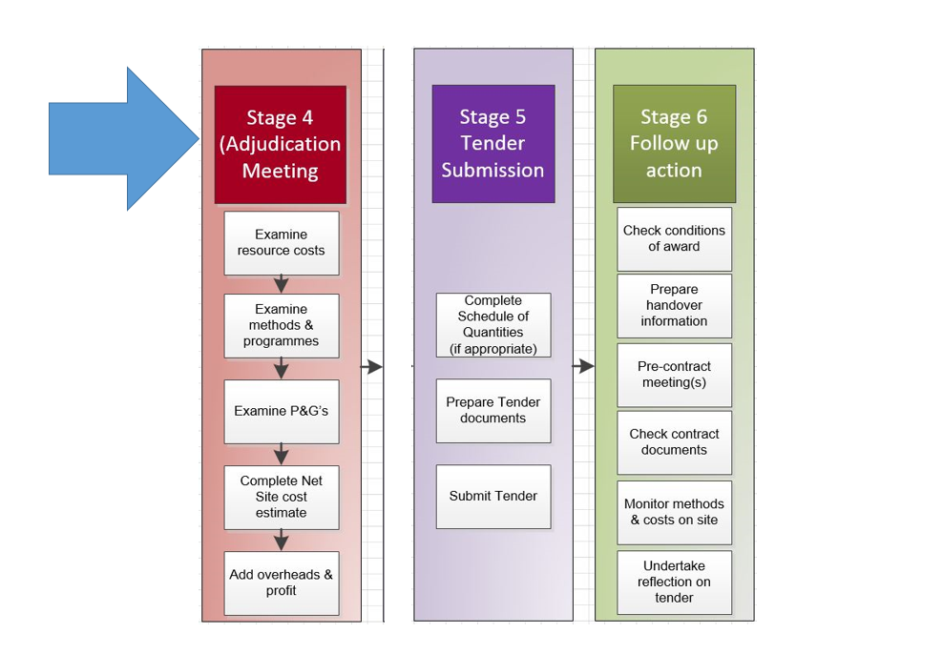

Slide 16
Procurement Options
Why are there different procurement options?
What impact do you think this will have on tendering?

Slide 17
Why???
Design responsibility;
Co-ordination of design & construction process;
Assessment of reward (cost vs. price); &
Appointment or apportion of Risk Transfer between parties.

Slide 18
Traditional DBB (Linear model) | Design and build | Management model | Alliance / P
Longer timeframes due to linear steps | Can reduce timeframes as not sequential | Can reduce timeframes as not sequential | Flexible process to suit different projects
Tender completed after project design | Tender covers design and build | Can be multiple tendering processes for various aspects of the work | Contracts negotiated rather than tendered
Greater control over design stage | Less control over detailed design as this can take place during construction | Good control over design phase as well as some ability to overlap design and construction | All parties can influence design and construction process
Contract sum largely determined before full construction starts | Contract sum more definitely determined before full construction starts | No certainty over costs at outset, and risk in terms of time | Cost reductions can be achieved by principals accepting greater share of risks, “open book” approach to cost disclosure

Slide 20
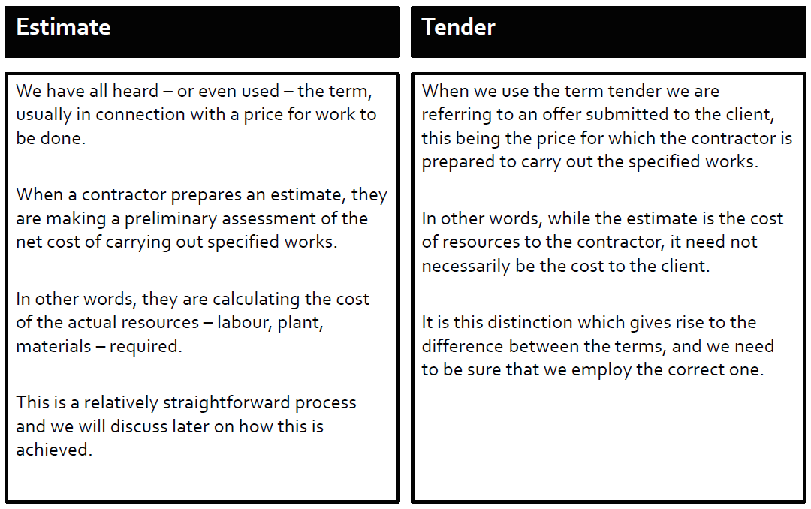
Estimating vs Tendering

Slide 21
ESTIMATE ACTIVITY
We will be compiling an Estimate/Tender report later this afternoon.
Please do not share your tender amounts, you will be colluding or even responsible for bid rigging!!!!

Slide 22
Principal Activities
1. Select procurement method
2. Prepare tender documentation
4. Receive & open tenders
5. Evaluate tenders
6. Accept & award tender
3b. Develop a tender list
3a. Invite / call for tenderers

Slide 23
1. Select procurement method.
Traditional contract procurement route
    Longer time – lead to critical work scheduling
    Less errors – more precise
Fast-track contract procurement route
    Shorter time
    Consequences – may be lead to critical error, variation.

Slide 24
2. Prepare tender documentation (non finite)
Letter of invitation
Checklist for submission of tender
Articles of agreement
Conditions of contract
Form of tender
Tender specifications
Schedule of quantities
Tender drawings
Schedule of day work rates
Sample copy of letter of acceptance
Sample copy of bank guarantee for performance bond
Sample copy bank guarantee for advance payment
Insurance……. etc.

Slide 25
3a. Invite / call for tenderers
Depends on the selection of tendering method chosen
    Open – produce tender notice
    Selective – shot listed contractors will be invited to tender if they wish
    Negotiated – only one contractor is approached- direct entry to project

Slide 26
Open Tendering
(no pre selection undertaken)
Seeking open tenders is an important way of obtaining best value for money, particularly in the absence of accurate market price knowledge or clear knowledge of all the competent potential tenderers available.

Slide 27
Multi-stage tendering
(Pre, pre/post or post selection)
May be used to cull a large number of respondents and identify the best service providers in a particular well-supplied market.
It also limits the number of tenderers to those that can demonstrate the requisite capacity in the first place.

Slide 28
Negotiated tendering
These Tenders are negotiated with a Main Contractor, even with the inclusion of some specialist Subcontractors.
Generally used in Cost Reimbursable Type Contracts, with early Starting Dates compare to Traditional Lump Sum type contracts.

Slide 29
Condition of Tenders
  NZS 3910: 2013 Condition of Tenders requirements on Page 132, Schedule to Condition of Tendering on Page 135.
  NZIA SCC 2018 Condition of Tender Schedule T to T5.
  Refer Letter for sample of Condition of Tender NZ3910.

Slide 30
Special Condition of Contract
  NZS 3910: 2013 Special Condition of Contract requirements on Page 91, Schedule 1 – Special Condition of Contract – Specific Condition data.
  Page 103, Special Condition of Contract – Other Condition of Contract.
  NZIA SCC 2018 Schedule B1 - Specific Condition of Contract.
  Schedule B2 – Special Condition of Contract.
  Refer Letter for sample of Special Condition of Contract NZ3910.

Slide 31
Risk Transfer – Responsible Commitment in partnership
The demise of Ebert Construction and Arrow International recently has forced Government and Building Industry to look closely at some of the causes that are continuing to give the Industry major concerns.
Some of difficulties in delivering public value of work in the Industry is due to:
    Culture of mistrust and lack of cohesion among those involved.
    Quality of Tender Evaluation
    Waste in the Tender Processes.
  We must exercise fair-play to all in the spirit of procuring a partner, not a builder.
  “A project is only successful if it is successful for everyone”

Slide 32
Procurement
Poor procurement leads to poor documentation, poor performance and the risk of consultant and contractor failures.
Procurers responsibility to ensure that high quality tender documentation with experienced evaluation teams, and a focus on capability to deliver a fair price.
Tenderers responsibility to have appropriate governance overseeing tender submissions providing complete, accurate and high quality submissions.

Slide 33
Special Conditions of Contract
Serious concerns over the use of special conditions of contract.
Creation of a false sense of security.
Blanket approach on minor through to major projects.
Lack of understanding of the impact of special conditions.
Common concerns – time bars, caps on liability and Engineer to Contract (EtC).

Slide 34
Time
Driver is cost and time certainty.
Examples of final accounts taking too long.
Condition precedent time bars creating a culture of disentitlement.
Perception the Client is wanting to get something for nothing.
Exacerbated by EtC issuing bulk instruction once a week.

Slide 35
Limits
NZS Condition of Contract does not include caps on liability.
Contractor believes that they should not bear all liability from failure to comply with contract.
Client believe they should not be required to pay more that the agreed price for the contractor to meet their obligations.
Disproportionate liability caps between contractors and consultants.

Slide 36
Engineer to Contract (NtC)
Important to consider EtCs dual role under contract.
Principal has a duty to ensure EtC fulfills all aspects of the role reasonably and in good faith.
Perception of EtC is becoming an advocate of the Principal when require to act independently.
Exemplified where Principal has amended General Conditions to remove their duty, to ensure EtC will solely act to the benefit of Principal.

Slide 37
Attitude
Risk must sit with the party best placed to manage the risk.
Contractors not adverse to Risk Transfer providing:
  They are able to influence and manage the risk.
  Reasonable costs are accepted within the contract sum.
Client must consider ability of parties to manage risk, and the value for money of transferring that risk.
Contractor must show a level of maturity where risks are retain by the Client to assist in mitigation.

Slide 38
The Silent Risk
Lack of understanding by Clients of the risk being transferred by the Consultants
Risk buried in appended contract documents.
Performance specification do not transfer design liability, designers must verify system design and retain design risk.
Client progressively in expectation contractor has responsibility for design issues during construction.
Drives lack of participation and culture that "I am just a Builder, I will do exactly what you tell me”

Slide 39
Responsible Comittment
Client must acknowledge that if procurement is under a traditional construction only contract, the contractor is not responsible for design.
Risk transfer must be accurately costed at all stages.
Risk transfer table should be included in the Contractors and consultants tender documentation to set expectations.
Ability of Contractors to raise concerns on risk at tender stage.
If Risk transfer has not been transparently identify in project business case, or agreed by governance board, then there is no approval to transfer that Risk.

