Slide 1

HAWKINS - ESTIMATION AND TENDERING
Resource & Preparation of the
estimate

Slide 2
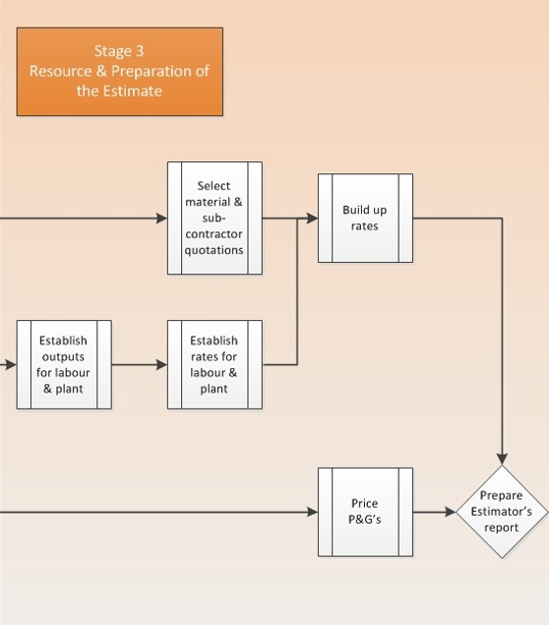

Slide 3
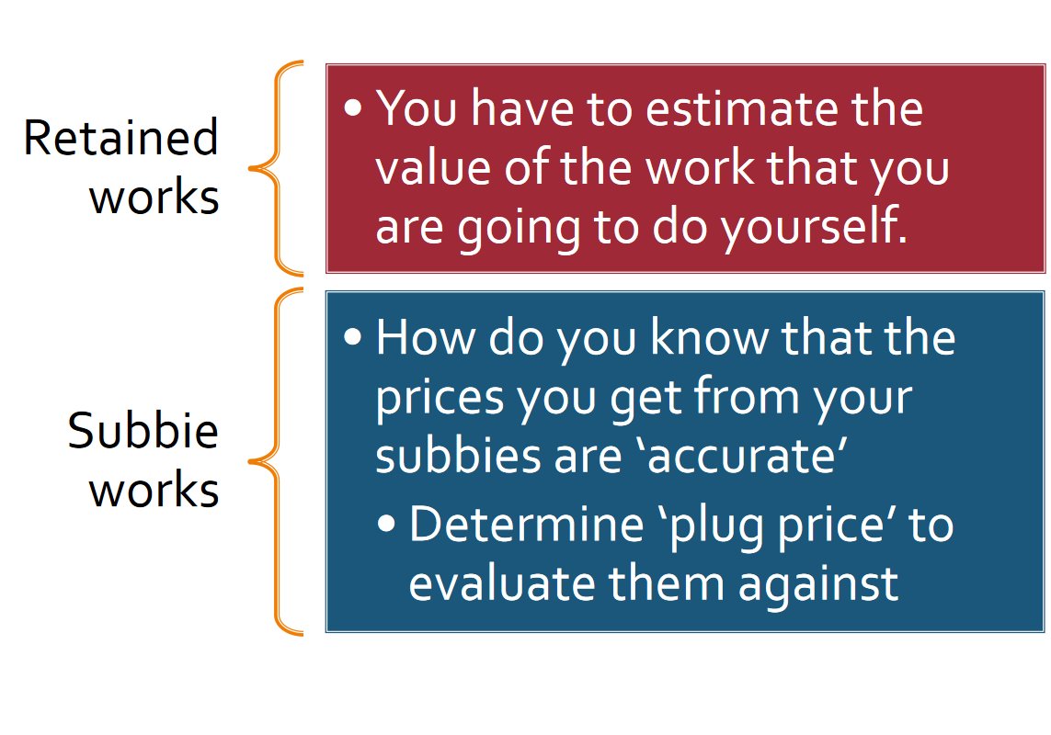

Slide 4
Selection of Subbies Quotations
Select subbies:
1. Quality of the sub contractor
2. Quotations
How long will it be open for acceptance
How long the job will take
Member of a trade association - free dispute resolution process, extra warranties if the work is not done properly
Tag – qualification, tender/quote conditions
Determine:
Plug price
Provisional sum
Tags to carry forward to the client

Slide 5
What are the key issues you need to take into account as a main contractor?

Slide 6
Subbies Quotation
Why the MC charges:
Attendance
Profit
What is RFI & NTT?

Slide 7
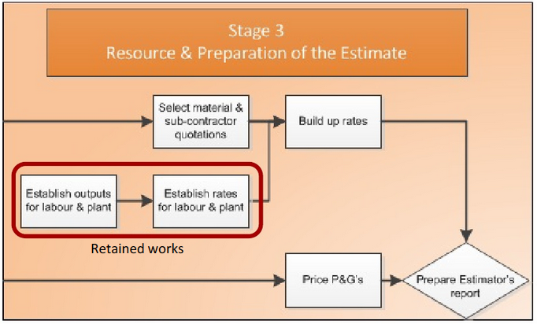

Slide 8
Pricing
Pricing labour, plant and materials

Slide 9
Retained works
Establish Rates for Plant
Establish Rates for Materials
Establish Total Hourly Rate for Labour
Build up unit rates from the above three components

Slide 10
Plants
Which is cheaper – labour or plant hire?

Slide 11
Establish rates for Plant
Use the correct plant for the job i.e. assess quantities and methods.
Programme must be considered for duration of plant hire –continuity.
Assess various sources of plant

Slide 12
Calculate rate per hour for each option and each piece of plant.
Cost include: hire rate, fuel, lubrication, servicing, maintenance charges, tyre wear and replacement.
Plant can be costed on the basis of operating cost per week.

Slide 13
Where do you price plant?
Individual unit rate?
Preliminaries?

Slide 14
Establish rates for Materials
Ensure that materials comply with the specification of the project.
Does the quotation include for delivery to the site?
Are there any special delivery conditions?

Slide 15
Does the quotation include for packing and crates and the cost of returning them where required?
Unloading and distributing around site. All actions have a cost. Can either be priced into unit rate or as overhead cost.
Samples of material.
Allowance for waste must be made

Slide 16
Will it be available in suitable quantities?
Some products manufactured in fixed sizes or minimum number must be ordered. Must remember to cost for this.
Surcharges may be levied on cost of transporting smaller loads.
Materials must be ordered in the unit in which they are sold

Slide 17
Are there any onerous conditions?
For what period does the quotation/estimate remain open?
What discounts are offered?

Slide 18
Establish rates for Labour
Labour is the most difficult resource to price accurately and to control the cost of.
All direct and indirect costs must be considered.
At the estimating stage, the productivity (output) of labour must be assessed.

Slide 19
Time is essential when calculating labour & therefore a balance needs to be struck between the time & cost of using labour and the time & cost of using plant.
Use information readily available (feedback from current jobs)
Labour constants must also be assessed, i.e. the amount of time it takes to lay 1m² of bricks.

Slide 20
Labour build up rate
URE = Unit Rate Estimating

Slide 21
Cost of materials
Cartage
Waste
Fixings
(e) equipment
Labour
CCWFeL
.

Slide 22


C
C
W
F
(e)
L
COST OF MATERIALS
Start with Retail Cost
less discount for:-
  Project bulk buying.
  Builders terms (general).
  Long term purchasing agreements.
Payment terms & conditions.
  Prompt payment discounts.
  Long settlement agreements.
  Special terms of sale & payment.

Slide 23

C
C
W
F
(e)
L
Cartage
Transport from supplier to project.
Often included with the suppliers rate
Factors that influence values:-
  Volumes & number of deliveries required
  Distance (remote locations = extra charges)
Examples of methods of calculation
  Carpentry $/m3 per

Slide 24
C
C
W
F
(e)
L
Waste
Sources of material waste
Transportation damage
Cutting and shaping
Handling errors
Theft
Loss (accidental)

Slide 25



C
C
W
F
(e)
L
Fixings
Examples of methods of calculation
  Carpentry nails kg/m3 @ $x/kg.

Slide 26


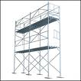



C
C
W
F
(e)
L
Equipment
Prelims <> (e) <> L (tools)
This provision is for minor equipment only:
  E.g nail guns.
  Not hand-tools (part of labour cost build-up)
  Not major plant & equipment (See P&G section)

Slide 27




C
C
W
F
(e)
L
Labour
Labour Constants
Net Contract
(labour) Rate
Examples
Hr pay = $30.00/hr.
NCR = $54.00/hr.
NCR is approx 1.8 x gross hr pay to employee.
Sample work-up information in Rawlinsons
Carpentry Examples
Plate
75mm x 50mm m 0.120 hrs
100mm x 50mm m 0.130 hrs
150mm x 50mm m 0.150 hrs
Stud
75mm x 50mm m 0.120 hrs
100mm x 50mm m 0.130 hrs
150mm x 50mm m 0.150 hrs

Slide 28
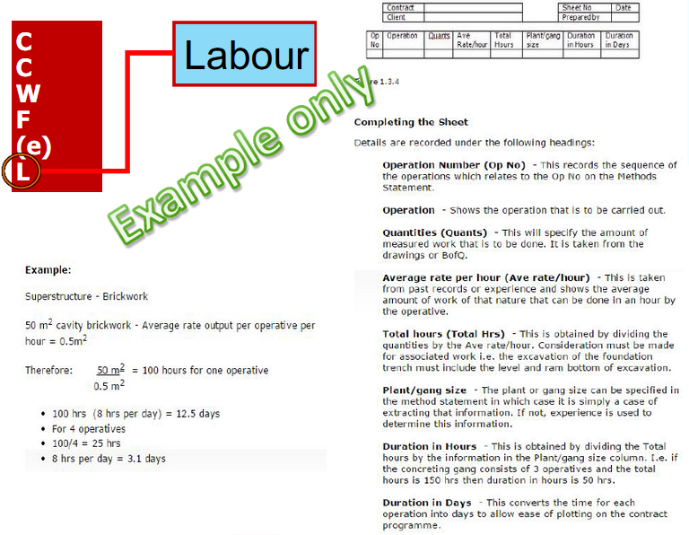

Slide 29
Activity (5 minutes) discuss with your peers
What is the purpose of Estimate?

Slide 30
Purpose of estimate
Contractor’s purpose of estimate
Determine project cost and profit.
Implement cost control measures.
Develop data base information that can be used for future projects
Client’s purpose of estimate
Making investment decisions at conceptual stage.
Negotiate and finalise the contract at the implementation stage.
Implement cost control measures

Slide 31
Estimates are not guarantees of costs
An estimate can only be as accurate as the information upon which it is based.
Depend on many factors: Document completeness, currency of data base, the skill and judgement of the estimator

Slide 32
Included sums - SOQ
Provisional sums – This is an allowance usually estimated by the QS and included in the tender documents/SOQ for an element of work which is yet to be defined.
Examples
Ground conditions – Rock excavation
Making good existing walls
Electrical work

Slide 33
Prime Cost Sums (PC Sums) – This is an amount of money that is allowed for an item or set of items which is yet to be chosen. It is adjusted once that particular item is chosen.
Examples
  Floor tiles
  Tap fittings

Slide 34
Contingency – This is an amount of monies set aside for unforeseen works and can only be spent under the authorisation of the Client/Architect/QS. The amount is sometimes inserted into the SOQ so the tenderers know
Trade Summary – This is typically at the front of the SOQ and is a summary of all the trades price. The total of all the trades gives the contract price for the project. It is always exclusive of GST.

