Slide 1


Hawkins Module - 2023
Decision to tender
Tendering Process
The Estimate
Risk Assessment
Notes:
With the logo on the left – background or expansion information.

Slide 2
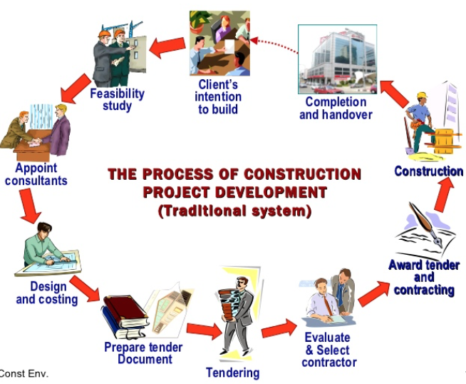
Overview
(Sxsw Construction Environment, 2011)

Slide 3
Design Phase
The Early Stages of a Contract
Concept Design
Preliminary Design
Documents used for Tender Estimate
Developed Design
Basic elemental estimating
Detailed Design
Estimating using sub-elements and approximate quantities
Estimating using detailed Trade-based quantities and rates

Slide 4
2. The decision to tender
Tenders are expensive and time consuming to prepare, so MC needs to decide whether to tender or not. MC workload must also be known at this time for consideration.
Invitation to tender
  From whom?. Must reply within timeframe.
Inspection of tender documents
  Who will inspect the tender documents?
  What information and questions should be asked.

Slide 5
2. The decision to tender (contd.)
Questions should cover the following items
Sufficient tender period for preparation of tender.
Conditions of Contract, Any modification to Special Conditions. Is it worth the Risk doing this project.
Time frames/Operation conditions clearly defined
  Programme/Staged/timing/access/restricted hours/dangerous conditions
Value and extent of project, What is MC work involvement and its own contributions like to be.
How well developed and details are the tender documents or is it hastily prepared.

Slide 6
2. The decision to tender (contd.)
Questions should cover the following items
Is Schedule of Quantities (SOQ) prepared based on Standard Method of Measurement, if not what other method is being used.
Is the SOQ a Contract Document.
If no SOQ provided, how much time needed to prepare quantities for Tender.
Are the Tender Drawings adequate to prepare measure.
Name of Client/Consultants/QS
What is the likely value of the Project.
Who else is tendering

Slide 7
2. The decision to tender (contd.)
The Final Decision whether to Tender of Not is solely a Management Decision, some considerations could be:
Sufficient and clear information results from its findings to the above questions to make a decision.
The level of commitments in relation to certain and expected Construction work.
Company's Resources available and Capacity needed.
Climate Conditions and Risk.
If Decision is YES, then estimate must start straight away. If NO, then all documents must be returned with reason why.

Slide 8
3. Tendering Process
Tendering Process
  Tenders usually consist of Price and Non-price Attributes (refer separate slides)
People involved in the Tendering process
  Estimator/QS
  Project Manager/Site Manager
  Commercial Manager/General Manager
  Bid Manager / Head Office
  Administrator for compiling the Bid

Slide 9
3. Tendering Process (contd.)
The Role of the Quantity Surveyor/Estimator
  Review the Tender documents
  Send out Subcontractor Invitations
  Measure and price Concrete, Carpentry and P&G
  Oversee the tender queries and issue of NTT’s
  Site Visit (for entire Tender team)
  Analyse subcontract prices and price any gaps
  Compiling the tender estimate for review with the team

Slide 10
4. The Estimate
The purpose of the tender estimate is to predict the most economical cost of the project
The components of the Estimate include:
  Contractor’s Own work
  Subcontractor Pricing
  Prime Costs, Provisional Sums, Provisional Quantities, Contingencies
  P&G
  Margin

Slide 11
4. The Estimate (contd)
The tender documents sometimes includes a Schedule of Quantities (SOQ) for completion by the Contractor, and is
  Produced by an independent QS
  based on ANZSMM 2018. Previously based on NZS 4202: 1986
    Also called a BOQ or Bill of Quantities

Slide 12
4. The Estimate (contd.)
Establishment of All-in-Rates for plant
Establishment of All-in Rates for materials
Establish total hourly rate for labour
Build-up of unit rates (schedule rates)
Price the schedule of quantities
Extend and check schedule of quantities
Calculate preliminaries and project overheads
Prepare Tender letter
Report to Management

Slide 13
5. Risk Assessment
What are the risks with tendering and how do you minimise these risks?
  Construction technical
      Can’t build it as anticipated – construction method statement/buildability
  Contractual/legal
  Can’t meet specified requirements- use standard conditions of contract. Understand all terms/seek specialist advice

Slide 14
5. Risk Assessment (contd.)
What are the risks and how do you minimise these risks (continued)?
  Construction planning
      Can’t complete on time - outline planning during tender period
  Mistakes in the bid compilation
      Arithmetical errors/duplication/omissions
      Use checking routines/standardise process/carefully compile submission documentation

