Slide 1

CSTU5170 - Sociology for Social Practice: Inequality and Social Change
Introduction to the course
Semester two 2023
Craig Tunnicliffe

Slide 2

Karakia
MANAWA MAI
Manawa mai te mauri nuku
Manawa mai te mauri rangi
Ko te mauri kai au
He mauri tipua
Ka pakaru mai te po
Tau mai te mauri
Haumi e, hui e, taiki e
Embrace the life force of the earth, embrace the life force of the sky
The life force I have fathered is powerful, and shatters all darkness
Come great life force,
Join it, gather it, it is done

Slide 3

Waiata Purea nei
Purea nei, e te hau
Horoia, e te ua
Whitiwhitia, e te ra
Mahea ake nga, poraruraru
Makere ana, nga here
E rere, wairua, e rere
ki nga ao, o te rangi
Whitiwhitia, e te ra
Mahea ake nga, poraruraru
Makere ana nga here (x2)

Slide 4
Agenda for today learning objectives
Get to know each other
Get a sense of the course
  Have you been to moodle yet?
  What are the assessments?
Introduce some key sociological ideas/concepts.
Not freak you out too much

Slide 5

This course may expand your mind!
You will learn some new stuff, and new language for things you already know.
It’s going to ask you to think!
It will definitely hurt your brain
  This is your brain growing
You may feel emotions
Confusion, Anger, Sadness, surprise wonder, etc.
My hope is that you may also feel affirmed, empowered, inspired to make change.
Go slow, but keep on going.
You won’t “get it” all in one go, but you will start to make connections, hear these ideas in other papers, in the media. Then they may “click”.

Slide 6

Teaching approach
Ako. We are both teachers and learners simultaneously
Critical pedagogy
  educational practice that focuses on the dismantling of relations of domination and the (enabling of) power of individuals to take action for social justice.
  Together we will explore ways to work for social justice through understand the barriers to social justice.
Critique of western epistemological hegemony
  That is, the critique of western ways of knowing and the ways they position themselves as “the way”
Inquiry based learning (you will need to read, to think, and to reflect).
You will be invited to Question everything
It is okay to ask questions!! We will not think you are silly because you don’t know something.
It’s just that you don’t know it… yet.

Slide 7

ko wai au who am I

Slide 8
Sociology for Social Practice
Learning to think sociologically is one of the most important skills a social worker can bring to their practice (Cunningham & Cunningham, 2008).
Understanding our own biographies (our own life stories) in sociological terms (the forces that shape our lives) better equips us to comprehend the lives of those we work with” (Cunningham & Cunningham, 2008, p.9).

Slide 9
Our stance as social practitioners
International Federation of Social Workers (IFSW) (2014) Global Definition of Social Work
Social work is a practice-based profession and an academic discipline that promotes social change and development, social cohesion, and the empowerment and liberation of people.
Principles of social justice, human rights, collective responsibility and respect for diversities are central to social work.
Underpinned by theories of social work, social sciences, humanities and indigenous knowledge, social work engages people and structures to address life challenges and enhance wellbeing. The above definition may be amplified at national and/or regional levels.”

Slide 10
Our stance as social practitioners
Aotearoa New Zealand Association of Social Workers (ANZASW) affirms that member social workers are committed to:
  The development and just allocation of the resources that enable everyone to achieve their full potential.
  Action for social change is necessary to achieve social justice. (ANZASW, 2018)
  This is about addressing inequality at both the macro (big) and Micro (small).

Slide 11
A closer look at this definition
A just (fair) allocation of the resources?
  What is just (fair)?
  When does it become unjust (unfair)?
  When does some inequality become too much inequality?
Action for social change is necessary to achieve social justice
  How do we take action?
  Where do we take action?
When considering social change ask:
  Who benefits? Who gains?
  Who is marginalised? Who looses?
These questions form the heart of this course.

Slide 12
Our stance as
social practitioners
We may have different positions about a number of things
We do however support the concept that inequality is bad and that social justice (fairness, equality, equity) is good.
We also
Understanding the sociological drivers of inequality make us more able to effect change.

Slide 13

Becoming curious.
Learning to think sociologically

Slide 14

Coffee

Slide 15
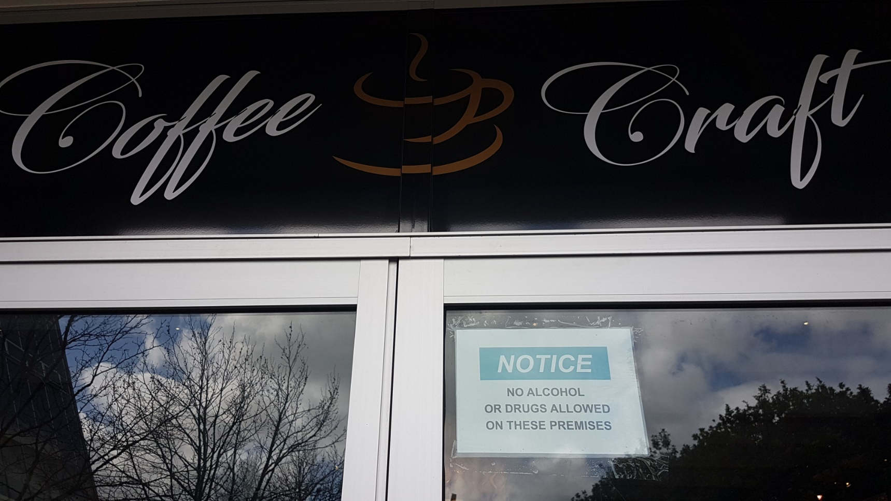

Why are some things more deviant than others
But coffee is a drug?

Slide 16
Whakawhanaungatanga
Line up
Form pairs. Choose someone unfamiliar to you.
Become curious, ask questions, 3 minutes each,
Find out
How does this person identify themselves (e.g. gender, ethnicity, class).
Where do they come from? (e.g. where in Tāmaki Makaurau, where in the world)
Report Back, by introducing your new friend

Slide 17

Break

Slide 18


So what is sociology?
We will get to that
But first lets start small

Slide 19


What is an idea?
An idea is a thought. It can be of a thing and create a mental image of that thing (pencil) or it can be abstract (pain).
Ideas can create more ideas
I’m thinking about a flower
Were we thinking about the same flower?
Not everyone thinks the same

Slide 20


What is a concept?
Different philosophers have used the two terms in different ways and some synonymously
A concept is a set, or a group of ideas, that build or helps us build an understanding of the world
Concepts may be thought of as “interpretative constructs”. Things that help us interpret information, ideas, etc.
We all use concepts.
Concepts are abstract ideas.
Concepts may include generalizations
  All use of language involves abstraction
  E.g. DOG.
  Refers to all dogs?
    Big dog? Small dog? Hairy dog?
    The more broad the concept the more it includes
    But does it tell us what we need to know?

Slide 21
Sociology uses specific concepts
Norms
  The unspoken rules that govern and guide behaviour
Socialisation
  How we learn these rules
Roles
  The positions we occupy in our day-to-day life. (Mother, Father, Son, Daughter, teacher, student, employer, employee)
Expectations (or normative assumptions)
  Assumptions of how we should think, act, or do, based on some social feature (e.g. ideas on the way we should dress to fit our
Key concepts >>>>>
Power
Privilege

Slide 22
More complex concepts
Inequality
Class
Ethnicity
Gender
Modernity
Consumerism
Key concepts >>>>>
Power

Slide 23
And theories
Theory comes into play when ever we wish to explain or explore something
It is about developing arguments and using concepts which answer questions (e.g. why is there racism, what are the consequences of this racism, how did ideas of “race “emerge, who has benifited, who has been marginalised?)
Theory involves abstracting from features of particular events/ issues, developing concepts, and generalising.

Slide 24
Sociology develops theories.
Theories of…
Colonisation
Modernity
Capitalism
Consumerism
Class
Ethnicity
Gender
Identity
Power

Slide 25
So who knows about sociology?
You do!
You are already an expert in your own biography.
Have you heard about the haves and the have nots
  Then you know about class and inequality
Have you ever felt frustrated about who does (or who does not) do some household tasks?
  Then you know about gender (or gender roles)
Sociology can be thought of as a way to name some of the social experiences you already experience.

Slide 26
The Sociology of the Classroom
We doing the social NOW
Social relationships brought you here. Your biography has you here, now, shaping this part of our collective history.
What did you do to get here?
  Set alarm clock
  Childcare
  Negotiated with loved ones
  Debt (Student loan?)
We are currently engaged in a social relationship
Teacher/Student
Power (assessment, attention)
Surveillance (moodle)
Student politics
You are doing Identity right now… (how you see your self and how others may see you, how you think others might see you)
Notes:
Talk a little about context power and positioning – stories about me as worker that colleagues told to shut up if I raved too much and now you poor sods sit and listen for hours – all polite.
Same raves – different context - positioning. Link to elephant in the room of the gaze of assessment and how (and by Whom) competence is measured in this environment. Ie power that isn’t usually named starkly / Distasteful talk (like mentioning farts) but the kind of thing the Soc imagination is interested in
Link to soc imagination – whats under the rules? Turning over rocks
Introduce idea of haunting – ie if I am enabled in voice so powerfully in this environment speaking English – big words – in a suit and male and white – who haunts this room by virtue of being stripped of a voice and power?

Slide 27

So what is sociology?

Slide 28
Sociology is…
an “-ology”
The study of society
The study of social arrangements
including the processes that provide continuity and change.
Big picture (macro) stuff e.g. why do we arrange our economy this way.
Medium picture stuff (meso). E.g. what causes crime, why do we organize our families in certain ways
Smaller picture stuff (micro) e.g. how do I identify in this world (or construct an identify, or am I constructed by society?)
Key concepts >>>>>

Slide 29
Its is the study of…
…the world around us (or more specifically the people and their associations).
The structures (the way things are organised and arranged, including the mechanisms of inclusion and exclusion) (note: power is a key concept here)
The institutions (family, religion, education, media, work etc)
The social groups (social groupings) we belong to (e.g. rich, poor, employed, unemployed, man, woman, old, young etc)
The social roles we fulfil (fathers, mothers, partners, lovers, students, workers etc). And the behaviours that go with these.
Key concepts >>>>>

Slide 30
What is the social?
“The ‘social’ is produced in and through humans doing things collectively” (Matthewman, 2007, p.1).
“It is characterised by amazing richness, variety, complexity, puzzlement, and the capacity to excite both pleasure and misery” (Matthewman, 2007, p.1).
Notes:
Matthewman’s invitation to be seduced by sociology

Slide 31

Sociology offers…
Sociology offers a distinctive way of seeing and understanding the social world in which we live and which shapes our lives.
Sociology looks beyond normal, “common sense” and taken-for-granted views of reality, to provide deeper and a more nuanced understanding of social life.

Slide 32
Sociology offers…
Conceptual language to communicate complex ideas
A set of analytical tools (concepts)
An understanding of what causes inequality and social injustice
Different levels of analysis

Slide 33
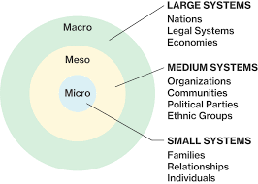
Sociological Levels of analysis

Slide 34
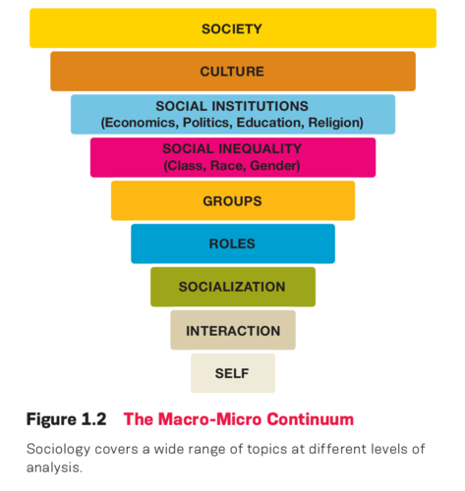
Sociological Levels of analysis

Slide 35
Key debates in sociology (and some more key ideas)
A big debate in sociology is the relationship(s) between structure and agency.
Structure (the social patterns through which a society is organized)
Agency (the ability to act or to effect change also the capacity of individuals to perceive their situation, reason about it, consciously monitor their action, form motives)
The structure agency debate is the question of how much the structures of society constrain or determine individual lives (or how much agency do we actually have).
Macro approaches tend to focus on the effects of structures on people. They understand the ways structure constrain options/choice
Micro approaches tend to focus on how the individual acts on their environments. They stress free will and choice.

Slide 36
Break

Slide 37

Class exercise
Explore the sociological imagination

Slide 38

The Sociological Imagination
C. Wright Mill’s book of the same name.
Reading on moodle is Chapter one
With the sociological imagination we can see that sociological understanding takes place at the intersection of biography (our or another person’s story) and history (our collective story).
Biography happens to individuals
History happens to societies

Slide 39
Sociological imagination
When we use the sociological imagination to look at the intersection of history and biography we will see both the large structural forces which shape our (and others) lives and the small areas of self that we live inside.
Our lives are lived in a complex loop between the two.
The loop between inside and outside
Society is inside and outside of every individual

Slide 40

The promise of sociology
Mills describes this promise as “the capacity to range from the most impersonal and remote transformations to the most intimate features of the human self – and to see the relationships between the two” (1959, p.7)
Mills argued that what we see as “private troubles” are not solely private but should be seen as “public issues”, to be debated and explored as general social phenomenon (1959, 6-7)

Slide 41
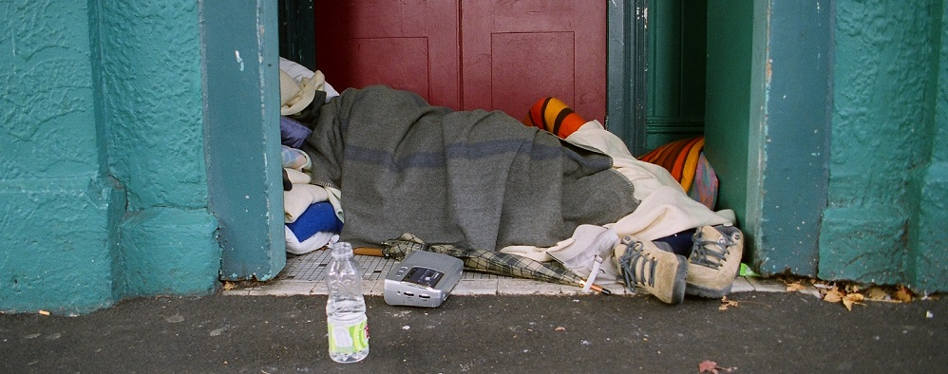
Group discussion
Is this a private or public issue?
What is the cause of homelessness?

Slide 42

Fin?

Slide 43
What Sociology Offers
Sociology provides an understanding of social issues and patterns of behaviour
Rules
Norms,
Transmission of…
Deviation from…
Notes:
Sociologists put our interactions with others into a social context.
This means they look not only at behaviors and relationships, but also how the larger world we live in influences these things.
Social structures (the way society is organized around the regulated ways people interrelate and organize social life) and
social processes (the way society operates) are at work shaping our lives in ways that often go unrecognized. Because of this perspective, sociologists will often say that, as individuals, we are social products.
Even though we recognize their existence, these structures and processes may “appear to people in the course of daily life as through a mysterious fog” (Lemert 2001, 6). Sociologists strive to bring these things out of the fog, to reveal and study them, and to examine and explain their interrelationships and their impacts on individuals and groups. By describing and explaining these social arrangements and how they shape our lives, sociologists help us to make sense of the world around us and better understand ourselves.

Slide 44
What Sociology Offers
Sociology helps us understand the workings of the social systems within which we live our lives
Structures (the way things are organised, the what)
Social processes (the way things operate, the how)
Notes:
Sociologists put our interactions with others into a social context.
This means they look not only at behaviors and relationships, but also how the larger world we live in influences these things.
Social structures (the way society is organized around the regulated ways people interrelate and organize social life) and
social processes (the way society operates) are at work shaping our lives in ways that often go unrecognized. Because of this perspective, sociologists will often say that, as individuals, we are social products.
Even though we recognize their existence, these structures and processes may “appear to people in the course of daily life as through a mysterious fog” (Lemert 2001, 6). Sociologists strive to bring these things out of the fog, to reveal and study them, and to examine and explain their interrelationships and their impacts on individuals and groups. By describing and explaining these social arrangements and how they shape our lives, sociologists help us to make sense of the world around us and better understand ourselves.

Slide 45
What Sociology Offers
Sociology helps us understand why and how society changes.
Notes:
Obviously, the social world is constantly changing. This change has been a major interest to sociologists from the beginning of the discipline. However, many sociologists believe that sociology should not stop with only explaining society and how and why the world changes. They argue that sociologists also have an obligation to act, using their unique skills and perspectives to work to improve the world. Sociology, they argue, is a “field of inquiry simultaneously concerned with understanding, explaining, criticizing, and improving (italics mine) the human condition” (Restivo 1991, 4). Armed with a sociological perspective, we can more effectively take action if we don’t like what is happening. We can better participate in shaping the future for ourselves and for others.

Slide 46
What Sociology Offers
Sociology helps us understand why we perceive the world the way we do.
Notes:
We are inundated with messages in a variety of forms about how we, and the world around us, both are and should be. These messages come in forms as diverse as guidance from parents and teachers, laws handed down by religious and political entities, and advertisements ranging from pitches for athletic shoes to feeding hungry children. Sociology helps us examine the types of messages we are constantly receiving, their source, how and why they influence us, and our own roles in producing, perpetuating, and changing them.

Slide 47
What Sociology Offers
Sociology helps us identify what we have in common within, and between, cultures and societies.
How do we differ?
How do variations become inequalities
Notes:
Sociologists know that, although people in different parts of the city, country, or world dress differently, speak differently, and have many different beliefs and customs, many of the same types of social forces are at work shaping their lives. This is an especially important perspective in a world where media headlines are often accused of focusing on divisive issues.
Sociologists look for what social structure and processes mean for various groups. They look at how various groups shape, and are impacted, by society.
Sociologists can help groups find common concerns, understand other groups’ perspectives, and find ways to work together rather than work at odds with each other.
Importantly sociologist are keen to explore how variations become inequalities

Slide 48
What Sociology Offers
Sociology provides us theoretical perspectives within which to frame these understandings and research methods that allow us to study social life scientifically.
Sociology is a social science.
Notes:
That means sociologists work to understand society in very structured, disciplined ways.
Like scientists who study the physical world, sociologists follow scientific guidelines that incorporate an assortment of theories and methods that provide for accuracy in gathering, processing, and making sense of information.
In the case of sociology, theories focus on how social relationships operate.
They provide a way of explaining these relationships. Scientific methods provide ways of generating accurate research results.
Unlike pure science we reject the possibility of objectivity.

Slide 49
What Sociology Offers
It gives us a foundation for social work practice
Notes:
The facts do not always speak for themselves. They have to be interpreted.
Like scientists who study the physical world, sociologists follow scientific guidelines that incorporate an assortment of theories and methods that provide for accuracy in gathering, processing, and making sense of information.
In the case of sociology, theories focus on how social relationships operate.
They provide a way of explaining these relationships. Scientific methods provide ways of generating accurate research results.
Unlike pure science we reject the possibility of objectivity.

Slide 50
references
Cunningham, J. & Cunningham, S. (2008). Sociology and social work. Exeter: Learning Matters
Dominelli, L. (1997). Sociology for social work. London: Macmillian Press
Matthewman, S. (2007). Introduction: On being sociological. In S. Matthewman, C. L. West-Newman & B. Curtis (Eds.). Being sociological. (p.1-24).New York: Palgrave Macmillan.
McLennan, G., Ryan, A., & Spoonley,, P. (2000). Exploring Society: Sociology for New Zealand students. Auckland: Pearson Education.
McLennan, G., McManus, R., Matthewman, S., Brickell, C., & Spoonley, P. (2019). Exploring society : Sociology for New Zealand students (Fourth ed.). Auckland: Auckland University Press.
Online Etymology Dictionary retrieved http://www.etymonline.com/
The University of North Carolina (ND). What is sociology. Retrieved https://sociology.unc.edu/undergraduate-program/sociology-major/what-is-sociology/
Stolley, K. S (2005). The Basics of Sociology. Westport, USA: Greenwood press.

Slide 51
karakia whakamutunga|
closing karakia
Ka wehe atu tatou
I raro I te rangimarie,
te harikoa
Me te manawanui
Haumi e, hui e, taiaki e

