Slide 1

Globalisation, social change, and Climate justice
CSTU5170

Slide 2
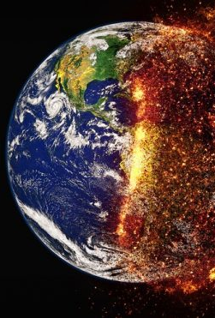
Thinking locally and globally
Global pandemic
Climate crisis
Ecological collapse
Economic instability (as seen most recently in the GFC)
Global rich (1%), global poor
War (and subsequent humanitarian crisis)
These issues require global solutions
These issues also require local solutions
As practitioners then, we need to think BOTH globally and locally

Slide 3
Social change
Sociologists like to draw attention to large scale shifts in the way(s) that societies organise.
What leads to change?
What are the “forces”
What are the influences?
What is the result of this change?
Is it fair?
Equitable?
Just?
What might we do about it?

Slide 4

What social changes have you experienced?

Slide 5

Quick recap of social changes

Slide 6

-isations
When added to a word, '-isation' creates a noun that denotes the act, process or result of an action (or actions)
We have seen a lot of –isations over the last couple of hundred centuries
Isations that have led to significant social change.

Slide 7
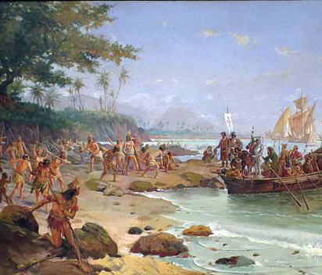
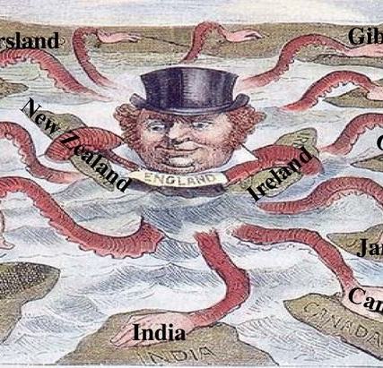
-isations
Colonization
The establishment of new territories
New social institutions
Legal
Political
Cultural
The destruction of existing social arrangements, customs, and traditions
It can be part of imperialization (the expansion of Empire)

Slide 8
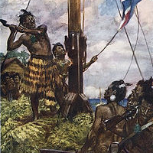
Colonisation and ideology
Colonisation is usually presented as in the interests of the colonised.
Colonisation denies the identity of the colonised through ideologies that deny the validity of colonised peoples languages, culture and ways of being in the world
Colonisation is more than physical – it is the imposition of the norms and ways of being in the world of one group on another (sometimes referred to as colonialism
The colonised are often forced to adopt as their own the ideologies of the colonisers.
Remember Hegemony.

Slide 9
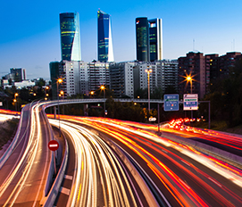
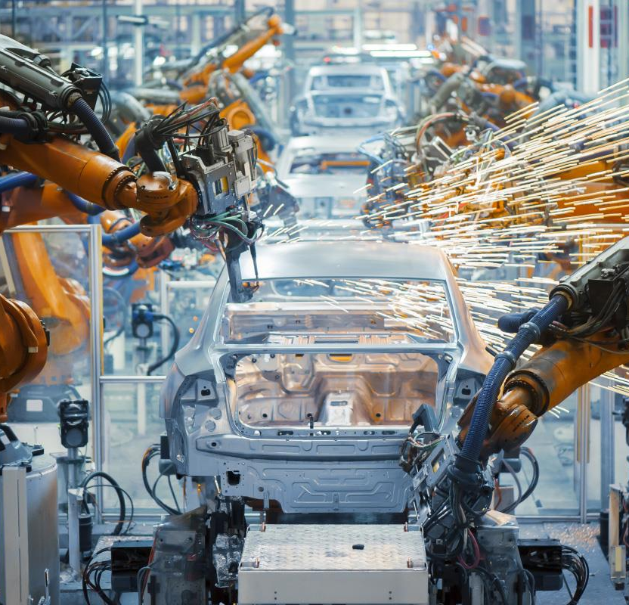
-isations
Modernisation
The processes associated with modernity
Nation states,
new technologies
Trains, planes, and automobiles, communication
Transformation of societies
Progress narrative
Industrialisation
The growth of mass production, labor exchange (contested), mass consumption
New technologies
Pollution and resource use

Slide 10
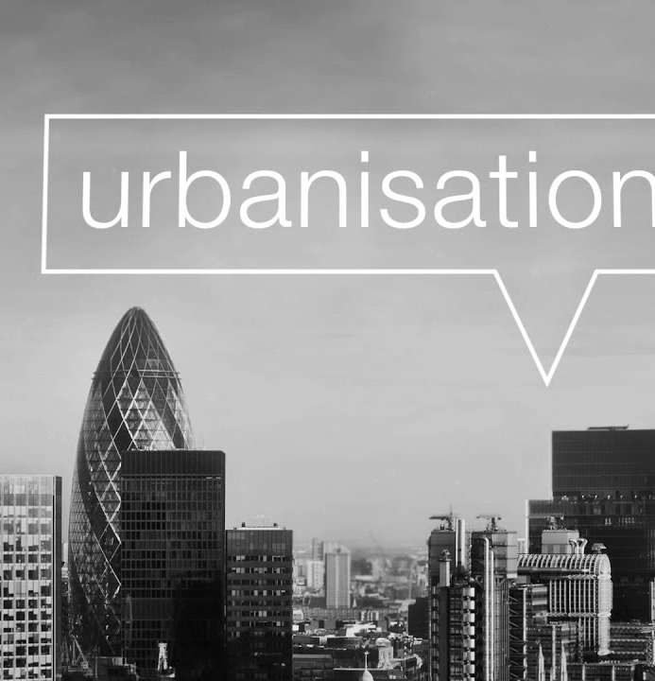
-isations, continued
Moving from rural to urban centers
The growth of cities
Closely linked to industrialization and modernization
Changes in family systems and living arrangements
“rural culture” is replaced by “urban culture”.
Associations with others in our community's change.

Slide 11
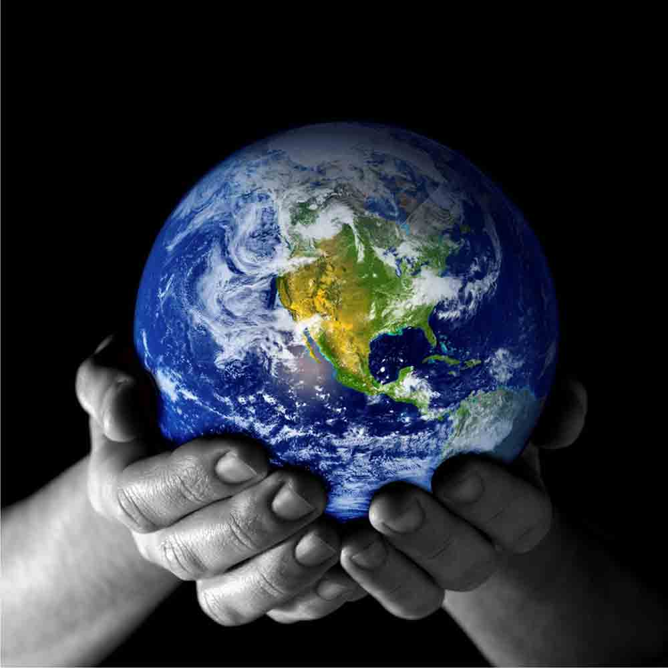
Globalisation

Slide 12
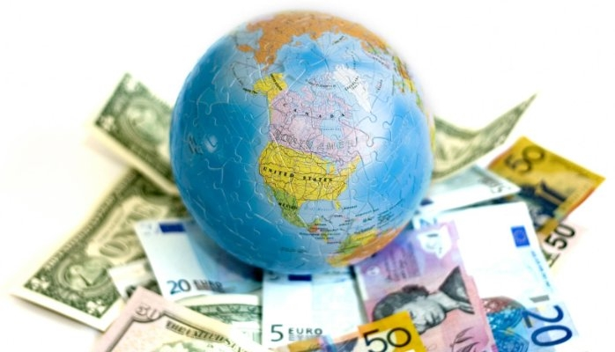
Globalisation: toward a definition
Beck describes globalisation as “A new kind of capitalism, a new kind of economy, a new kind of global order, a new kind of society and a new kind of personal life are coming into being, all of which differ from earlier phases of social development. Thus, sociologically and politically, we need a paradigm-shift, a new frame of reference (2002:2)”

Slide 13
Globalisation: toward a definition
Petras and Veltmeyer (2001) view discourses of globalization as globaloney. They see globalization as both imperialist and class project on international scale represented by a vast network of transnational corporations. Globalization is nothing but imperialism writ large as a consequence of crisis in contemporary capitalism.
“What is described as globalization is thus essentially a perpetuation of the past based on a deepening and extension of exploitative class relations into new areas previously outside of capitalist production….Moreover, the shifts in the axes of capitalist expansion from domestic production and exchange (enlarging the home market) to the world market has always been contingent on the political and socio-economic composition of the state, which orients economic policy.”(Petras and Veltmeyer, 2001:29).

Slide 14
Globalisation: toward a definition
Are we now de-globalising?
Held and McGrew (2007:2): “Today borders and boundaries, nationalism and protectionism, locality and ethnicity appear to define an epoch of radical de-globalization: the disintegration and demise of globalization. In fact, “…globalization rhetoric appears rather hollow”

Slide 15
Globalisation: toward a definition
A multi dimensional set of social processes that involve the expansion, intensification and acceleration of social relations across world-time and world-space. People, communities, and Nations around the world are increasingly being exposed to similar economic, social, cultural, and political forces, flows and processes. These forces have led to increasing global interdependence and interconnection particularly in relation to economic activity…but also in respect of communications and cultural exchanges.

Slide 16
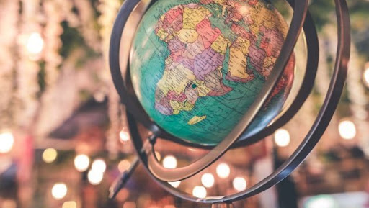
Dimensions of Globalisation
Economic
Political
Cultural
Technological
Ecological
Ideological

Slide 17
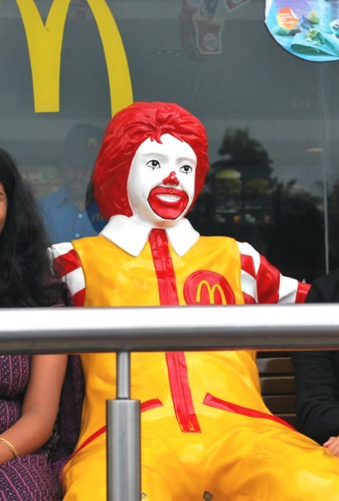
Dimensions of Globalisation
Economic
Trade (goods and services), global markets (on the news each night). Money moves
Political
Challenges to the power (sovereignty) of Nation states
Global integration through trade agreements
BUT…a return to Nationalism and boarders?

Slide 18
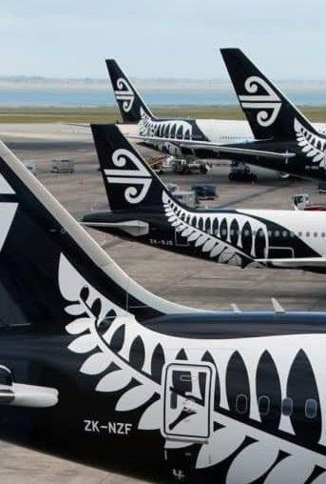
Dimensions of Globalisation
Cultural
Language, “lifestyles”, fashion, music, Western (cultural imperialism), appropriation.
(what then happens to local culture? – does it then become not much more than window dressing?)
Technological
Travel, satellites, communication, media (CNN, BBC), internet, financial exchanges, warfare

Slide 19
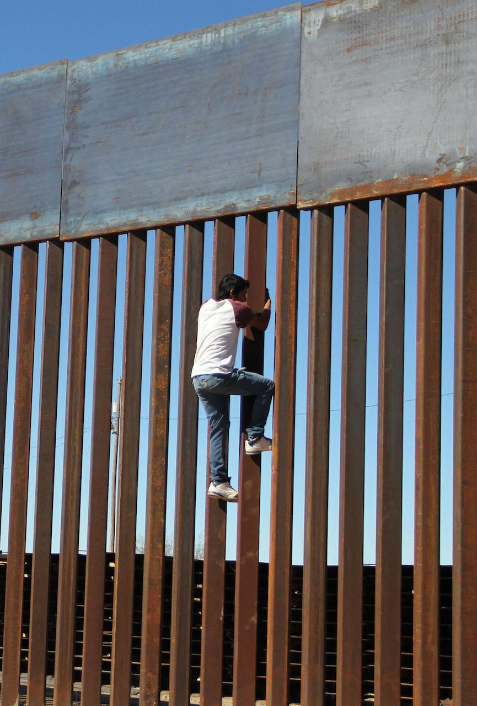
Dimensions of Globalisation
Ideological
Pro “global village”, “citizens of the world”
Con: anti-globalisation, anti-capitalist, environmental destruction, human exploitation, commodification, mass consumption
Ecological
Climate change, depletion of natural world, pollution, crisis.

Slide 20
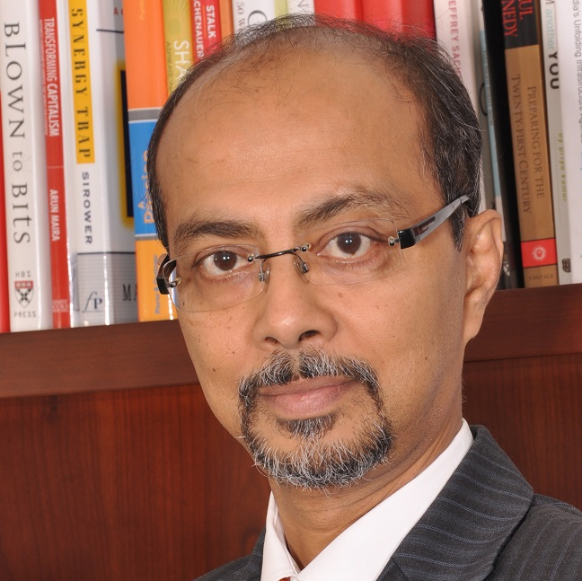
Watch (9mins)
Watch: https://youtu.be/_Z9ZAlTD5AM?t=81
This picks up after a discussion on the idea that globalisation (particularly economic globalisation) has slowed or stopped.
Arindam Bhattacharya DISAGREES
He say it has changed, but is still a significant force.

Slide 21
Economic Globalisation
Globalisation is often spoken of as purely an economic phenomenon.
This is a KEY dimension (BUT NOT THE ONLY DIMENISION)
The integration of trade and financial markets at a global level
Made possible by Technology, Communication networks, Powerful international economic institutions such as the International Monetary Fund and the World Bank
Pro economic positions hold the (contestable) view that if global markets work other global agendas will follow. Peace, social justice, human rights, environmental protection, mutual understanding, and cultural exchange.
Economic rationalism – the economy comes first, everything else takes second place
Governments are often powerless in the face of economic and global capital.
Notes:
Governments are often powerless in the face of economic and global capital. If a govt institutes policies that displeased the market, there would be an instant loss of capital, loss of investment, and a currency crisis. USA may be powerful enough to stand up to global market pressures, but can NZ?

Slide 22
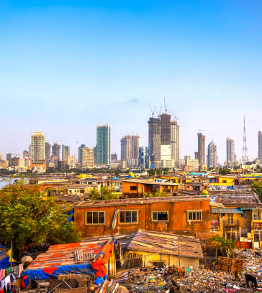
Economic Globalisation
The global economy employs 20% of the worlds workforce
The remaining 80% are marginalised and ignored. The rich and the poor – people and countries
Global networks are breaking down the divisions between these communities
National boundaries are less of a barrier and there are now marginalised communities in the “developed countries”. The 80/20 are at home too.
Globalised economies rule – McDonaldisation and Disneyfication = global markets
To be part of the global world is to be - powerful
Notes:
National boundaries are less of a barrier and there are now marginalised communities in the developed countries. Those who relied on the traditional economies such as fishing locally, vege growing for local communities, local education, furniture production, any non-exporting type production.
Globalised economies rule – McDonadisation and Disneyfication people in different parts of the world eating the same food, watching the same movies, listening to the same music, playing the same games.
To be part of the global world is to be cool, to wear the right clothes, have the right IT equipment, cell phones, etc, know the right music, etc to fit in you need to be up to date. Fashion police, oh that is so last year. Clearance houses sell last years stuff – why? Is it no good?

Slide 23
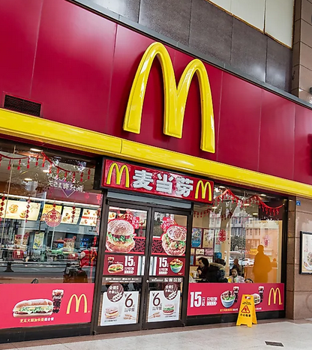
Corporate Expansion
Multi-national or trans-national corporations (MNCs or TNCs) – businesses with a headquarters in one country but with business operations in a number of others.
No matter where you go in the world, certain businesses will always have a presence.

Slide 24
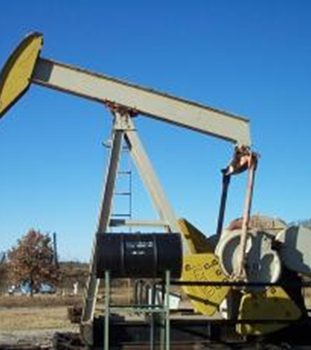
Corporate Expansion
Expanding revenue and lowering costs as key objectives
Sourcing raw materials
Controlling key supplies
Control of processing
Global economies of scale
The opportunities to be able to buy and sell in any country in the world
The opportunities for labor and capital to locate anywhere in the world
Externalization of costs (watch (3mins) Externalities

Slide 25

Corporate Dominance
Key Issues
Increased gap between rich and poor causes social instability
Non-renewable resources
Exploitation of labor
Including slave and child
Monopoly power
Damage to communities
Damage to cultures
Damage to the planet
Key questions
Accountability of Global businesses?
Ethical responsibility of business?

Slide 26

break

Slide 27
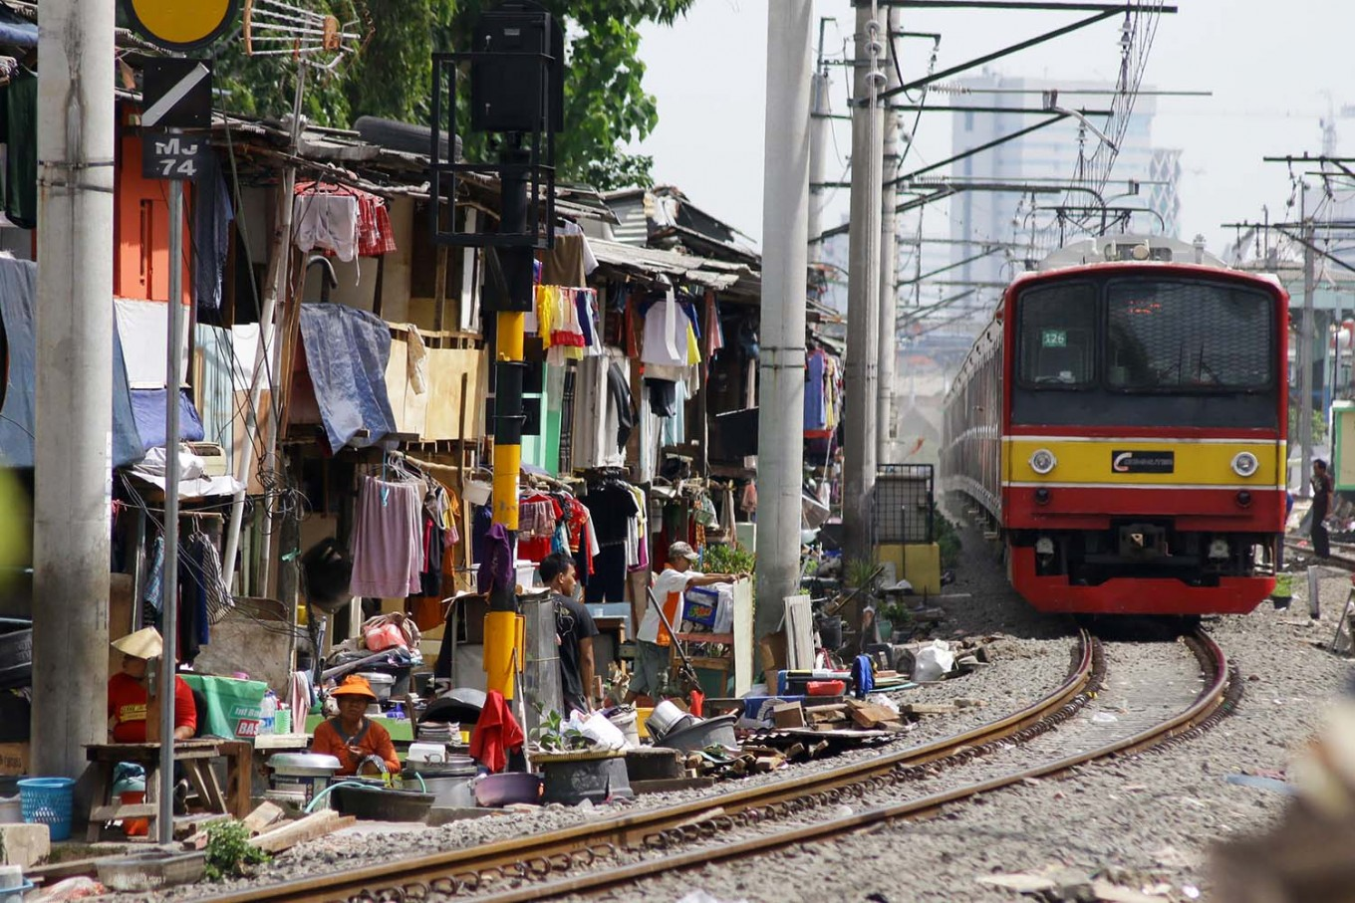
Questioning economic globalisation
Economic concerns dominate
Therefore, the rights of the rich and powerful dominate
Citizens of the world?: Are the poor?
Global markets pressure governments to make decisions that benefit the market (e.g. tax cuts, “free markets”).
Does this mean that governments are controlled by corporations?

Slide 28
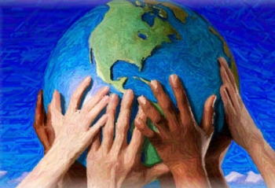
Ecological effects of Globalisation
Depletion of natural resources
Damage to habitats
Extinction of bio-diversity
Toxic Pollution
Health of local communities
Effects other nations
Pollution
Sea level rise
Often not the producer
Climate/Ecological crisis
Requires a global response

Slide 29
Climate justice

Slide 30
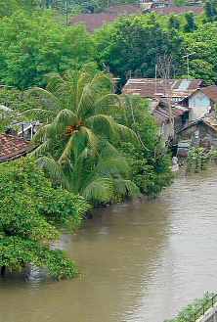
What is climate justice?
Climate Justice is a relatively new concept.
It positions climate change/global warming as more than an environmental issue
The environmental movement has primarily focused on the environmental degradation (including depletion of resources such as air, water and soil; the destruction of ecosystems; habitat destruction; the extinction of wildlife; and pollution).
Climate justice frames these as ethical and political issue which examines the effects of these changes, on people and communities.
A fundamental proposition of climate justice is that those who are least responsible for climate change are those who often are effected the most severely.

Slide 31
Theoretical approaches Two different approaches
ENVIRONMENTAL RESPONSE
GREEN RESPONSE

Slide 32
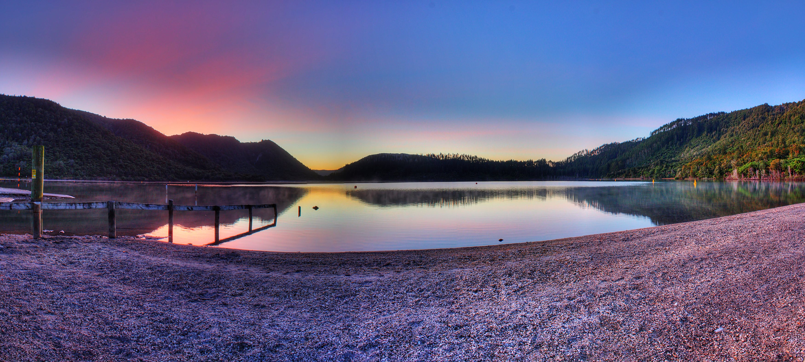
Environmental Responses
Seeks to solve specific problems, in isolation by finding discrete solutions
Linear thinking, which is embedded in Western thinking informed by industrial and technological progress.
Believes society will solve the issue through technical expertise and solutions
Sophisticated new technology should be expected, which requires a technical solution to solve the problems (water, air, pollution chemical reactions, soils climate, the eco-systems temperature)
Related to physical science, therefore views scientists as the experts

Slide 33

Green Response
More fundamental, radical approach
Environmental issues can not be seen in isolation, and are symptoms of underlying issues we’ve created
Social, political and economic change is required to create lasting change
Agrees that conventional, linear technological solutions are important in the short term, however a long term sustainable approach is required.
Requires a holistic ecological approach – not simply a technological solution
Stands on common ecological principles

Slide 34
The Green Perspective argues that….
Seek expertise from the social economic and political sciences, rather than the physical sciences, and technologies
Environmental response deals primarily with the symptoms.
Social practice accepts the green, rather than the environmental view of ecological problems.
If the ecological crisis to be effectively resolved, it will be through social economic and political change, rather than science
Local development is one of the most effective ways to develop a more sustainable society
The expertise of social practitioner and social workers in terms of both knowledge and skills has much to contribute to the green movement:
The green movement has been one of the forces behind the current upsurge of interest in community development (as a method of change)

Slide 35

An ecological perspective
Social Practice / Community Development

Slide 36

An ecological perspective
A central core of Green social and political theory
There is value in diversity, - if one were to accept a postmodern Green view, such diversity would be essential.
Familiar strands in conventional social and political discourse/theory; socialism, feminism, anarchism, alternative economics etc
Questions the separation of theory and action - critical social theory (Fay 1987; Held 1980), political practice Freire (1972), and the Marxist tradition.
Insists that both theory and practice must be integrated and incorporated in a single paradigm of knowledge/action.
36

Slide 37
Ecological Principles
HOLISM
Eco-centred philosophy
SUSTAINABILITY
Conservation
Reduced consumption
No-growth economics
Constraints on technological Development
Anti-capitalist
DIVERSITY
Valuing difference
No single answer
Decentralization
Networking and lateral communication
Lower-level technology
EQUILIBRIUM
Global/local
Yin/Yang
Gender
Rights and responsibilities
Peace and co-operation
Respect for life and nature
Rejection of linear solutions
Organic change
37
Notes:
These 4 principles represent a consensus position acceptable to those who identify as Greens. It serves as the ecological perspective for the model of community develop
Holism: every event of phen0menon must be seen as part of the whole
Sustainability: Systems must be able to be maintained in the long term
Diversity: organisms and systems evolve to meet the needs of particular circumstances. There is not just one answer.
Equilibrium: the need to maintain a balance between systems – changes monitored and alterations made
pment which is the focus of Tesoriero’s book.

Slide 38
Climate Change is Happening and Will Increasingly Affect the Poor
The increase the frequency and magnitude of extreme weather events, and duration of climate extremes will notably threaten their livelihoods.
Droughts,
Floods
Storms
Fires.

Slide 39
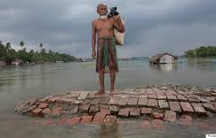
Climate change compounds existing poverty
Climate change will compound existing poverty.
It will impact on developing nations because of their geographical and climatic conditions.
The depend highly on natural resources, and have limited capacity and resources to adapt to a changing climate.
Within these countries, the poorest, who have the least resources and the least capacity to adapt, are the most vulnerable (IPCC 2001a).
Increasing inequities between the developing and developed worlds, is a serious threat to poverty eradication.
Current development strategies tend to overlook climate change risks.

Slide 40
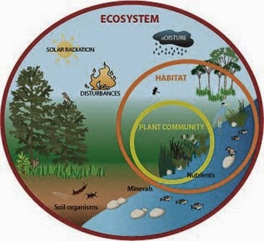
Poor people rely on eco-systems
Poor people are often directly dependent on goods and services from ecosystems
They are highly vulnerable to ecosystem degradation forcing exploitation of natural resources to survive
This will have wider economic effects
Essential ecosystem services will be necessary, including breaking down wastes and pollutants, purifying water, maintaining soil fertility.
Climate change will alter the quality and functioning of ecosystems, reducing their capacity to perform their role as important life support systems.
This will have important impacts on key economic sectors such as agriculture, water supply, and others.

Slide 41

Climate Change & Economic Development
The capacity to cope is highly dependent on the level of economic development.
In general, livelihood sources of the poor are usually narrower and more climate-sensitive than those of the non-poor.
Poor people are particularly vulnerable to climatic conditions such as prolonged drought and natural disasters
Forced to sell off their physical assets such as land, bicycles, and farming implements, undermining their livelihoods over the longer term.
Vulnerability varies, since some groups are more lacking in the financial, social, and political means of securing alternative livelihoods
Women for example may be constrained by social, cultural structures that limit their access to income, education, public voice, and survival mechanisms.
Climate change will add to these trends and increase vulnerabilities

Slide 42
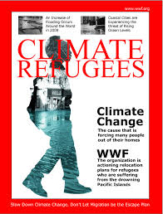
Involuntary Displacement, Migration, and Conflicts
Climate change may lead to mass migrations, as crucial resources become degraded and livelihoods are threatened.
Loss of land mass in coastal areas likely to lead to greater permanent or semi-permanent displacement of populations, which may have considerable economic and political ramifications.
The risk for potential conflicts, including social unrest, political instability, and wars over decreasing water or other natural resources
Will impact on the overall economy of poor countries, thus hampering potential for economic growth.
Costs of rehabilitation and diverting funds from longer-term development purposes.
Loss of human and economic capital.
This is particularly true for small countries and countries with low economic diversity, where the impact of climatic extremes cannot be well absorbed by economic activity in other regions or sectors

Slide 43
In our backyard Impacts of Climate Change on Small Island States:
The Pacific Islands are becoming increasingly vulnerable to;
Extreme weather events as growing urbanization and squatter settlements, degradation of coastal ecosystems.
Rapidly developing infrastructure on coastal areas intensify the islands’ natural exposure to climate events.
Climate Change in the Pacific: COASTS

Slide 44
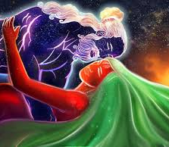
A MAORI WORLDVIEW
'Whatu ngarongaro he tangata, he toitu he whenua',
"people disappear but land remains".
.

Slide 45
The significance of land to Māori
Holistic
Social Structure
Economic Resource
Identity
Spiritual

Slide 46

Climate and Māori Society
Kaitiakitanga
Māori have always seen climate change as important
It affects natural environmental systems and resources
Influences social-ecological knowledge and practice,
Shapes community vulnerability and resilience,
Is directly linked to economic investment and government policy.
There is a widening interest to know more about the implications (and risks) of a variable and changing climate on different iwi/hapū/whānau.
It will present new challenges as well as opportunities for iwi/hapū/whānau and Māori enterprise.
Reaffirmation of traditional ways and knowledge as well as new and untried strategies will therefore be important
Promote Māori knowledge and values in environmental policy, planning and management.
Māori ecologists are playing a fundamental role in environmental issues

Slide 47
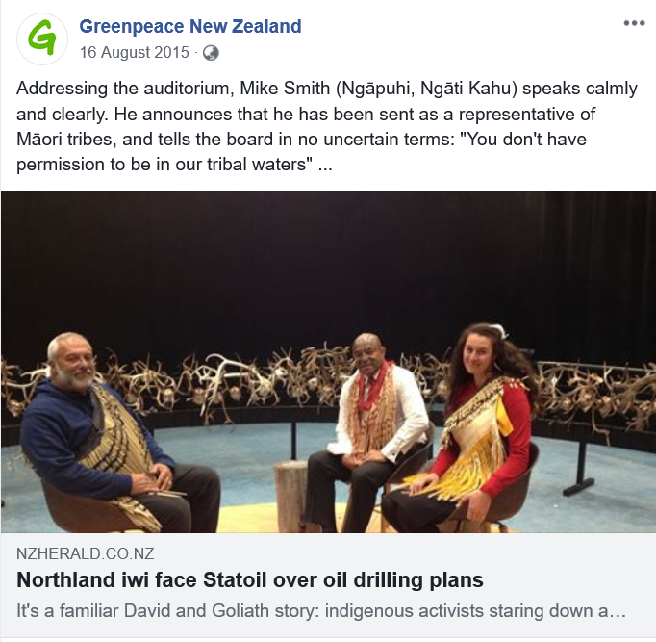
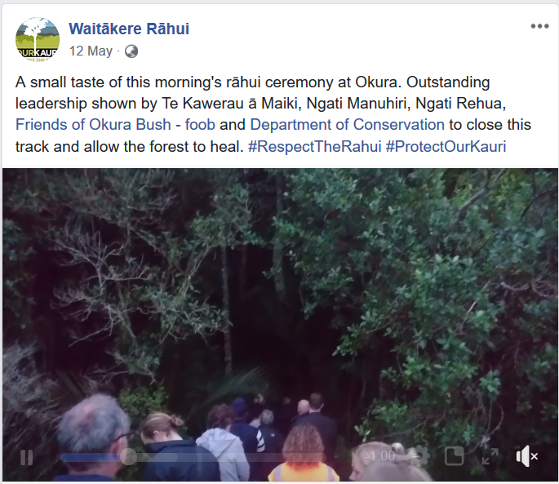
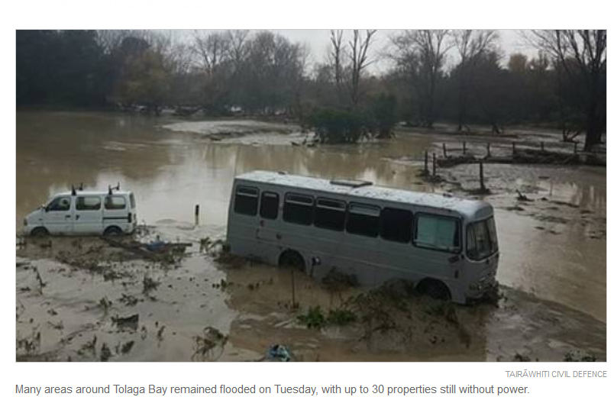
Māori responses to climate change
Oil Drilling on the East Coast
Waitakere Rangers Rahui – Te Kawerau a Maki
Local marae open doors during flooding

Slide 48
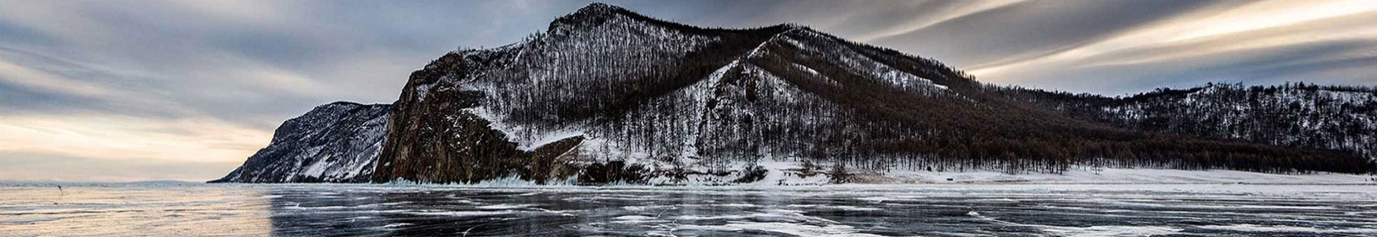
The role of Social practitioners Advocating for climate justice
Promote environmental justice
Socio-economic inequalities
Organise and mobilise
To organise and mobile communities in meeting human need ‘without costing the earth’ (Dominelli, 2012a, 2013).
Central aspect of the Global Agenda for social workers because it aims to tackle socio-economic inequalities that are particularly severe for marginalized people throughout the world.
The current model of industrial development is ‘not fit for purpose’. Social workers have a role to play in formulating alternative models of socio-economic development by promoting environmental justice

Slide 49
Gould, B. (2006). The democracy sham : How globalisation devalues your vote. Nelson, N.Z.: Craig Potton Pub.
Steger, M. & Wilson, E. (2013). In S. Matthewman, S., C. West-Newman, & B. Curtis, B. Being sociological (2nd ed.), pp271-. Basingstoke, Hampshire: Palgrave Macmillan.

