Slide 1
EDUC6006
Session 3
By Galina Stebletsova

Slide 2
Karakia timatanga
Manawa mai te mauri nuku
Manawa mai te mauri rangi
Ko te mauri kai au
He mauri tipua
Ka pakaru mai te pō
Tau mai te mauri
Haumi ē, hui ē, taiki ē!
Embrace the life force of the earth
Embrace the life force of the sky
The life force I have gathered is powerful
And shatters all darkness
Come great life force
Join it, gather it, it is done!

Slide 3
Focus of this session
Approaches to leadership and leadership styles

Slide 4
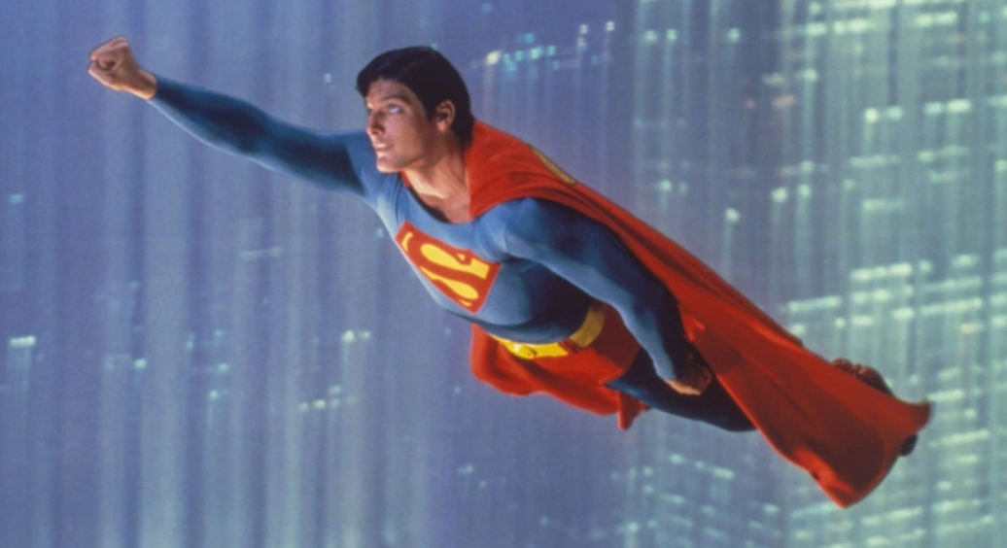
The hero leader
Who is this?
Is this approach to leadership still valid?
Why/why not?

Slide 5
SO who is the hero leader?
Traditional approaches to leadership resided in the notion of the ‘hero leader’, one person who chose to accept the roles and responsibility of being at the head of the organisation (Thornton, Wansbrough, Clarkin-Phillips, Aitken, & Tamati, 2009). Leaders were often spoken about in terms of personality traits such as determination, emotional stability and diplomacy.

Slide 6
Reflect on this statement. IN agreement?
“Anyone can deal with victory. Only the mighty can bear defeat. If you want to shine like sun first you have to burn like it. And I can fight only for something that I love, love only what I respect, and respect only what I at least know”.

Slide 7
Reflection
Think of a leader in your life who was the most influential. What were his/her qualities? Why would you call this leader influential or effective?

Slide 8
Understanding who you are
A Kaiako cannot lead without an understanding of who they are.
To be a teacher leader, it is vital to adopt an appreciative lens and for teachers to begin to see themselves as valued and contributing participants of their centres’ professional learning communities.
Kaiako should focus on their strengths and consider how these might become opportunities to develop leadership in their centres.

Slide 9
Transformational leadership
Transformational leadership is an umbrella term to denote leadership styles that are characterised by the way in which the leader accomplishes the organisation’s goals and objectives.
Not only does a transformational approach suggest organisational change, it also implies growth for the team and for the individuals (Rodd, 2013).
Focuses on continual improvement /change
Helps develop teams
Leads changes, and can sometimes be very challenging when drastic change is underway
Works to bring about change through vision
Creates agents of change – social justice
Image credit: A farm for butterflies, pupae and cocoons are suspended. Concept transformation of Butterfly - Gary Crowl International (gcinternational.org)

Slide 10
Servant leadership
People’s needs are at the core of servant leadership
Serving people will do well for them
Key outcome – the outcome for people
Leaders serve each team member, not just lead
Each team member is empowered as significant and highly valued

Slide 11
Distributed leadership
Distributed leadership is characterised by the recognition that everyone has their own strengths and interests. Taking a leadership role that utilises those strengths and interests affords greater agency and motivation. It is based on expertise and knowledge, and often, a formal role description with delegated authority.
“Distributed leadership, or the expansion of leadership roles in schools, beyond those informal leadership or administrative posts, represents one of the most influential ideas to emerge in the field of educational leadership in the past decade” (Hallinger and Heck, 2009, as cited in Harris, 2013, p.7). Distributed leadership can be considered as ‘power for’ rather than ‘power over’ (Talan, 2010) and it is characterised by its influence on others including children, teachers and families in early childhood education.
Image credit: Scene with many wild animals together river Vector Image (vectorstock.com)

Slide 12
Pedagogical leadership
Pedagogical leadership is to do with the practice of teaching and learning, curriculum knowledge and the interpretation of research into practice. It is leadership for learning, putting the focus on improving teaching and learning within the early childhood environment. It encourages collaboration between teachers, parents and children, and even children and families/whānau taking on the pedagogical leadership role, sharing, teaching and learning within their own areas of expertise.
Pedagogical leadership is complementary to distributed leadership. While distributed leadership emphasises the relational aspect of teaching and leading, pedagogical leadership provides the centre with direction and purpose. Pedagogical leadership is concerned with the practice of teaching and learning, curriculum knowledge and the interpretation of research into practice.

Slide 13
Class korero
Which approach to leadership correlates the most with your values and beliefs as a leader Kaiako? Why?

Slide 14
Karakia whakamutunga
Kia tau tō rangimārie
Ki runga I ngā iwi o te ao
Let your peace reign
On all the people of the world

Slide 15
references
Harris, A. (2013). . Distributed leadership matters: Perspectives, practicalities, and potential. Corwin Press.
Rodd, J. (2013). Leadership in early childhood: The pathway to professionalism (4th ed.). Allen & Unwin
Talan, T. (2010). Distributed leadership: Something new or something borrowed? Exchange, 193, 8-10.
Thornton, K., Wansbrough, D., Clarkin-Phillips, J., Aitken, H., & Tamati, A. (2009). Conceptualising leadership in early childhood education in Aotearoa New Zealand. Wellington, New Zealand: New Zealand Teachers Council.

