Slide 1
Session 8 :Ethical dilemmas and children’s rights
By Galina Stebletsova

Slide 2
Karakia
Ma te Rangatiratanga
Te Whakaritenga
Te Kaitiākitanga
Te Kōtahitanga
Me Te Ngākau Māhaki
Ka tau i raro i te whakaaro kōtahi
Hei ōranga mo tātou katoa
Haumi ē! Hui ē! Taiki ē!

Slide 3
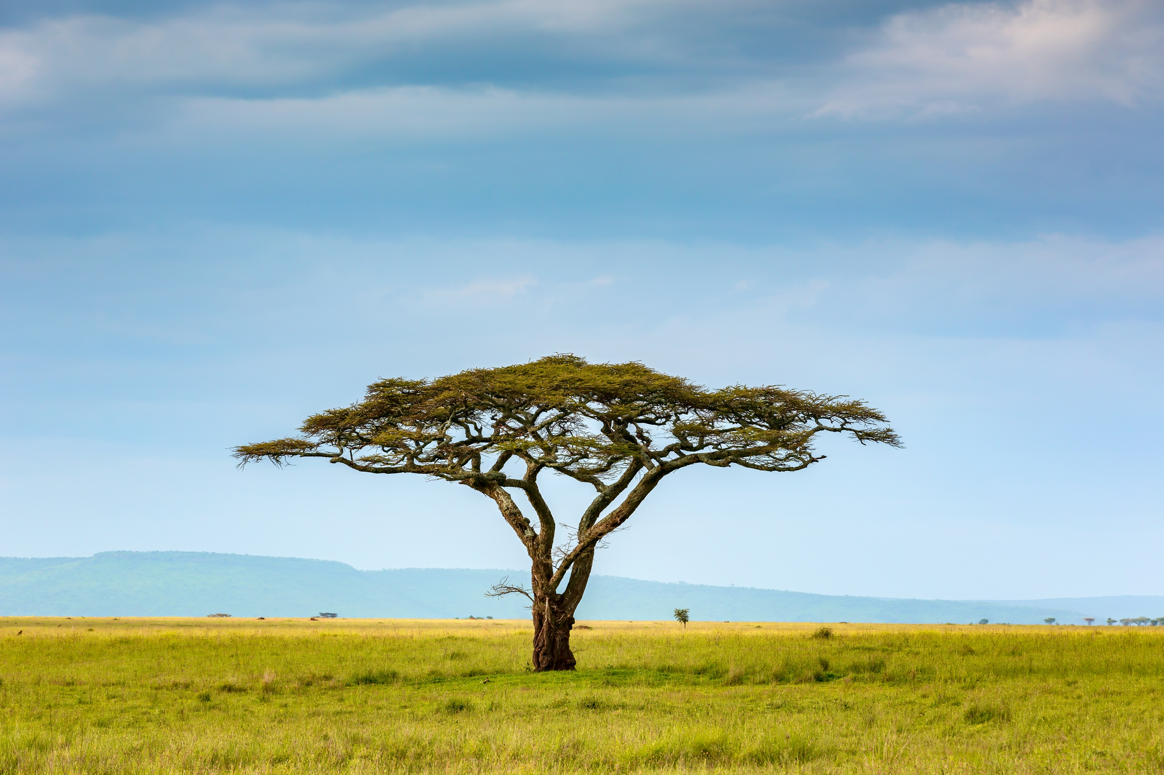
E tu kahikatea Hei whakapae ururoa Awhi mai awhi atu Tatou tatou e
Stand like the kahikatea (tree) To brave the storms Embrace and receive We are one together

Slide 4
Assignment Two patai?
Please have a look at Assignment Two Support Guidelines in Week 10 (Moodle page).

Slide 5
Ethical dilemmas…
“Dilemmas are by their nature difficult to resolve and involve both rational decisions and value judgements. Thinking ethically requires teachers to be able to clearly distinguish these two”
(http://ethics4teachers.massey.ac.nz)

Slide 6
Consider the following scenario…
A parent sends juice in a bottle with their toddler every day. The child asks for the bottle constantly. When you talk to the Mother about it, she says that the juice has vegetables in it and that is the only way she can get him to eat vegetables. Meanwhile, you are concerned about the child’s teeth and appetite.
WHAT DO YOU DO?
What rights would you link this dilemma to?
What are the links to Our Code Our Standards?
What about other policy documents/literature?

Slide 7
Consider the following scenario…
Your friend has enrolled their child into the centre that you are working in. The child is having issues settling into the centre and cries most of the day however when your friend comes to pick their child up the teachers tell her that her child is doing great.
You are not the teacher in the room.
WHAT WOULD YOU DO?
What rights would you link this dilemma to?
What are the links to Our Code Our Standards?
What about other policy documents?

Slide 8
Class korero
Read the article in Week 7 EDUC6006 Moodle page: Trnka et al. (2021). Negotiating risks and responsibilities during lockdown: ethical reasoning and effective experience in Aotearoa New Zealand.
Reference this article using APA 7th format (see APA Quick Guide in Week 10 Moodle page)
Have you come across similar ethical dilemma recently?
What are the implications when discussing collective solutions?

Slide 9
Karakia whakamutunga
Kia tau tō rangimārie
Ki runga I ngā iwi o te ao
Let your peace reign
On all the people of the world

