Slide 1
Latches Timers Counters

Slide 2
Latches and Timers
The output with an L inside will turn the output D on when the input A becomes true. D will stay on even if turns off.
Output D will turn off if input B becomes true and the output with a U inside becomes true.
If an output has been latched on, it will keep its value, even if the power has been turned off.

Slide 3
Timing diagram associated with a latch

Slide 4
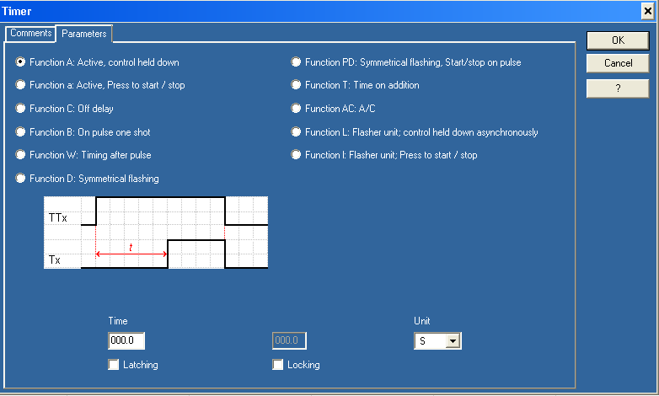
Timer ON
When the input to the timer is triggered the timer starts to count up.
When the preset value is reached a switch associated with the timer changes state.
The timer automatically resets when the input to the timer changes state.

Slide 5
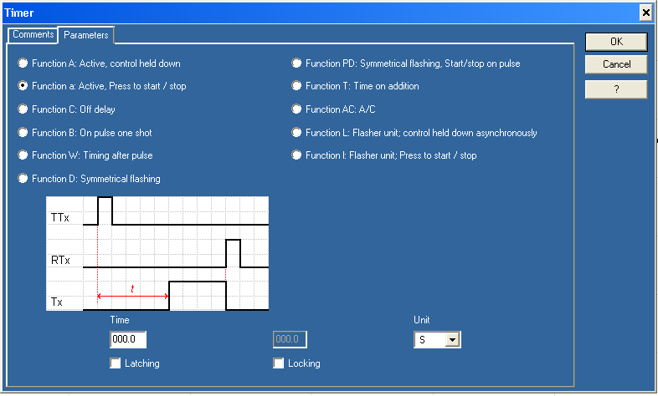
Pulsed Timer
Pulsed timer option uses an input pulse to trigger the timer.
After the pulse has been detected the timer times for a period of time and then changes the state of the switch associated with the timer.
To reset the timer a reset timer coil must be added.

Slide 6
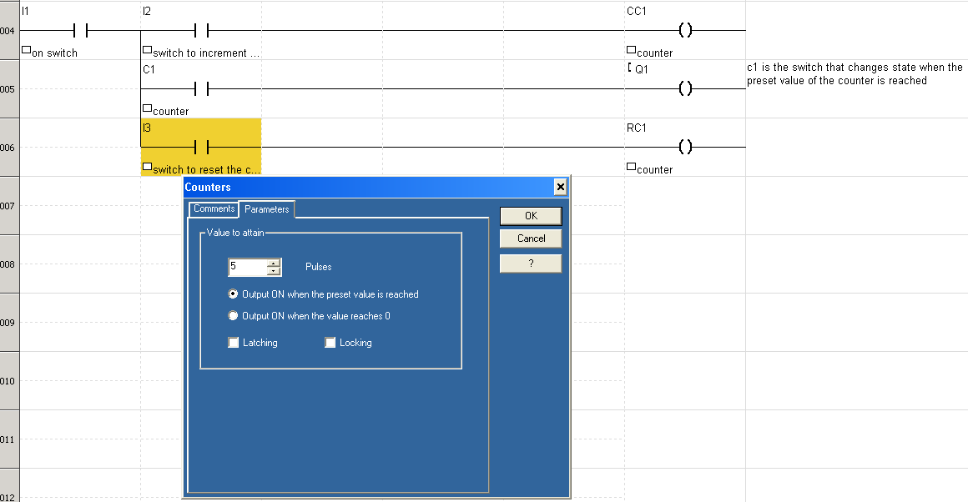
Counter
When the input to a count-up counter goes true the accumulator value will increase by 1.
If the accumulator value reaches the preset value the counter switch/contactor will change state.
Counter with preset value of 5

Slide 7
Press Example
1. A toggle start switch (TS1) and a limit switch on a safety gate (LS1) must both be on before a solenoid (SOL1) can be energized to extend a stamping cylinder to the top of a part.
2. While the stamping solenoid is energized, it must remain energized until a limit switch (LS2) is activated. This second limit switch indicates the end of a stroke. At this point the solenoid should be de-energized, thus retracting the cylinder.
3. When the cylinder is fully retracted a limit switch (LS3) is activated. The cycle may not begin again until this limit switch is active.
4. A cycle counter should also be included to allow counts of parts produced. When this value exceeds 5000 the machine should shut down and a light lit up.
5. A safety check should be included. If the cylinder solenoid has been on for more than 5 seconds, it suggests that the cylinder is jammed or the machine has a fault. If this is the case, the machine should be shut down and a maintenance light turned on.

Slide 8
Allan Bradley ladder logic solution to the press example

