Slide 1
PASS session: NSCI 5730 Earth processes
Forces | 28 March 2019

Slide 2
What were covering today:
Convection currents
Forces
Units of measurement
Atmosphere layers

Slide 3
Activity!
I need 8 brave volunteers….

Slide 4
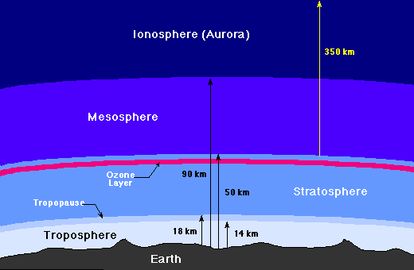

Slide 5
Flash card time…
Atmosphere!
Individually or in pairs fill out the flash cards
You can use lots of different colors to help you remember!
Cut the cards out and have a go at putting them in the right order

Slide 6
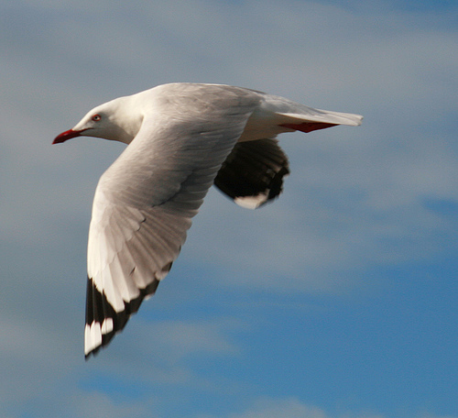
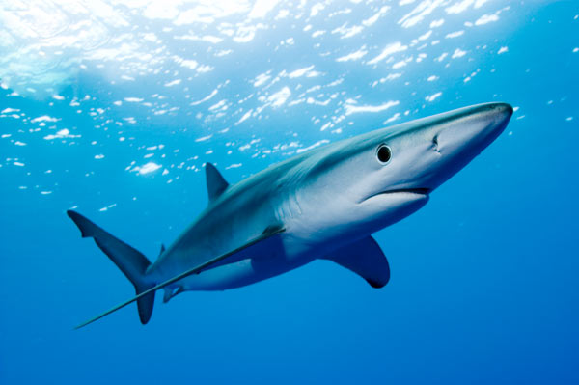
gravity
thrust
Biomechanics
drag
gravity
lift
thrust
drag
lift

Slide 7
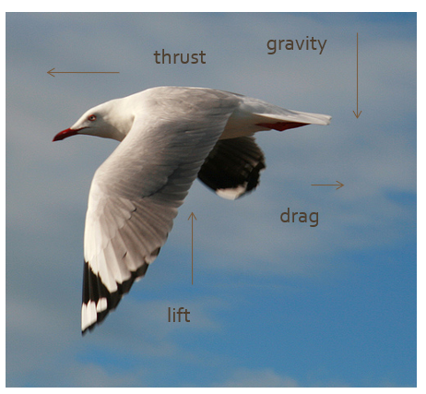
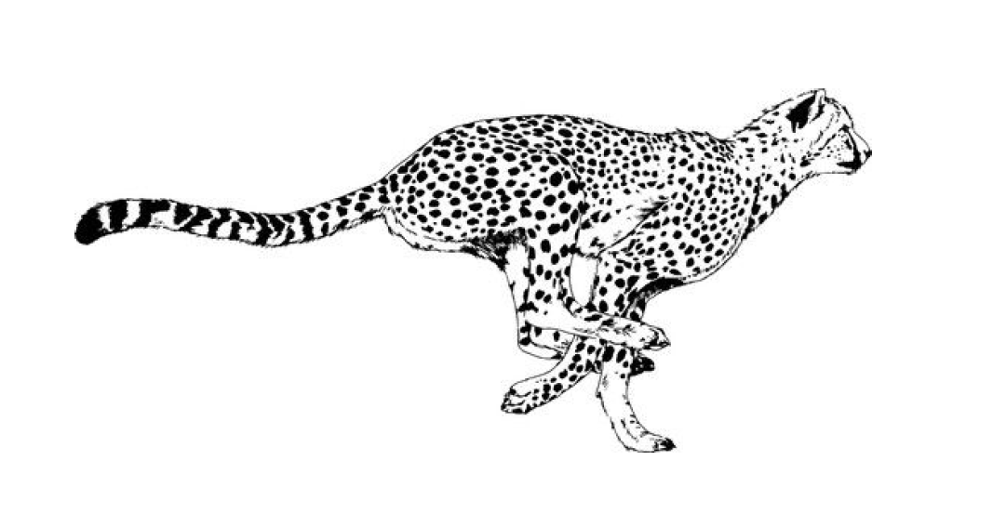
Add a Slide Title - 3

Slide 8
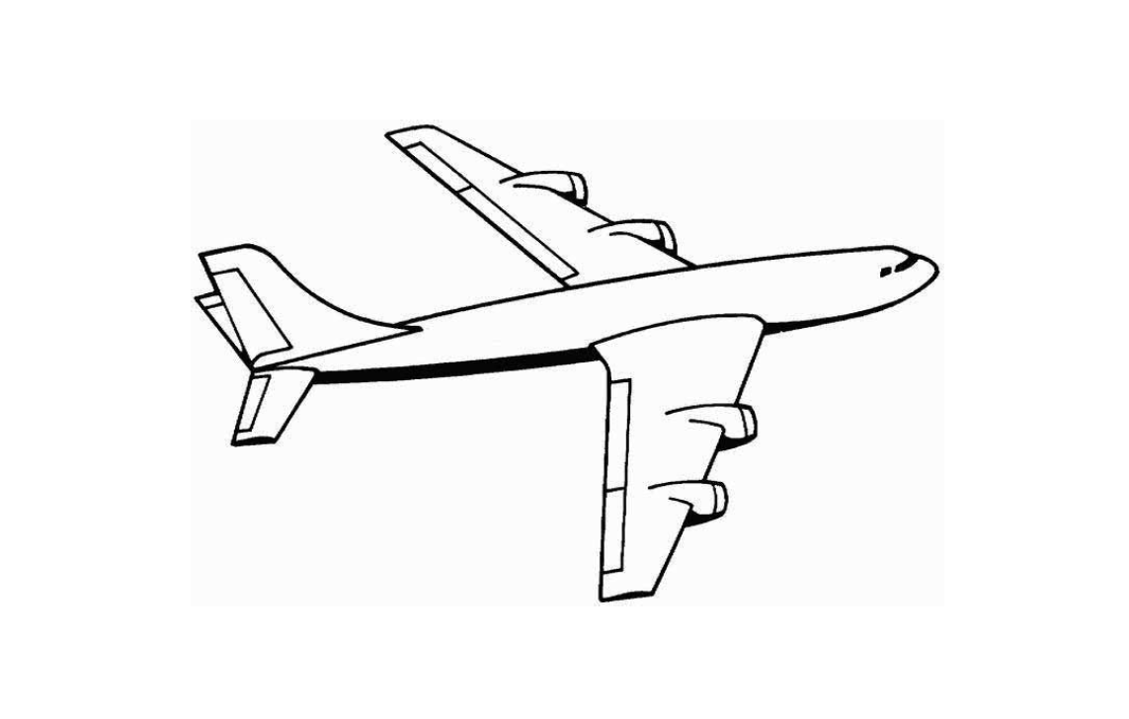
Add a Slide Title - 3

Slide 9
Add a Slide Title - 3

Slide 10
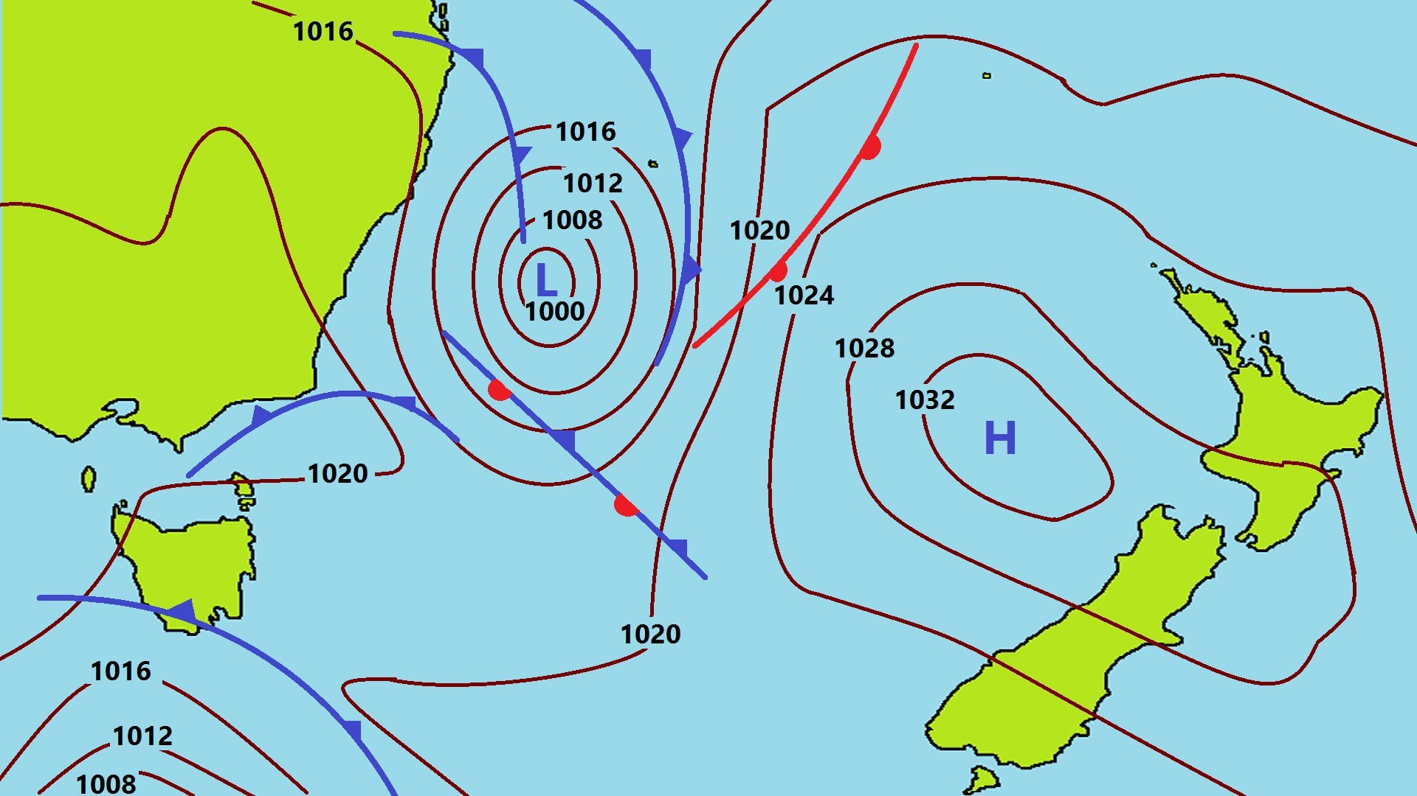
Add a Slide Title - 4

Slide 11
Next week:
Atmosphere
Ozone
Greenhouse gasses
Weather
This will be one pass class you definitely don’t want to miss!

