Slide 1
Working with the new spreadsheet
Notes:
This is to guide you with using the spreadsheet to complete assignment 2.

Slide 2
Overview
Notes:
The workbook has four worksheets as shown here as four “tabs”.
used for calculating the GFA for the project. This is a simple exercise you complete at the start of your assignment
The Workbook. This is where the majority of your time will be spent (more on this later)
Elemental summary report. Complete the project information boxes (name etc). The rest of the report will self generate as you work through the Workbook tab.
Assumptions – hopefully self explanatory
Query Sheet – to record any information exchanges – in the usual QS format.

Slide 3
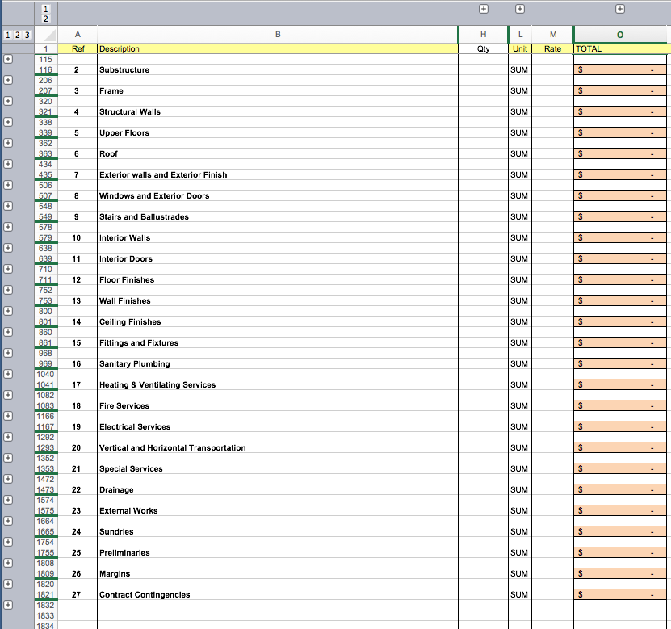
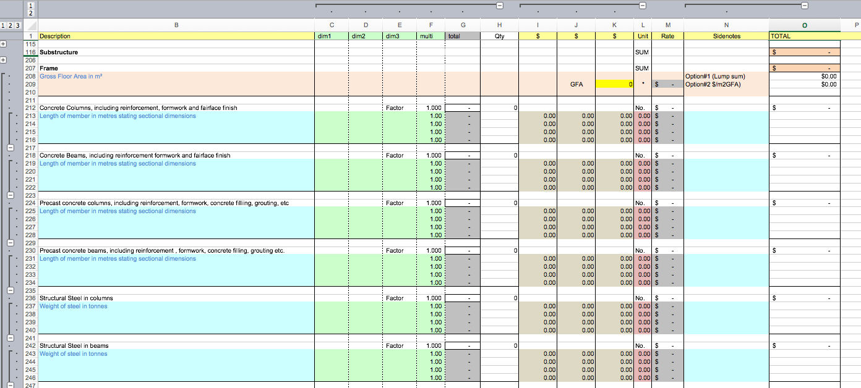
The Workbook (tab 2)
Notes:
The workbook has a number of different views depending upon which combination of Group and Ungroup controls you have open.
We will now investigate how to use this worksheet.

Slide 4
How to….with the workbook 1
Notes:
The views are controlled with the group and ungroup commands. Experiment with these to see how they change the way you can view the spreadsheet.

Slide 5
How to….with the workbook 2
#1 measurements
#2 pricing
#3 sidenotes
#4 pricing notes
Notes:
#1 is the measuring zone for each item. Standard QS format – horizontal layout
#2 is the pricing zone. This is in a freeform layout for maximum flexibility
#3 is for audit trails & sidenotes for the DimSets.
#4 is for pricing notes and references.

Slide 6
How to….with the workbook 3
Option#2
Put your $/m2 value here.
Linked to the GFA range name
Option #1 Put your $ value here.
Notes:
The intention is that the items used to create each of the elemental summaries will be building up using the measuring and pricing zones of the spreadsheet – however there are situations where you may simply wish to use a “lump sum” monetary allowance or use a $/m2 GFA calculation for the elemental total.
Therefore Option 1 Allows you to place a value in cell Option 1 Lump Sum which will be included in the elemental total.
-and or -
Option 2 allows you to place a value in the grey $/m2 cell – and this will calculate a total which will be included in the elemental total.
Note that these options can be used alone, together or in combination with measured elemental items.

Slide 7
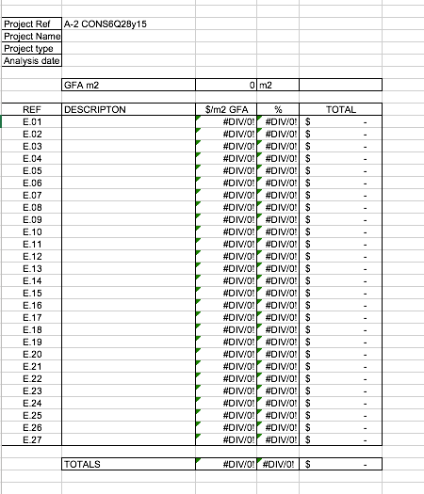
The Elemental Summary Report
Notes:
Most of this worksheet is populated by links to Named Ranges in the workbook or GFA worksheets.
You only have to:
Complete the Project information cells at the top of the sheet
Add the elemental descriptions in the “Descriptions” column.

Slide 8
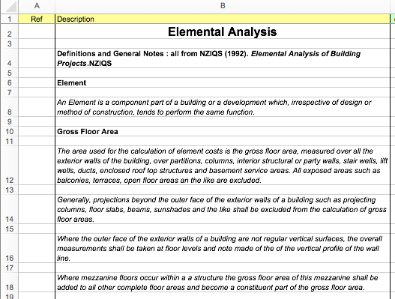
Review
Notes:
This is only a brief overview of the contents of the spreadsheet.
In review note that the format is very similar to the pSOFT templates used in the measuring papers.
The spreadsheet is intended to assist you to complete your assignment.
Dimensions and pricing can be accommodated in a number of different ways of arriving at an elemental total
measure and price,
$/m2 GFA
or Lump Sum
Or a combination of these techniques.
Please ask if you need additional support.

