Slide 1
EDUC6006: Leading Ethical Practice
Session 2
By Galina Stebletsova

Slide 2
Karakia
Manawa mai te mauri nuku
Manawa mai te mauri rangi
Ko te mauri kai au
He mauri tipua
Ka pakaru mai te pō
Tau mai te mauri
Haumi ē, hui ē, taiki ē!

Slide 3
In this session
We review what we have been learning so far
We look at kaiako as a leader and consider implications for practice

Slide 4
Ethics…
.. Is at the core of early childhood education since the decisions that teachers routinely make will influence all aspects of pedagogy, including but not limited to the level of agency children have available, the way in which the child learns, or the parameters that limit or expand parental influence on their child’s curriculum (Dalli & Thornton, 2013).
Let’s unpack this statement.

Slide 5
Korero 1:
What is your understanding of leadership? Can we say that every kaiako is a leader? Why/why not?

Slide 6
“Leadership is…
… a desire to make a difference to the lives of others by transforming values into action, vision into reality, obstacles into innovations, challenges into successes, separateness into collaboration, and risks into rewards”.
(Rodd, 2013, pp.12-13).
What aspects of this statement correlate the most with your personal and professional values and beliefs? Why?

Slide 7
Korero 2:
Suggest what professional qualities of an ECE Kaiako leader could be and consider how these qualities might be related to the ethical practice. Use 2-3 references from Our Code Our Standards to support your views.

Slide 8
Our Code Our Standards reminds us that…
We as teachers have obligations to a range of stakeholders
We understand that families and whānau and the wider community trust us to guide their children and young people on their learning journey and to keep them safe
We must act with/be acting with integrity and professionalism in all that we do, we maintain this trust and confidence
The profession has expectations of us to ensure we understand the influence that we have on others
We have a responsibility to each other, to make sure we all understand these expectations and make the right decisions each and every day.
(Education Council/Matatu Aotearoa, 2017, p. 6)

Slide 9
So who are the stakeholders?
A person with an interest or concern in something.
Stakeholders individual work and experiences bring unique perspectives to situations
Stakeholders need to be supported to engage in action that seeks to improve outcomes for the children of their community.
What are examples of stakeholders in your centre?

Slide 10
Stakeholders…
Parents … and whānau
Children
Kaiako including you
Cooks & van drivers
Owners and management
The centre environment
The community
The government – Teaching Council, MoE, ERO,
Primary schools
Professional development providers

Slide 11
Korero 3:
In your view, whose responsibility is communication with stakeholders in an ECE centre, teacher’s, or leader’s? Why? Support your view by an example from practice.

Slide 12
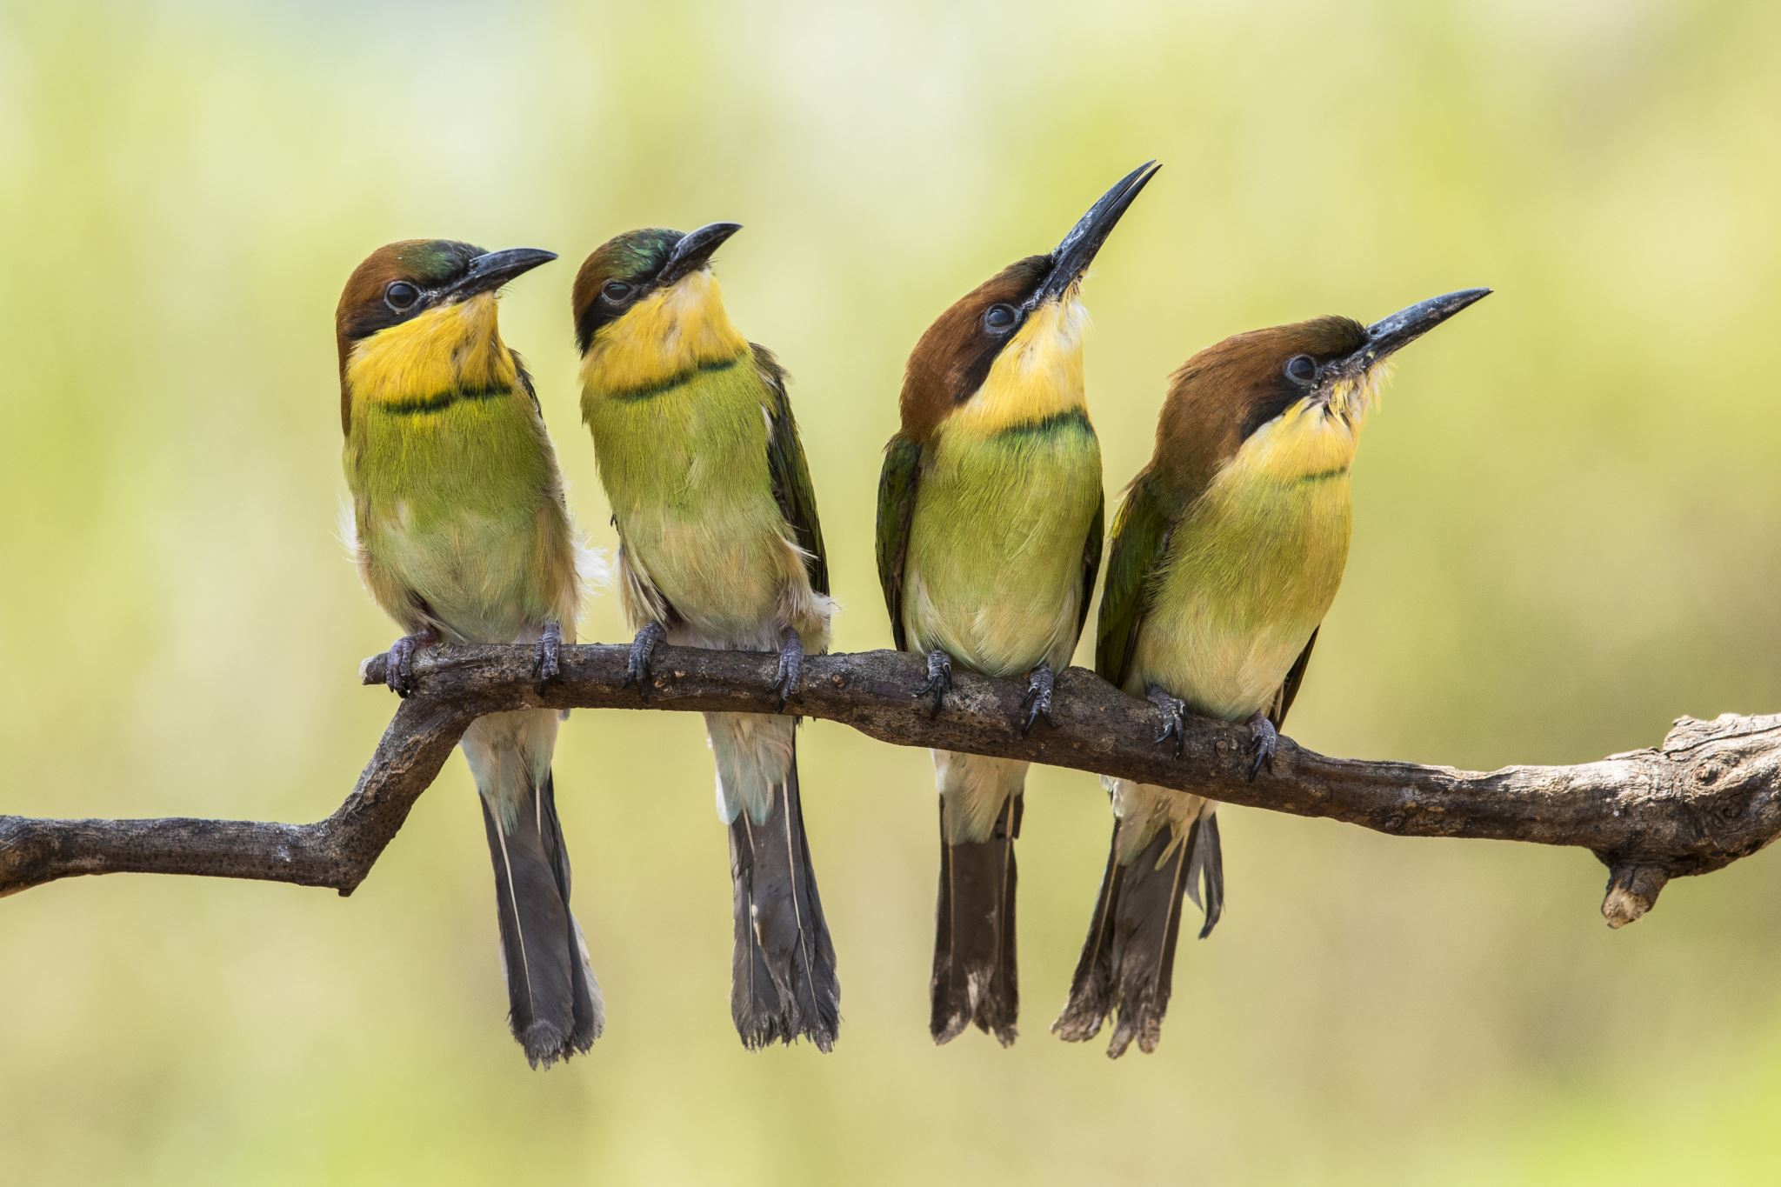
Communication
Communication is simply the act of transferring information from one place, person or group to another. Every communication involves (at least) one sender, a message and a recipient. ... These include our emotions, the cultural situation, the medium used to communicate, and even our location
What are some of the ways we communicate in the centre?
Phone
Portfolios
Public notice – noticeboard
Newsletter
Communication book – for whanau and/or for staff
Routine charts, accident charts, planning records, E-portfolios
Meetings with whānau

Slide 13
What are some causes of communication breakdown?
Language barrier
Hearing impairments or ability to hear
Time
Articulation
Stress
Background noise (radio)
Being given relevant information
Involvement
Hierarchies – not given
Not attending meetings
Receptive skills
Intimidation
Own & others perceptions
Inappropriate channels used

Slide 14
Korero 4: Professional leadership and responsibilities of a leader kaiako
What are they?
Are they different from those of any other Kaiako in the centre? Why/why not?
Explore Te Haututanga I Leadership page from Te Whariki here:
Leadership | Te Whāriki Online (tki.org.nz)
… let’s have a korero on what professional leadership means to you. What is the role of your personal values and beliefs?

Slide 15
Patai?

Slide 16
Karakia Whakamutunga
Ka wehe atu tātou
Iraro i te rangimārie,
Te harikoa, me te manawanui
Haumi ē! Hui ē! Taiki ē!

Slide 17
References
Dalli, C., & Thornton, K. R. (2013). Professionalism and leadership. In D. Pendergast & S. Garvis (Eds), Teaching early years: Curriculum, pedagogy and assessment (pp.301-314. Allen & Unwin.
Education Council New Zealand/Matatu Aotearoa. (2017). Our Code Our Standards. Our Code, Our Standards :: Teaching Council of Aotearoa New Zealand
Rodd, J. (2013). Leadership in early childhood. McGraw Hill Education.

